Slide 1

The contribution of the VCSE sector to public health in Thames Valley
Key findings from Third Sector Trends
Tony Chapman and Jonathan Wistow
St Chads College, Durham University
Presentation for Thames Valley VCSE Alliance Conference
25th June 2023

Slide 2
A comparative study of the voluntary sector
Third Sector Trends has been running since 2010 in the North of England and was widened in 2019 to the whole of England and Wales.
In 2025 there were 8,680 survey responses from all types of registered voluntary organisations.
In Thames Valley there were 326 responses and 1,212 across the whole of South East England.
The research is underpinned by a complete database of 205,000 geographically mapped organisations from all registers, including 9,427 in Thames Valley.
Five parallel localised area-based studies including Thames Valley, North East England, Wales, East of England and South West England.

Slide 3
Sector structure, energy, financial wellbeing and optimism

Slide 4
The VCSE sector in Thames Valley is large, productive, impactful, confident and resilient
~9,430 registered organisations. Sector income is around £2.65bn.
Thames Valley VCSE sector produces £4.5bn in added fiscal, economic and use value. When sector energy and intangible value is added, it comes to about £10.3bn.
~49,450 VCSE sector employees in the area – signs of marginal increase rather than decline – but issues with recruitment and retention.
~188,340 regular volunteers deliver 13.6m hours work. Their proxy replacement value is £166m-£258m. 32% of orgs still not recovered volunteer numbers fully from pandemic (38% nationally).
Most VCSE organisations’ leaders are confident about their future finances and exhibit real ‘vitality; in their outlook.

Slide 5
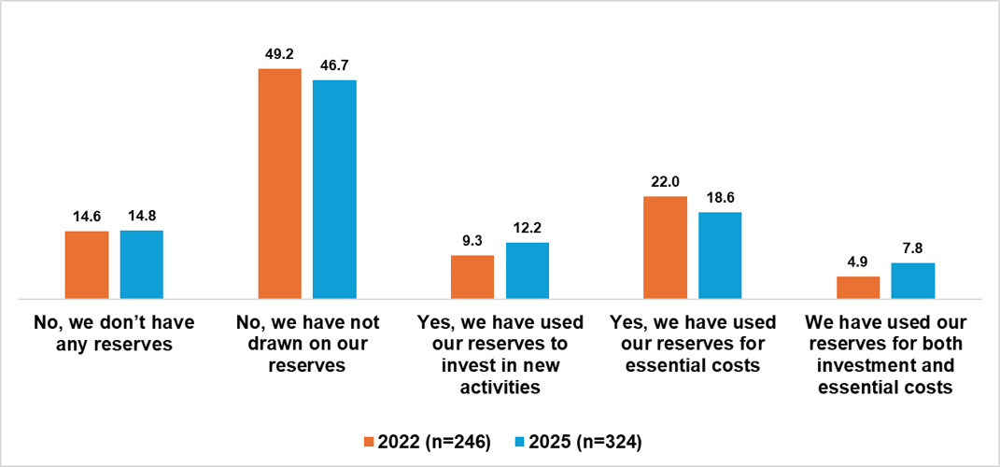
The VCSE sector in Thames Valley is generally in good financial shape

Slide 6
VCSE organisations’ expectations about future finance in South East England are highly optimistic
 | Income will… |  | Financial support from private businesses will… |  | Grants from charitable foundations will… |  | Funding from statutory agencies will…
 | Increase | Decrease | Increase | Decrease | Increase | Decrease | Increase | Decrease
Thames Valley | 30.1 | 14.0 | 25.0 | 13.8 | 25.6 | 20.2 | 14.9 | 29.7
Sussex | 29.2 | 14.6 | 20.9 | 11.8 | 23.2 | 22.2 | 14.2 | 35.5
Surrey | 26.0 | 16.4 | 22.2 | 14.4 | 18.8 | 19.8 | 5.9 | 39.7
Hampshire and IOW | 29.0 | 13.3 | 28.7 | 12.5 | 30.9 | 20.6 | 15.9 | 38.1
Kent | 24.4 | 15.4 | 17.5 | 14.4 | 17.8 | 21.5 | 11.8 | 31.2
South East England | 27.7 | 14.7 | 22.9 | 13.4 | 23.3 | 20.9 | 12.5 | 34.8

Slide 7
Core findings and issues for debate on the contribution of the VCSE to public health and wellbeing

Slide 8
VCSE sector ‘direct’ interaction with public health agendas

Slide 9
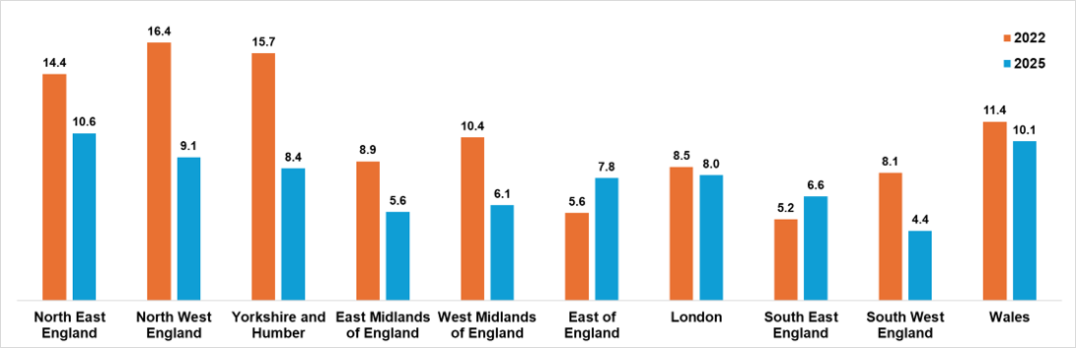
In most areas, VCSE organisations are becoming more averse to delivering public service contracts [not in East & SE but from very low base]

Slide 10
Participation in the delivery of public service contracts in South East England
 | Not aware of these opportunities | Aware of these opportunities but they are not relevant to our organisation’s objectives | Ambivalent (may need support, information or see barriers) | Bidding for or delivering public service contracts now
Thames Valley | 33.1 | 48.3 | 12.0 | 6.7
Sussex | 36.0 | 47.1 | 9.9 | 6.8
Surrey | 34.7 | 42.2 | 14.3 | 8.9
Hampshire & IOU | 37.3 | 42.3 | 14.1 | 6.2
Kent | 35.8 | 50.2 | 9.0 | 5.0
South East | 35.3 | 46.4 | 11.8 | 6.7

Slide 11
Productive intra and inter voluntary sector relationships

Slide 12
VCSE organisations’ relationships in South East England
 | We have useful informal relationships with other voluntary organisations and groups | We often work quite closely, but informally, with other voluntary organisations and groups | We often work in formal partnership arrangements with voluntary organisations and groups
Thames Valley | 73.0 | 58.0 | 23.5 | 326
Sussex | 75.4 | 63.4 | 27.9 | 266
Surrey | 71.6 | 61.9 | 30.6 | 149
Hampshire and IOU | 69.5 | 54.8 | 19.0 | 244
Kent | 67.5 | 56.2 | 23.4 | 203
South East England | 71.7 | 58.7 | 24.4 | 1,212

Slide 13
VCSE organisations’ relationships with business in South East England 2025
 | They give us money to help us do our work | They provide free facilities, or goods and services to help us do our work | They provide volunteers to help us do our work | They provide free expert advice to help do our work | N=
Thames Valley | 27.2 | 25.3 | 15.5 | 17.6 | 326
Sussex | 29.0 | 23.8 | 11.9 | 16.3 | 266
Surrey | 32.4 | 25.2 | 15.6 | 19.3 | 149
Hampshire and IOU | 30.2 | 26.1 | 17.7 | 16.6 | 244
Kent | 32.5 | 23.1 | 8.6 | 12.6 | 203
South East England | 29.7 | 24.7 | 14.0 | 16.5 | 1,212

Slide 14
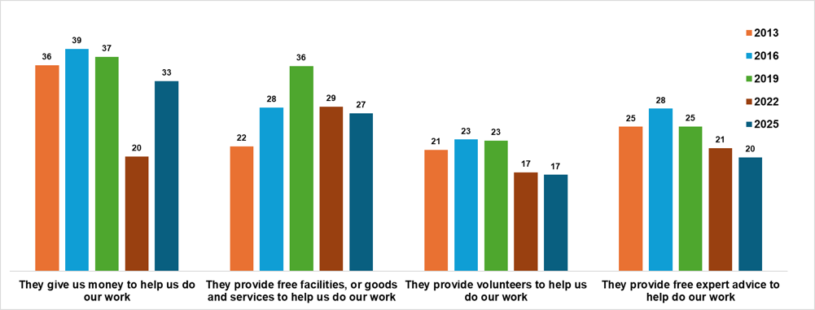
Business support is currently in decline nationally – but not everywhere
Covid-19 Pandemic

Slide 15
VCSE organisations’ relationships with public sector agencies in South East England
 | They value the work of our organisation | They inform our organisation on issues which affect us or are of interest to us | They involve our organisation appropriately in developing and implementing policy on issues which affect us | They act upon our organisation's opinions and / or responses to consultation | N=
Thames Valley | 90.4 | 64.9 | 41.8 | 41.3 | 326
Sussex | 85.9 | 58.3 | 43.5 | 43.4 | 266
Surrey | 86.3 | 64.4 | 41.4 | 38.1 | 149
Hampshire and IOU | 90.2 | 58.9 | 38.3 | 33.9 | 244
Kent | 88.7 | 61.2 | 33.9 | 41.4 | 203
South East England | 88.6 | 61.5 | 40.1 | 40.9 | 1,212

Slide 16
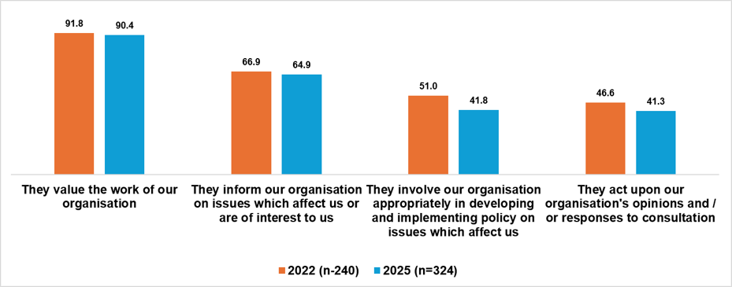
Comparing levels of VCSE organisations’ productive relationships with the public sector in Thames Valley 2022 and 2026

Slide 17
VCSE organisations’ engagement with public organisations and policy makers in South East England – baseline findings
 | Opportunities for effective collaborative working have increased (e.g. with local council / NHS) | Policy makers give us much more notice now about new initiatives | Policy makers are more receptive to our arguments even if they don't always agree | Public sector agencies seem to be working together more effectively | We're asked more often to help improve engagement with local people
Thames Valley | 52.4 | 27.6 | 38.9 | 31.2 | 62.0
Sussex | 54.0 | 33.3 | 39.8 | 47.9 | 59.2
Surrey | 64.6 | 34.1 | 38.4 | 30.8 | 68.8
Hampshire and IOU | 55.0 | 36.3 | 44.9 | 43.5 | 55.9
Kent | 48.5 | 25.5 | 32.6 | 27.0 | 59.8
South East England | 54.2 | 31.1 | 39.1 | 36.7 | 60.6

Slide 18
Many VCSE organisations’ actively try to influence social and public policy in South East England – but not necessarily on the same issues
 | We tend to steer well clear of political issues | We try to go to relevant meetings/events which relate to our kind of work | We campaign to further the interests of our beneficiaries | We tend to work behind the scenes to influence policy
Thames Valley | 75.1 | 67.4 | 46.2 | 44.6
Sussex | 74.1 | 69.1 | 45.9 | 42.7
Surrey | 76.9 | 66.2 | 41.3 | 37.1
Hampshire and IOU | 78.0 | 65.5 | 44.9 | 39.6
Kent | 82.4 | 65.2 | 43.1 | 32.5
South East England | 76.9 | 66.9 | 44.7 | 40.2

Slide 19
Valuing and investing in both the ‘tangible’ and ‘intangible’ value produced by the voluntary sector

Slide 20
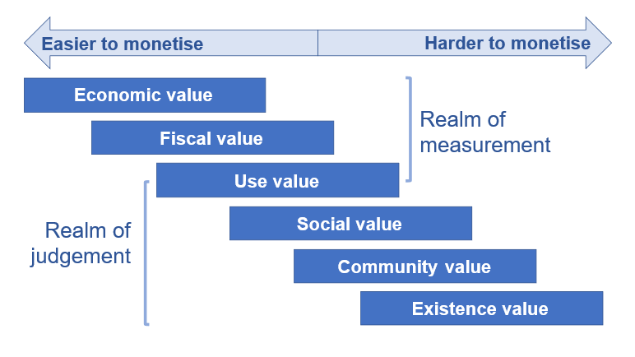
The VCSE sector produces value in many ways
- some are measurable, some are not

Slide 21
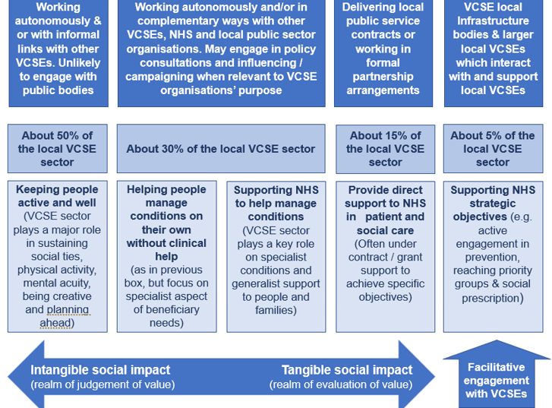
Much of the value the VCSE produces on public health and wellbeing issues sit ‘below the radar’

Slide 22
Appreciating ‘intangible value’ and supporting VCSE organisations to improve public health
The contribution of the voluntary sector to public health is made in many ways by organisations of many sizes and purposes.
Contractual work, which is growing in Thames Valley is funded by public agencies to meet their statutory or strategic objectives.
Much of the ‘indirect’ or ‘intangible work’ is funded by the National Lottery, Charitable Trusts and Community Foundations or by other forms of fundraising.
Local authorities and the NHS ICB have a bigger role to play in resourcing intangible value produced by the voluntary sector.
But they should also use their ‘soft power’ as anchor organisations to influence the encourage investment from other sources.

Slide 23

All reports from Third Sector Trends are available here: https://www.stchads.ac.uk/research/third-sector-trends-in-england-and-wales/publications-from-third-sector-trends/
Tony Chapman
St Chad’s College, 18 North Bailey, Durham University, Durham DH1 3RH tony.chapman@durham.ac.uk

