Slide 1
Middlesbrough’s Approach to Resettlement of Refugees and Migrants
Shahda Khan
Strategic Cohesion and Migration Manager

Slide 2
Migration and Integration 2004-2017
Asylum Support Team
Cohesion Pathfinder
Middlesbrough Cohesion Partnership
Middlesbrough Interfaith Network

Slide 3
Migration & Integration 2018
CVF Response
Community Hubs
EMAT
NE Strategic Migration Partnership
CMF
Stronger Communities Middlesbrough

Slide 4
CVF Sector Response
TVoS
RRF and Cleveland Police
mima
MEC
MFC
Teesside University

Slide 5
Hubs and Ethnic Minority Achievement Team
Range of activities/groups/events
Welcome New Arrivals
Language Support
Drop In Sessions
Ongoing Support

Slide 6
NE Strategic Migration Partnership
Hosted by Middlesbrough Council
Link between ‘us’ and the Home Office
Thematic Sub Groups
Identify and Respond to Emerging Issues

Slide 7
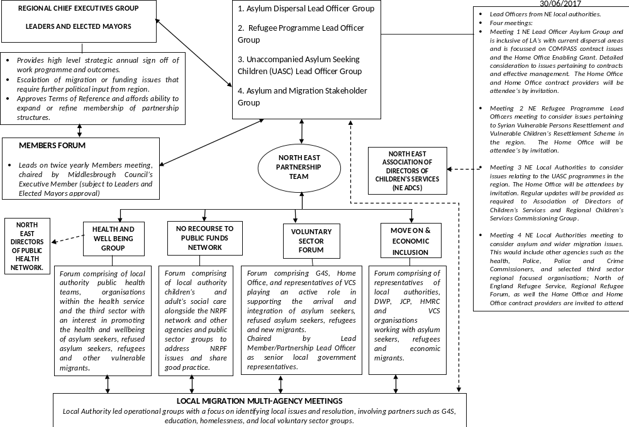

Slide 8
CMF Programme
Three projects:
Data Mapping
Education
Cohesion
LASO
Independent Evaluation

Slide 9
Stronger Communities Middlesbrough
SCM focus on three priority wards, Newport, North Ormesby and Thorntree/Brambles Farm
Primary aim is to work with residents both from the settled and the migrant communities; support them to gain a greater understanding of each other
Also for agencies to have a better understanding of what support local communities need
Recognise the positive contributions of all our communities

Slide 10
What Have We Done to Date?
Connected with local residents and organisations
Engaged with local residents who don’t access services
Collaboration with local services and internal colleagues that work with residents
Hosted a number of CommUnity Conversations
Delivered three funding workshops
Identified residents for Advisory Groups in each ward

Slide 11
CommUNITY Conversations
Provided a safe open space for local residents to discuss their experiences of living in their neighbourhood & discuss challenges and concerns
CommUNITY Conversations and the one to one surveys with local residents have supported the development of the orientation presentation
Identified that an online directory is needed of both council departments and external agencies

Slide 12
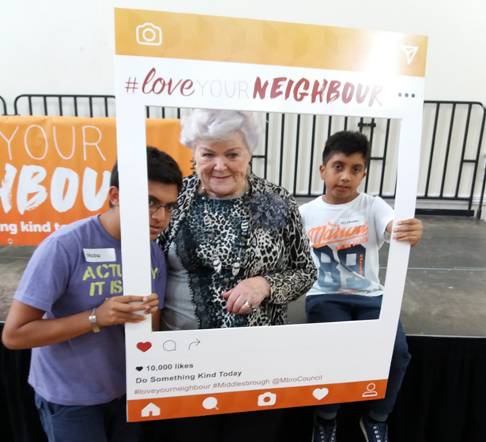

Slide 13
Funding Workshops
Funding is open to Voluntary, Community and faith groups
£20,000 was allocated to each priority wards and each group can apply for up to £2,000
Workshops are an opportunity for community groups to gain knowledge on how to apply for grant funding
Equal access regarding funding opportunities essential to address sense of ‘unfairness’

Slide 14
Advisory Groups
Stronger Communities Middlesbrough’s aim is to create a fairer, safer, and stronger community for all
Advisory Members are key community connectors to help engage and encourage local residents to participate and contribute
Membership is reflective of local communities

Slide 15
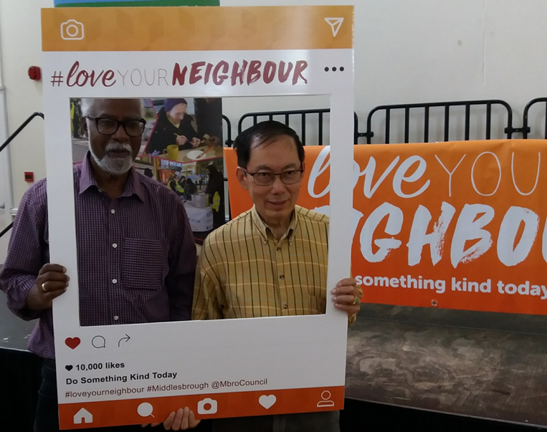

Slide 16
Welcoming New Migrants to Middlesbrough
Working with new migrants -10 years or less in Middlesbrough:
Orientation Pack
Volunteering
Safeguarding
.

Slide 17
Orientation Pack
2 Presentations; SCM and Police
Priority Wards; Central, Newport/Gresham and North Ormesby
Delivered by SCM team, Cleveland Police and volunteer Interpreters
Include a list of Support Services/key contacts

Slide 18
SCM Presentation
Provide information on wide range of issues including:
How to register with a GP
Bins and Recycling
Parenting and Safeguarding
Middlesbrough Council Services
Housing Issues
We have consulted with numerous residents & R.R.F, MAP, Cleveland Police and volunteers who will be involved in the project

Slide 19
Police Presentation
An introduction to some UK laws including:
How to contact emergency services
UK laws on Sex and relationships
Driving legally & safely
Domestic Abuse
Equality, Hate Crime and Social Inclusion

Slide 20
Volunteers
Promote volunteering more effectively to the communities we are working with
Volunteer translators who provide assistance with the delivery of the presentations ( Accreditation)
Create and identify more volunteer opportunities to enable communities to work closely together

Slide 21
Volunteer Policy
Following discussions with Volunteer organisations, we have created some guidelines as part of a policy in regards to RAAS (Refugee and Asylum Seeker) Volunteers.
This will be implemented into Middlesbrough Council’s volunteer policy and to support other V.C.S groups to recruit more volunteers from diverse communities.
Welcome any feedback

Slide 22
Safeguarding
As part of the Orientation strand we are delivering safeguarding awareness:
Sessions for communities on relevant issues including child protection, HBV & FGM
Workshops for Practitioners on better understanding needs of new & emerging communities

Slide 23
What’s Next?
Second round of CommUNITY Conversations
Story Telling Workshops
Conflict Resolution Workshops ( CTM)
Acts of Kindness
Localised Cultural events
Second round of Funding Programme and Workshops
Final round of CommuUNITY Conversations
Award Ceremony- for all those involved in SCM Project
Learning from SCM to embedded into service delivery

Slide 24
Thank you for listening, any questions?
shahda_khan@middlesbrough.gov.uk

