Slide 1

Anchor Institutions
&
Community Businesses
Stuart MacDonald
Associate Director
Grace Brown
Researcher
CLES

Slide 2

About CLES
Through our work we aim to achieve social justice, good local economies and effective public services for everyone everywhere.
Notes:
Leading independent member and research organisation, realising progressive economics for people and place.

Slide 3
Why a new
approach is
needed
David Burch
Researcher
Notes:
As a fundamental driver of this new approach, local wealth building aims to reorganise and control the local economy so that wealth is not extracted but broadly held and generative, with local roots, so that income is recirculated, communities are put first and people are provided with opportunity, dignity and well-being. Through local wealth building we are seeing a democratic, social and economic movement, which seeks to provide resilience where there is risk and local economic security where there is precarity.
Local Wealth Building has a particular focus on the activities of anchor institutions. Anchor institutions are large established organisations, rooted in local communities, which can improve local economic and social wellbeing through the use of their spend, employment practices, and use of land and assets.

Slide 4
Economic development is failing
Success is measured in terms of increases in GVA, competitiveness, job creation, reduction in employment, however:
  Little emphasis on who gets the jobs, how much they are paid or the extent to which inequality is reduced
  Economic development focused on attracting inward investment from outside of the local economy, meaning that profits from local production are extracted
The prevailing model of local economic development has failed to engage with questions around the distribution of wealth:
  Who owns it?
  Who has power over it?
  Who benefits from it?

Slide 5
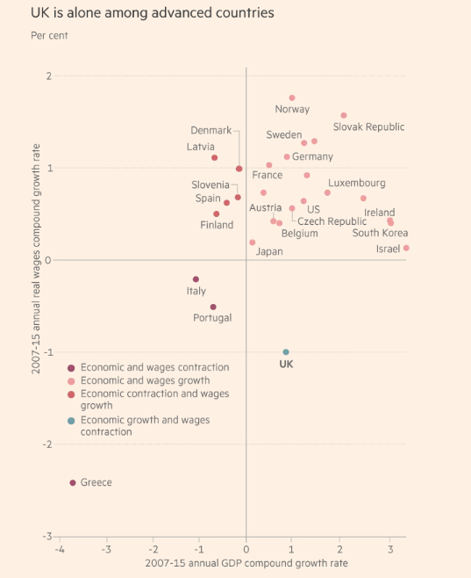
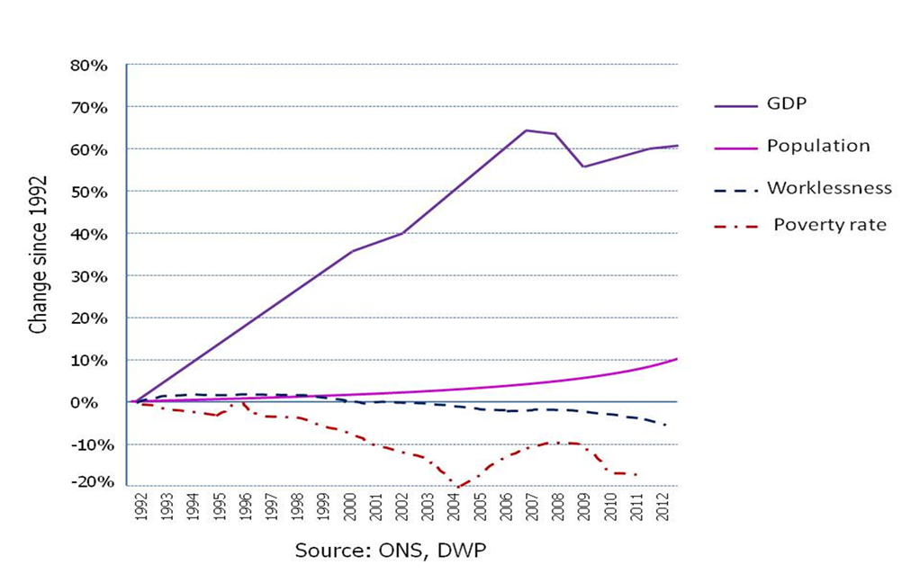
Living standards are falling

Slide 6
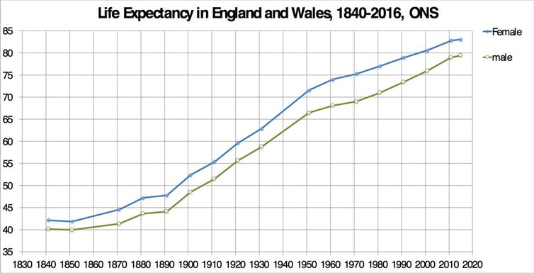

Life expectancy is falling in some places
How difference in life expectancy in Hartlepool can be 12 years within just one mile!

Slide 7
Local wealth building
Change agents
The challenge
Poverty
Low wages
Inequality
Under-employment
No local development
Benefits few local people
Dispersed supply chains
More inclusive
Prosperity
Living wages
Equality
Decent jobs
Develop from within
Distributed wealth
Local supply chains
Businesses
Social sector
Public sector
Land and property holdings
Pension funds
Social innovation

Slide 8
Local Wealth
Building in practice
Victoria Bettany
Senior Researcher
David Burch
Researcher

Slide 9

What is Local Wealth Building

Slide 10
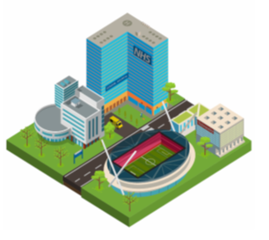
Anchor institutions
An anchor institution is one that, alongside its main function, plays a significant and recognised role in a locality by making a strategic contribution to the local economy
Notes:
Spatial immobility: these organisations have strong ties to the geographic area in which they are based through invested capital, mission and relationship to customers and employees
Size: anchor institutions tend to be large employers and have significant purchasing power. Both these factors influence the level of impact these institutions can have on the local economy

Slide 11
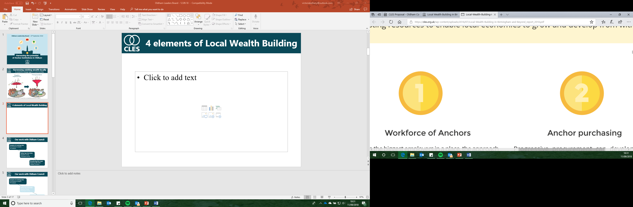
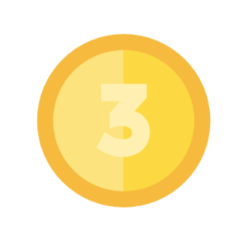
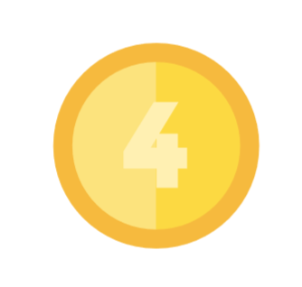
4 elements of Local Wealth Building
Workforce of Anchors
Anchor purchasing
Anchor land, property & assets
Ownership of the economy
Notes:
At the heart of the Local Wealth Building approach, then, are four strategies for harnessing existing resources to enable local economies to grow and develop from within.
Procurement - Progressive procurement can develop dense local supply chain of local enterprises, SMEs, employee owned businesses, social enterprises, cooperatives and other forms of community ownership. This type of procurement is locally enriching because these types of businesses are more likely to support local employment and have greater propensity to retain wealth and surplus locally.
Employment - Often the biggest employers in a place, the approach that Anchors take to employment can have a defining effect on the employment prospects and incomes of local people. Recruitment from lower income areas, commitment to paying the living wage and building progression routes for workers are all examples of the actions Anchors can take to stimulate the local economy and bring social improvements to local communities.
Land and Assets - Anchors are often major land holders and can support equitable land development (through establishment of Community Land Trusts) and development of under-utilised assets for community use. In terms of financial investments, directing pension funds to local investment priorities can bring transformative capital to locally rooted enterprises.
Democratic Ownership of the Local Economy - At the heart of Local Wealth Building is the principle that wealth is broadly held. Cooperatives, mutually owned businesses, SMEs, municipally owned companies and local banks enable the wealth generated in a community to stay in that locality and play a vital role in counteracting the extraction of wealth.

Slide 12


Local Wealth Building & Community Business
Ownership of the economy
At the heart of Local Wealth Building is the principle that wealth is broadly held. Cooperatives, mutually owned businesses, SMEs, municipally owned companies and local banks enable the wealth generated in a community to stay in that locality and play a vital role in counteracting the extraction of wealth.

Slide 13

Anchor Institutions
and Community Businesses
David Burch
Researcher

Slide 14



About the research
The research seeks to support the development of local ownership of the economy through Local Wealth Building, looking at how anchor institutions can support community businesses to realise their local economic and social potential.
Case studies

Slide 15
Barriers
There are a number of barriers preventing better engagement between community businesses and anchor institutions:
Lack of understanding and information;
Limited recognition or dedicated strategy;
Complicated procurement processes;
Capacity;
Nature of organisations;
Financial pressures.

Slide 16
Enablers
The research found a number of good practice examples that worked to enable better collaboration between anchors and community businesses.
Liverpool City Council: Pre-market engagement and diluting procurement
Liverpool Clinical Commissioning Group: Platform development
Community business consortium
Ipswich County Council: Spinning out of services

Slide 17



Recommendations for community businesses
Four key recommendations for community businesses related to:
ABC
Visibility
Evaluation
Collaboration
Language

Slide 18



Recommendations for anchor institutions
For anchor institutions, there were three recommendations:
Support community
businesses
Harness local spend
Maximise use of assets

Slide 19
Local Wealth
Building in
Hartlepool
David Burch
Researcher

Slide 20

About Empowering Places
Hartlepool (Dyke House) with Wharton Trust
Bradford (Manningham) with Carlisle Business Centre
Grimsby (Southward, Nunsthorpe and Bradley Park) with Centre 4
Leicester (Braunstone) with B-Inspired
Luton (Northwell) with Marsh Farm Futures
Wigan (Abram) with Abram Ward Community Charity
Plymouth (Devenport and Stonehouse) with Real Ideas Organisation and Millfields Trust

Slide 21



Developing a Hartlepool Anchor Network
Introducing concepts
Exploring potential
Anchor Institution workshop
Anchor Institution engagement
Anchor Institution workshop
Telephone interviews
Workforce
Purchasing
Land, property, assets
Recommendations paper

