Slide 1



Dyke House
Our Thriving Square Mile

Slide 2
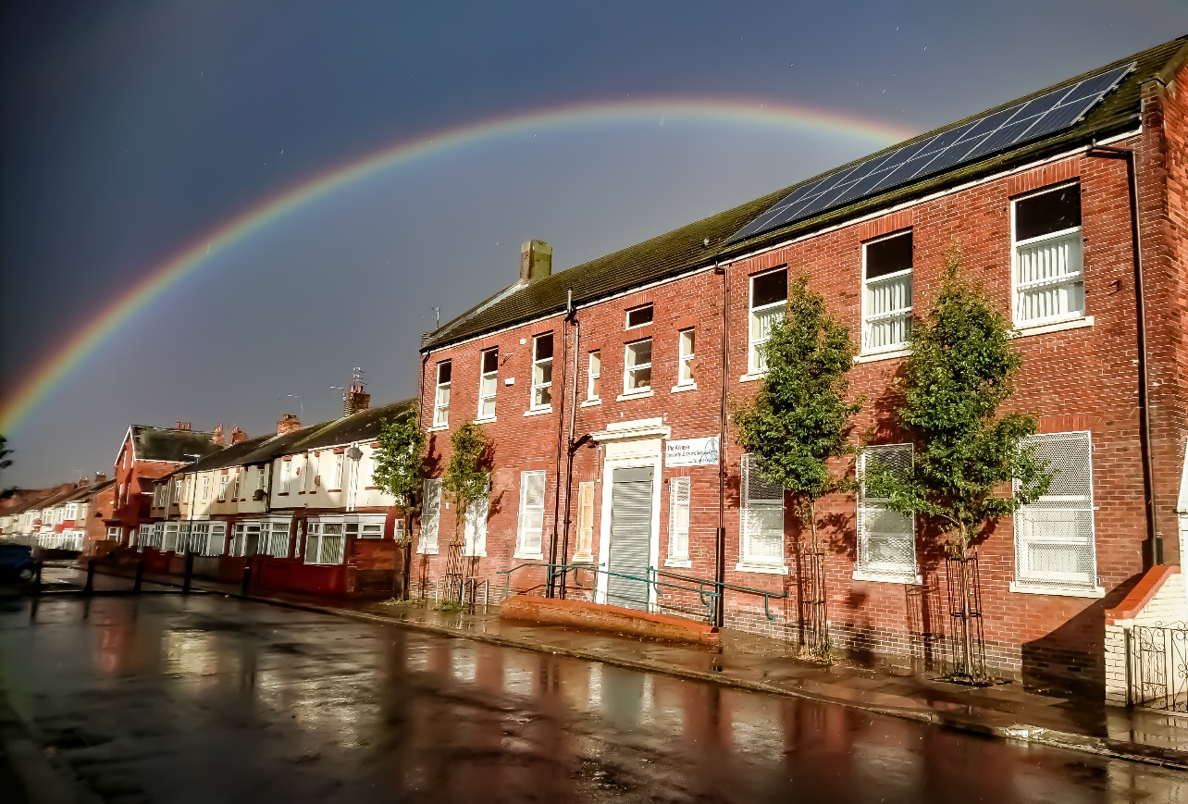
The annexe

Slide 3
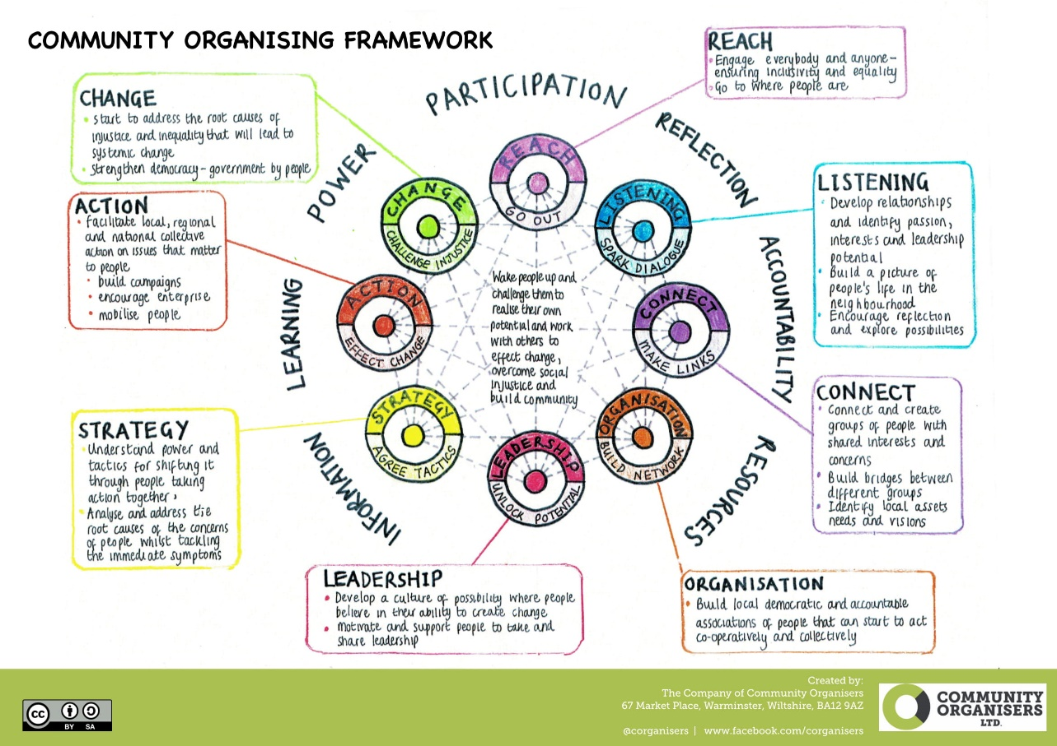
Our approach

Slide 4









What happens

Slide 5
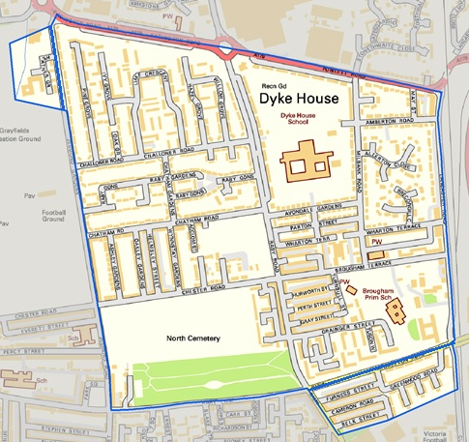
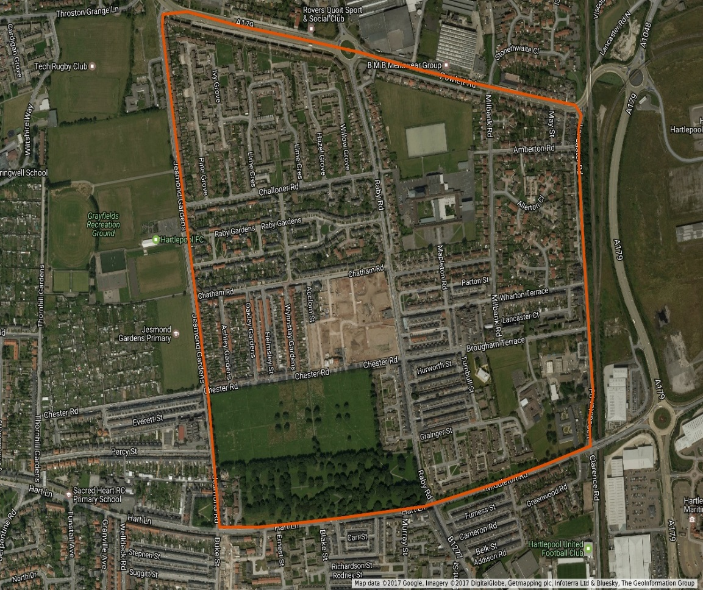
Dyke House

Slide 6
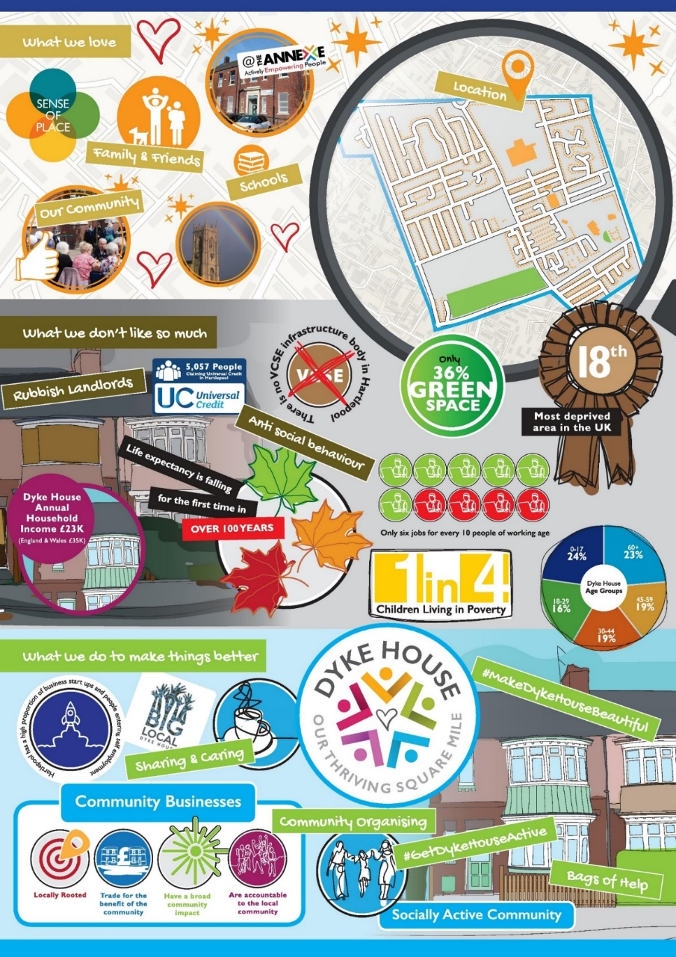
What we hear

Slide 7


What we love

Slide 8

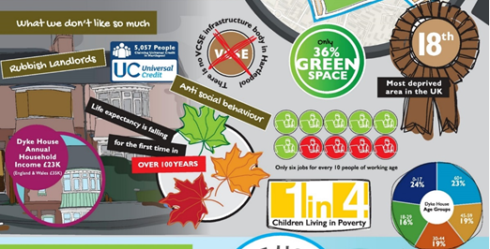
What we don’t like

Slide 9


What we do!

Slide 10

The road to empowering places

Slide 11

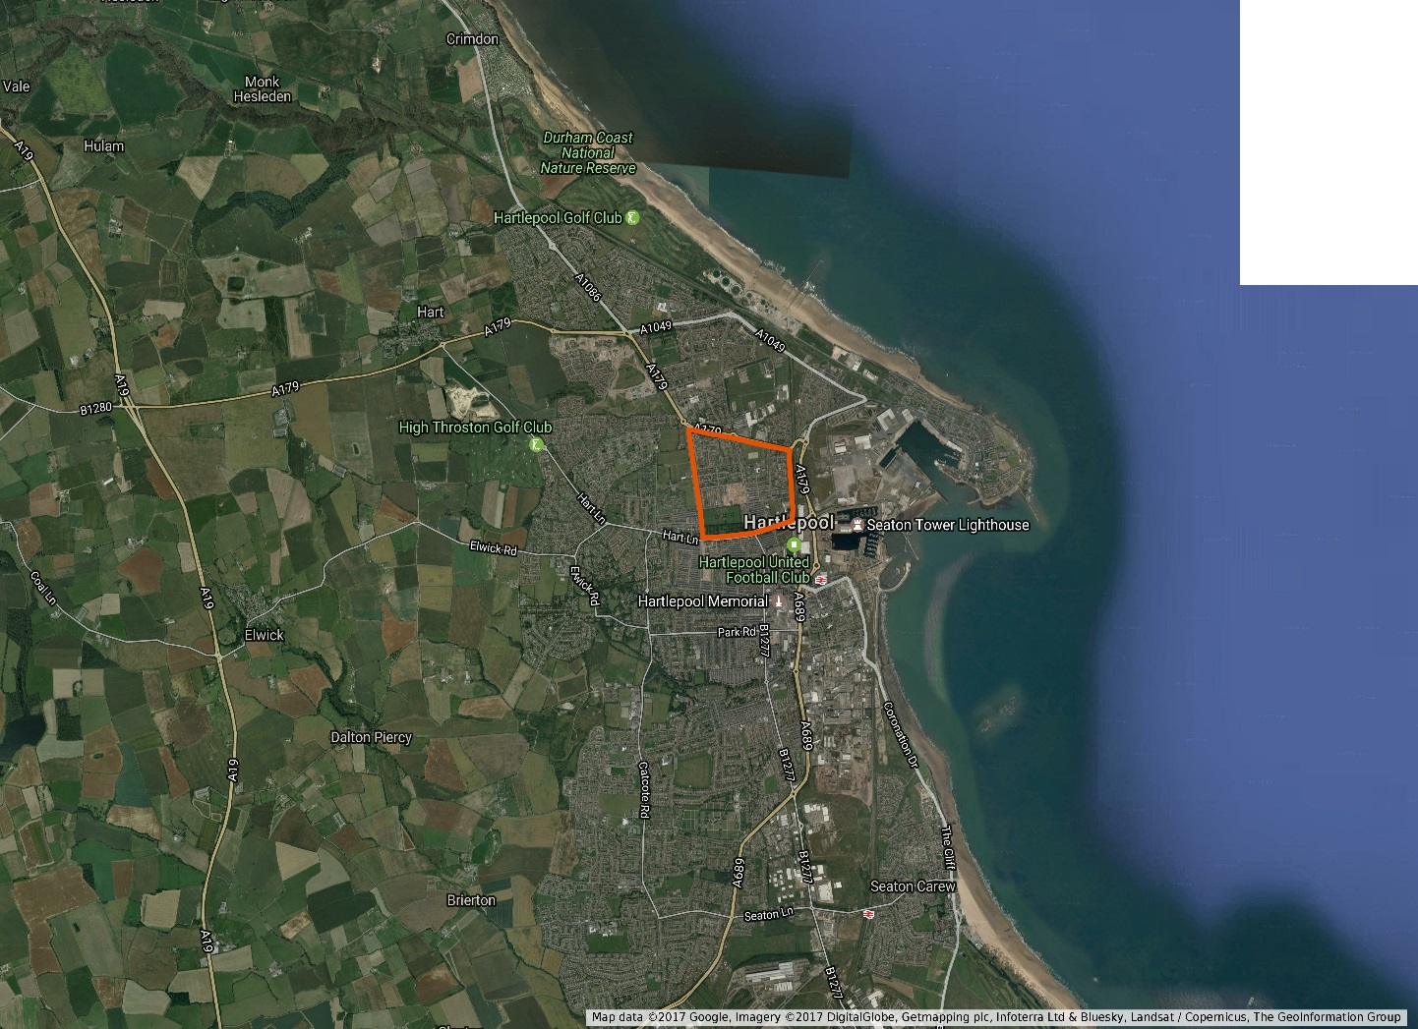
Refreshing our knowledge

Slide 12
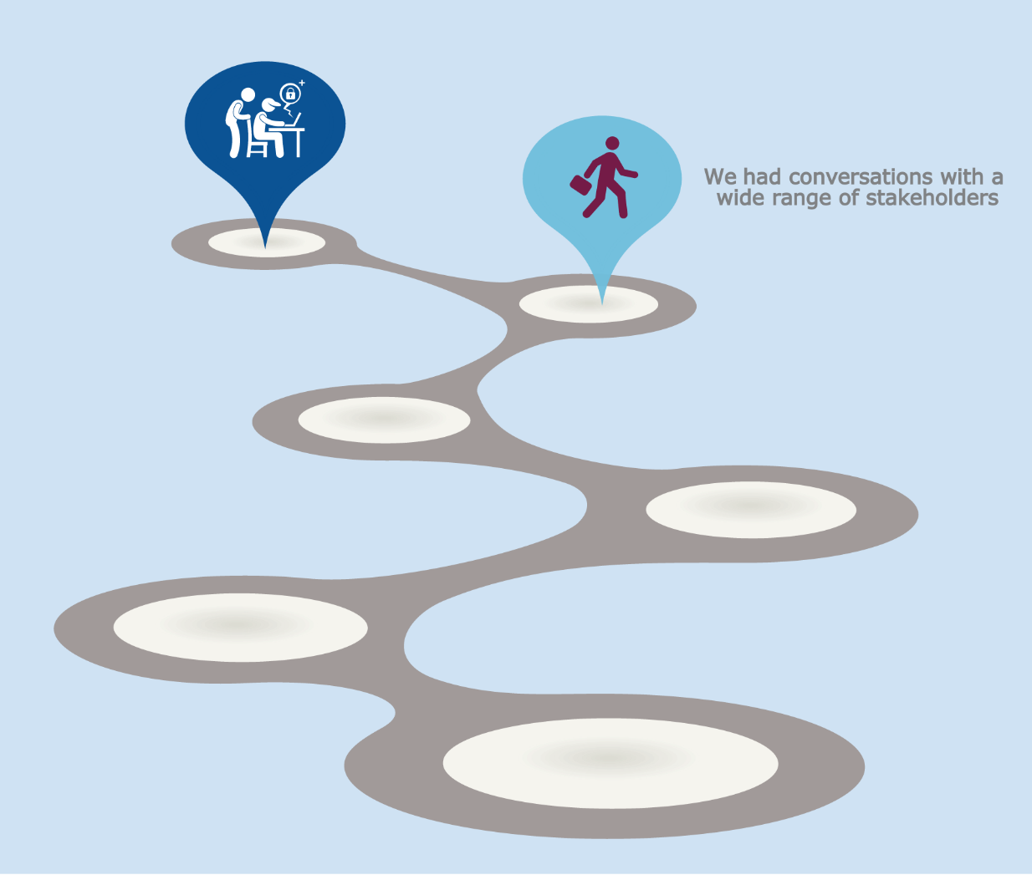
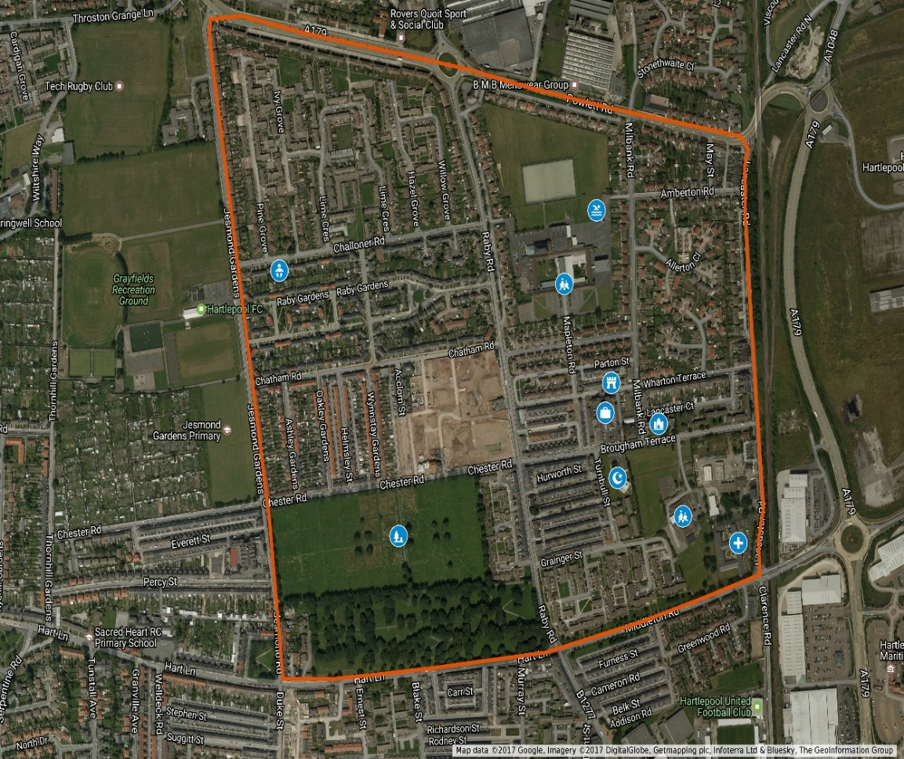
Stakeholders

Slide 13
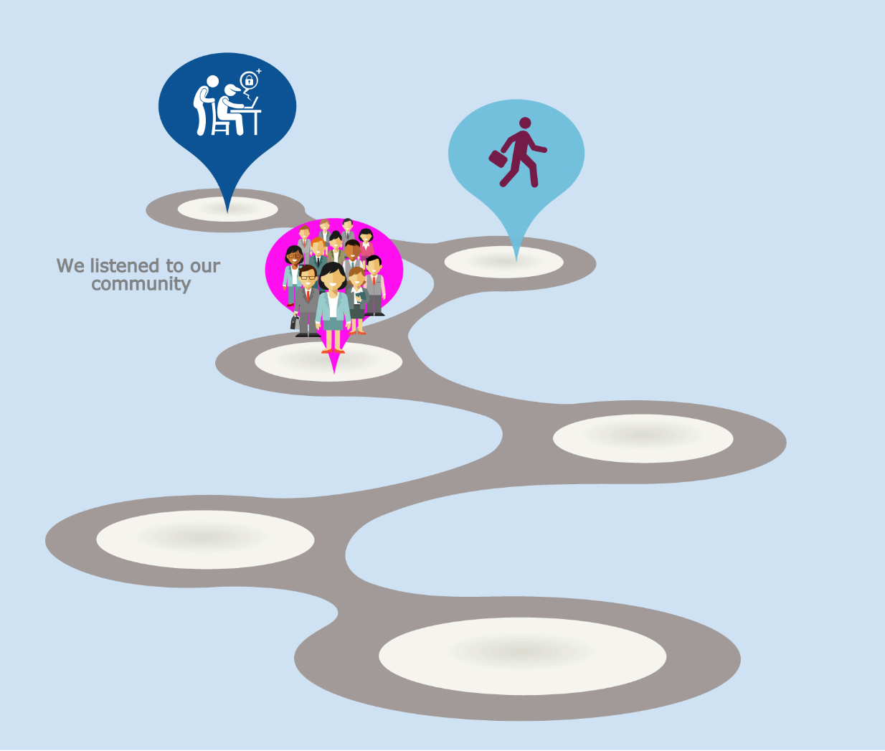
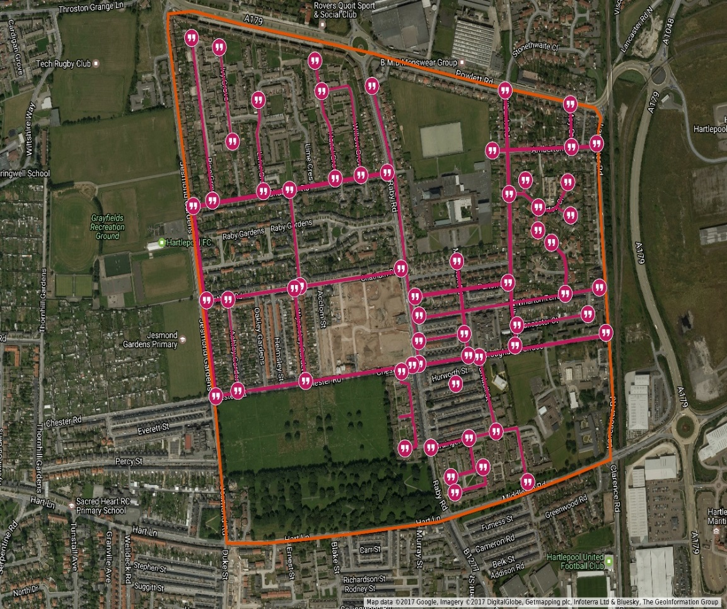
Listening

Slide 14

Key messages
Housing
“Poverty Premium”
Money leaking
Employment
Poor health
No shared understanding of “Community Business”

Slide 15
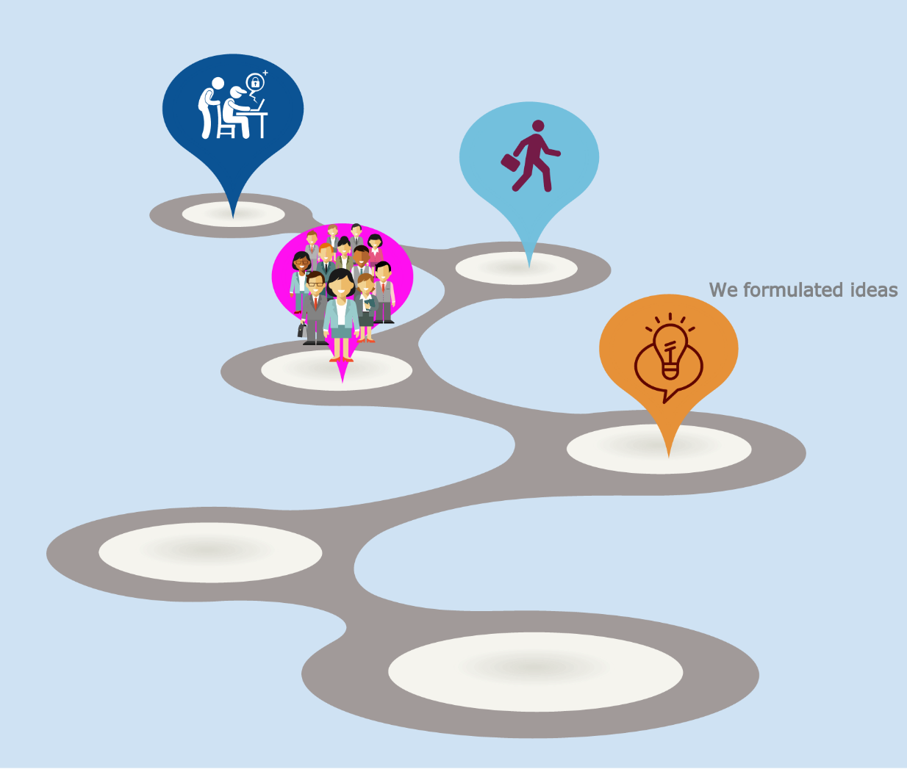
Not just the annexe
Our local community
Big Local Partnership
Tees Valley Community Foundation
Joseph Rowntree Foundation

Slide 16
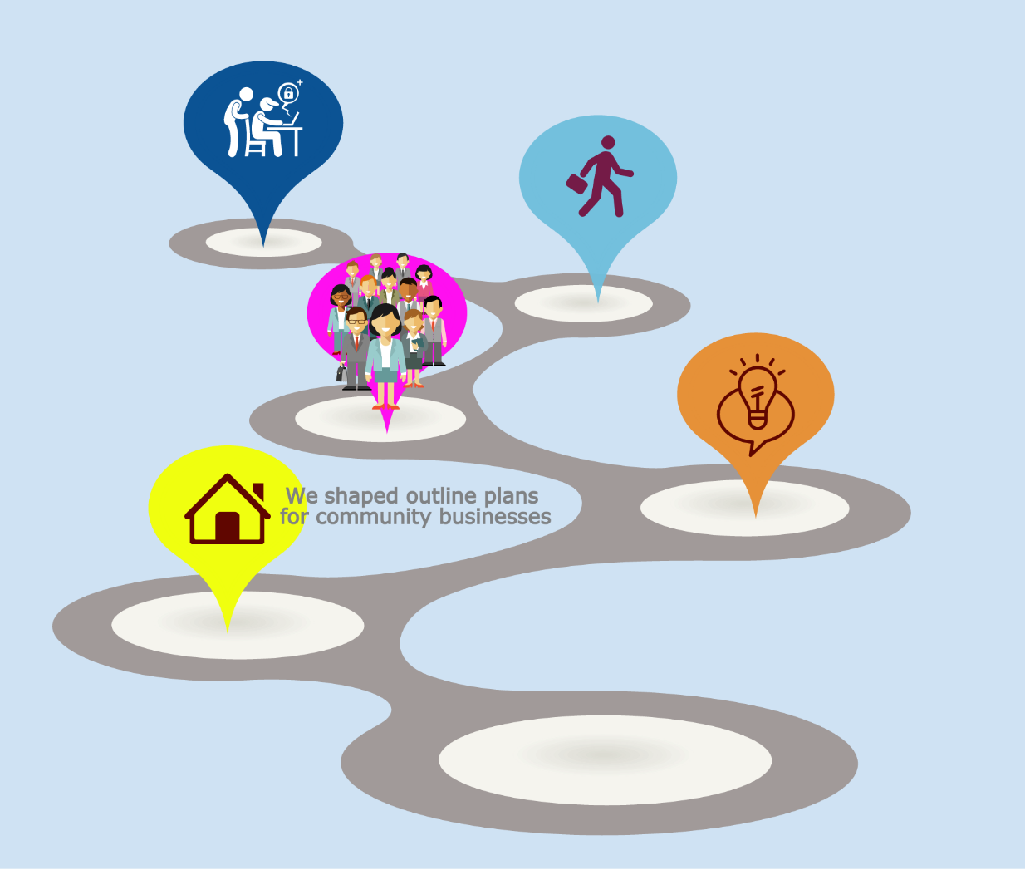
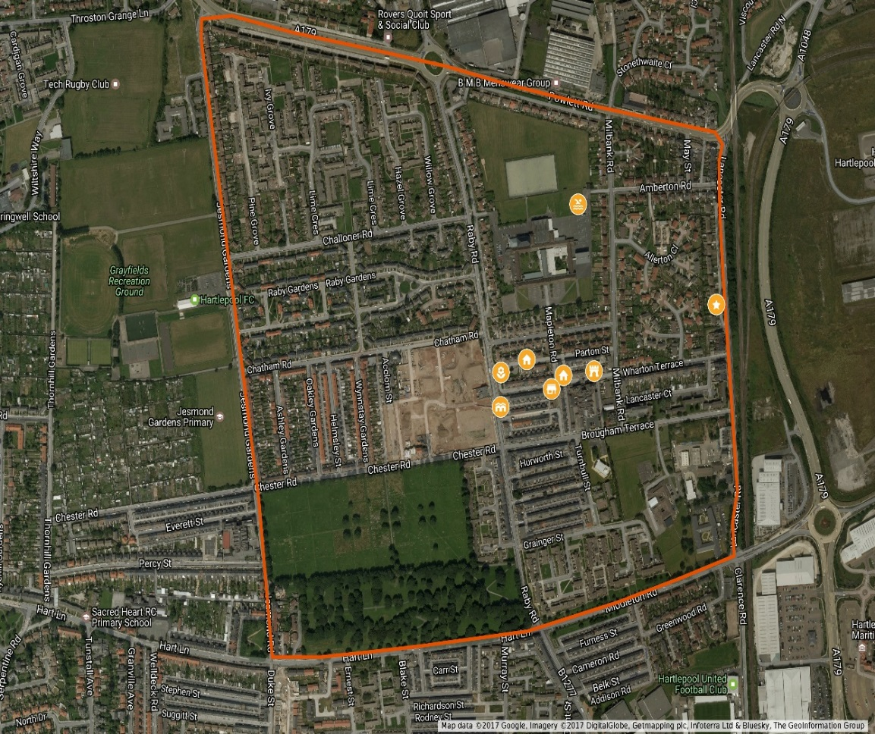
Building the possible

Slide 17
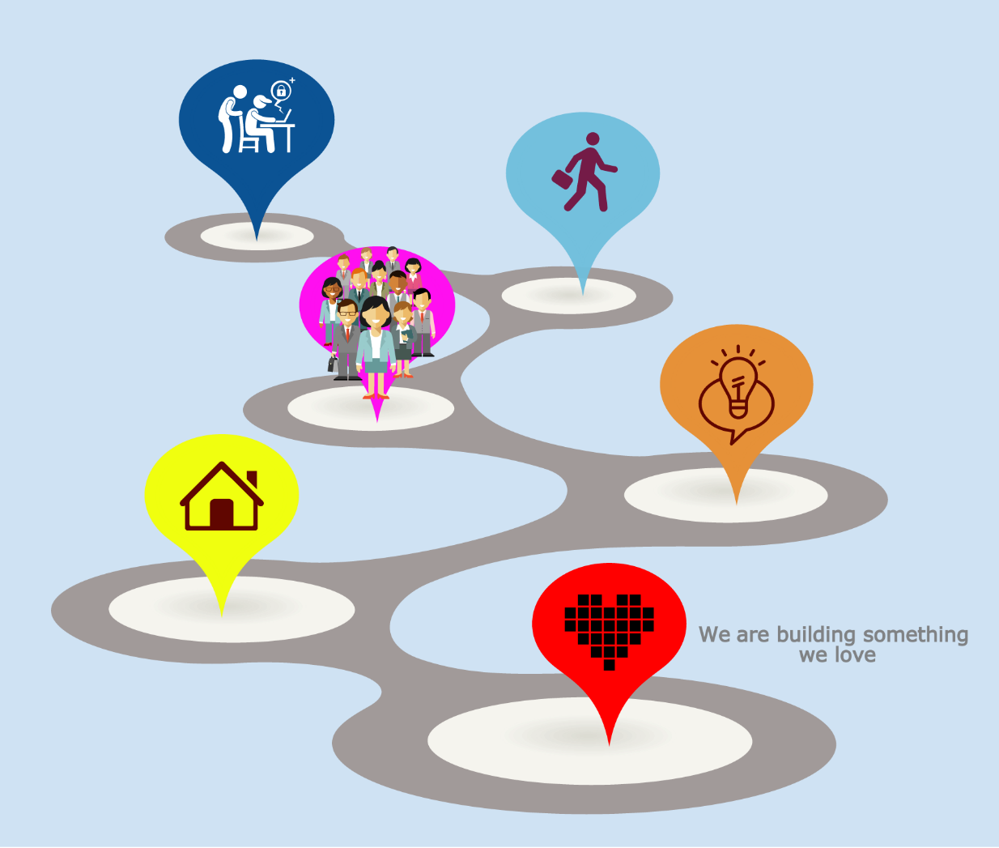
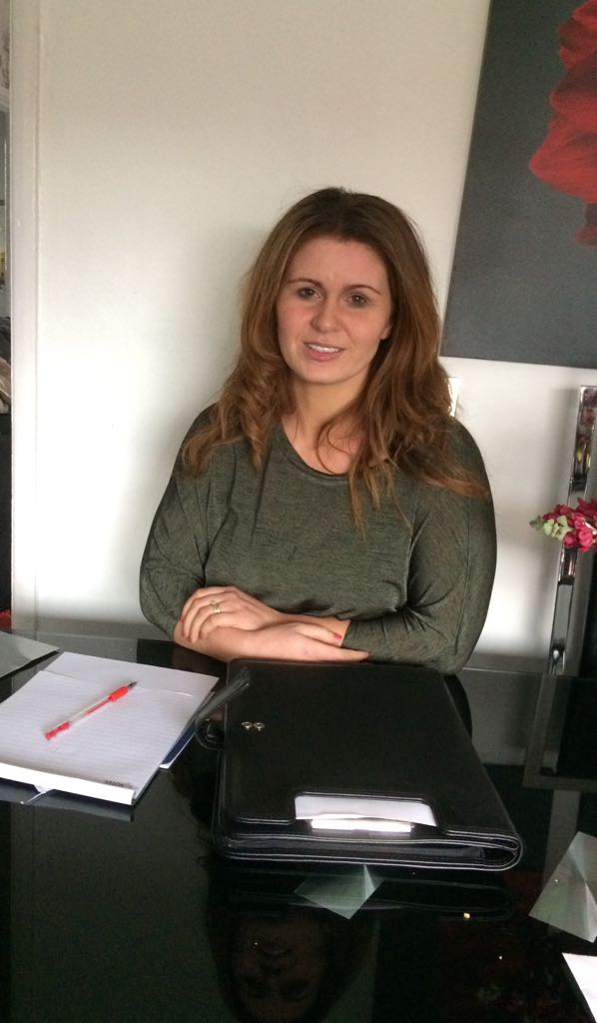
Community business
Christine

Slide 18
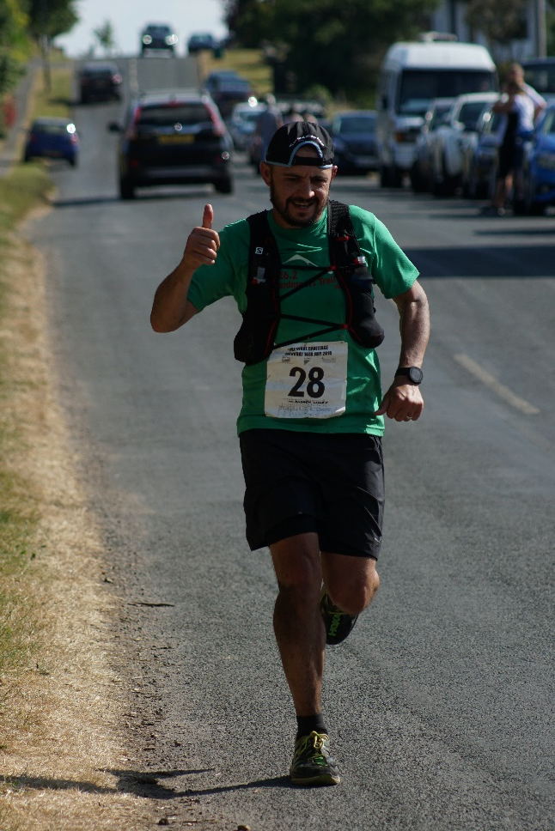
Community business
Andrew

Slide 19
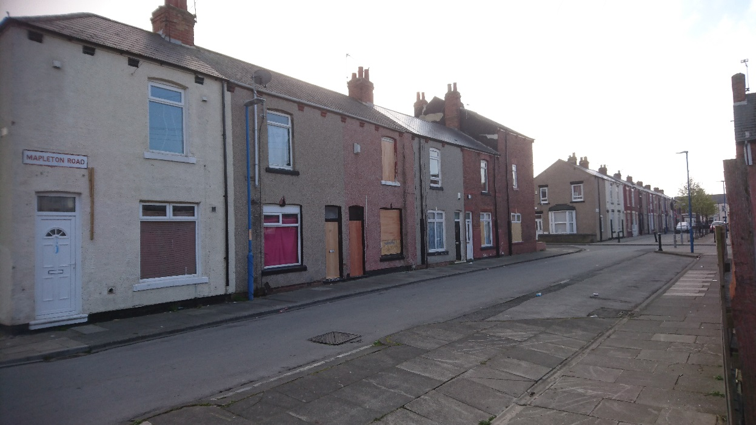
Community business
Annexe Housing

Slide 20
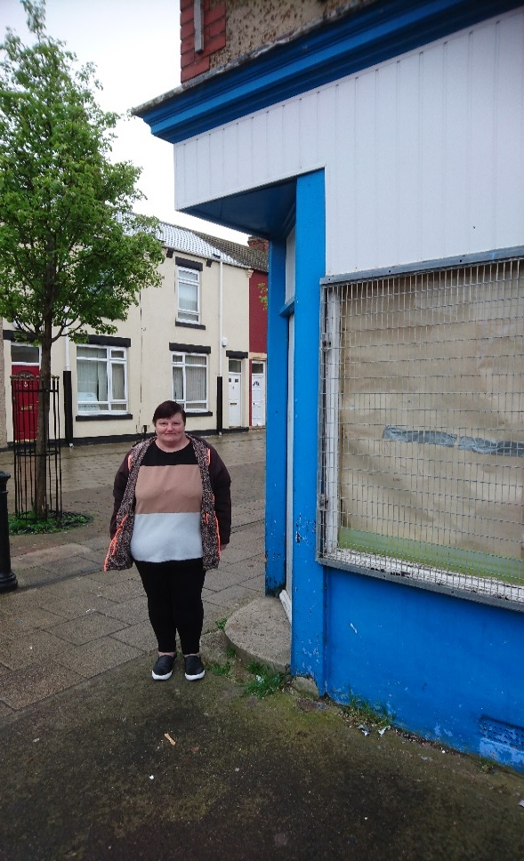
Building the possible
Andrea

Slide 21
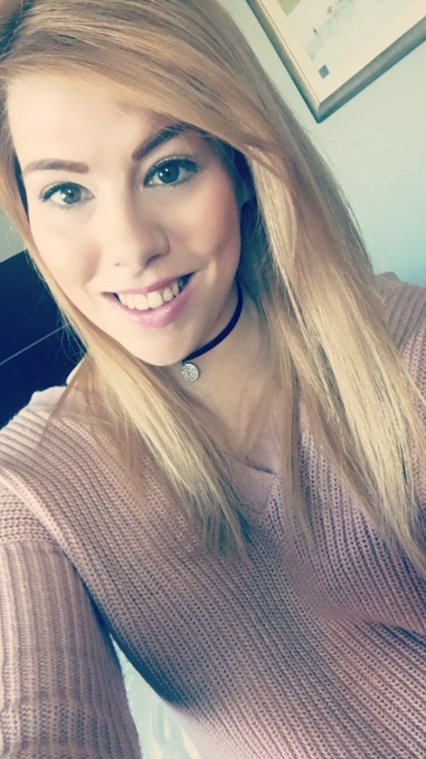
Building the possible
Caitlin

Slide 22
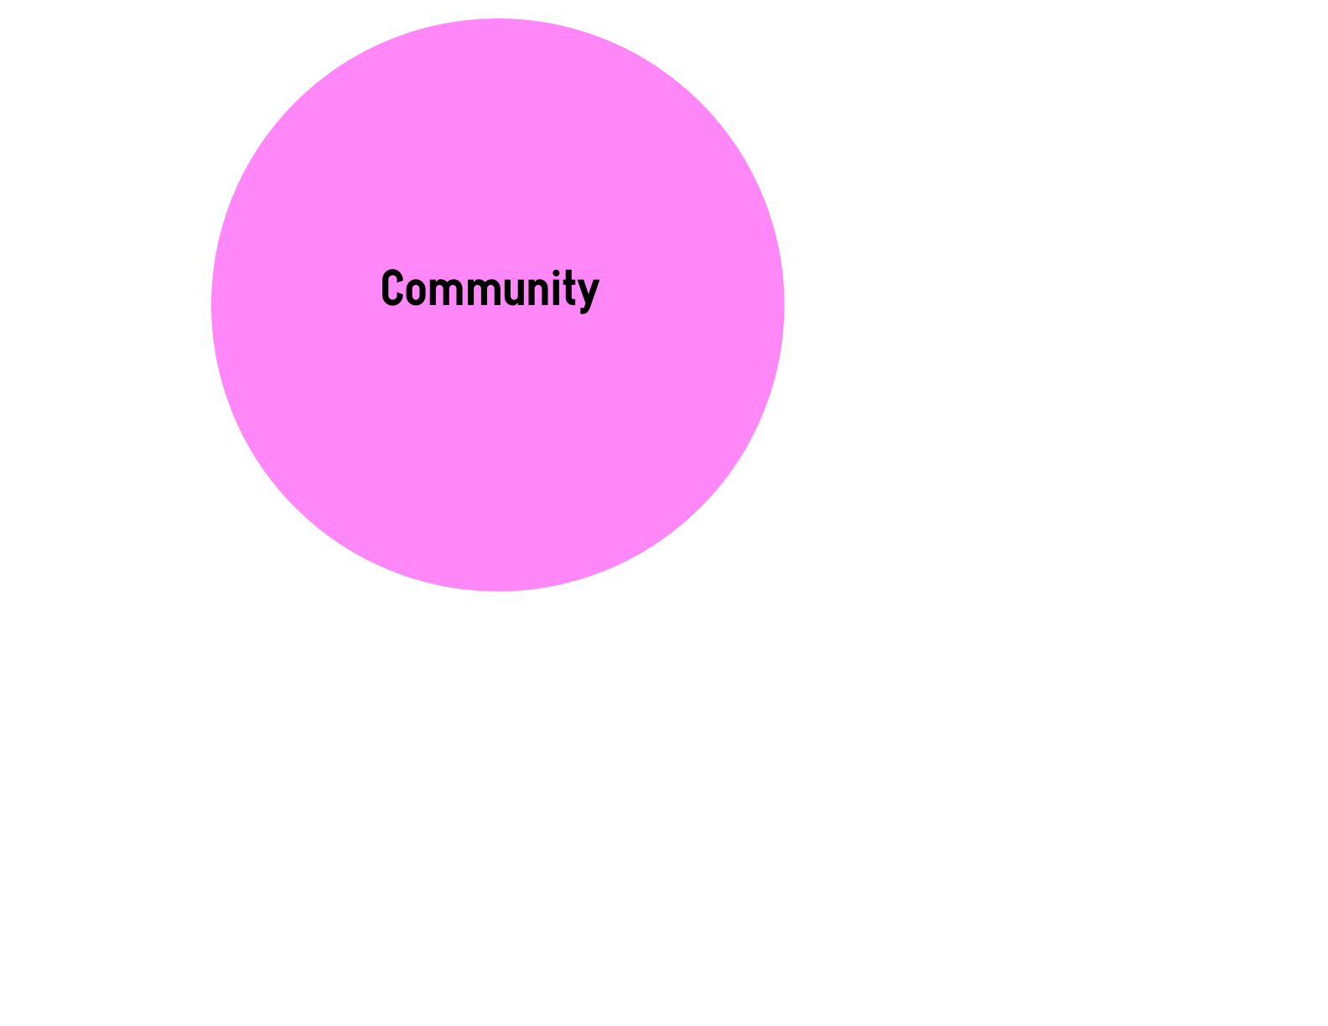
CATALYSING COMMUNITY BUSINESS

Slide 23
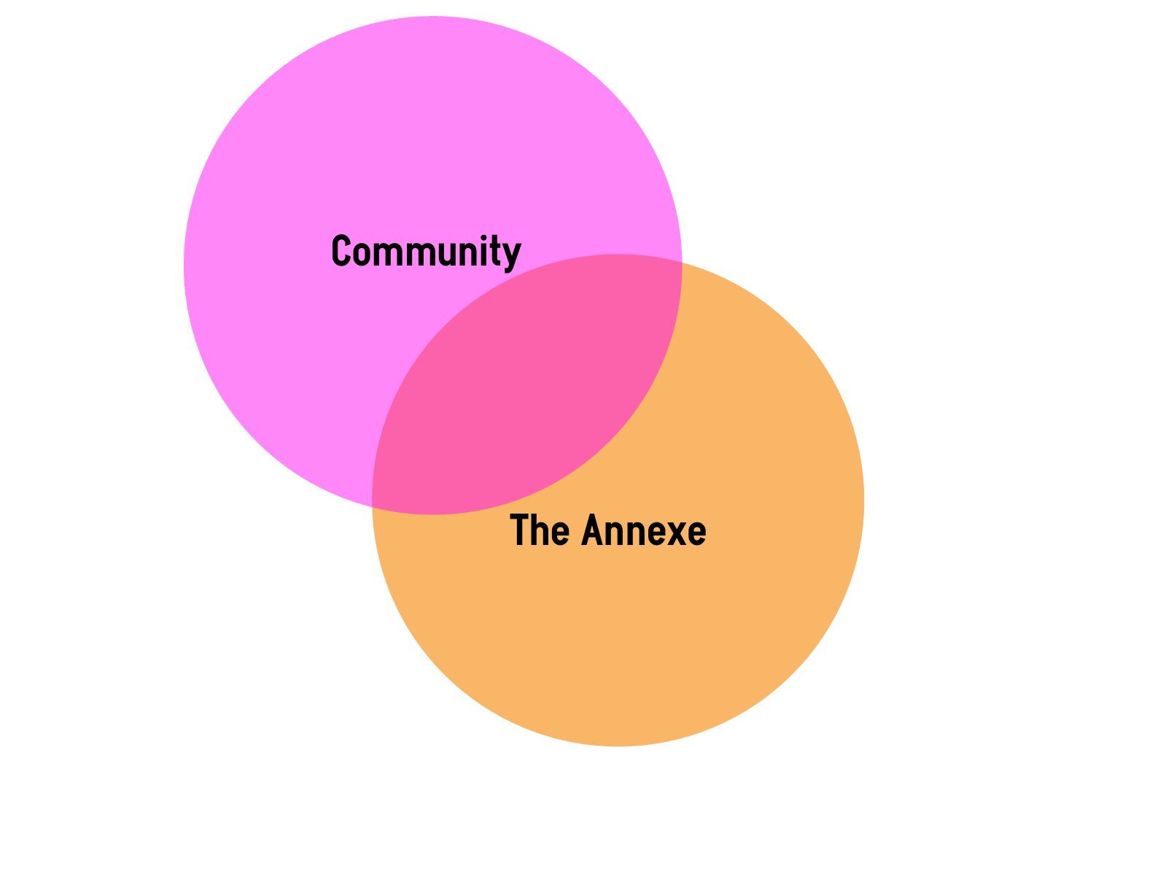
CATALYSING COMMUNITY BUSINESS

Slide 24
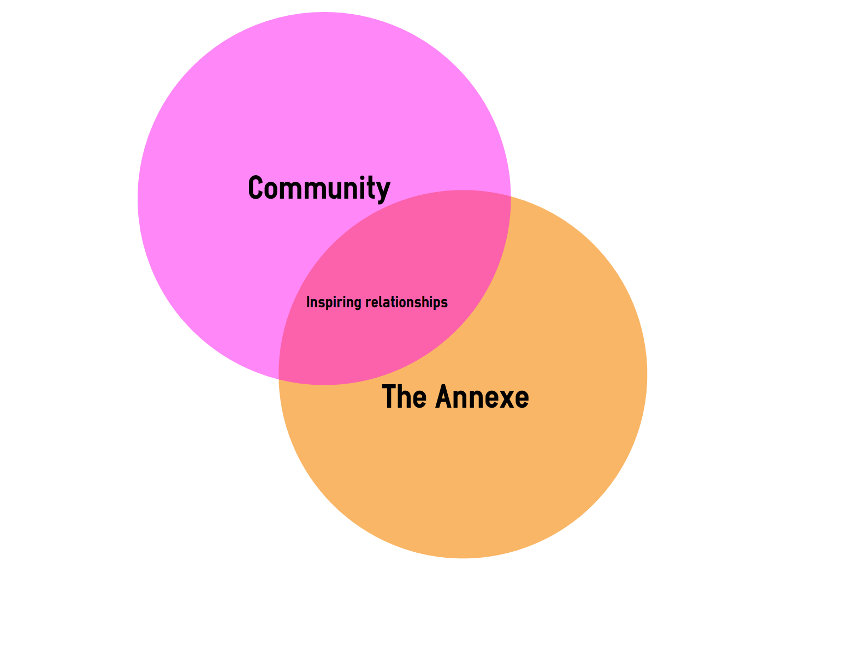
CATALYSING COMMUNITY BUSINESS

Slide 25
CATALYSING COMMUNITY BUSINESS
Big Local
TVCF

Slide 26
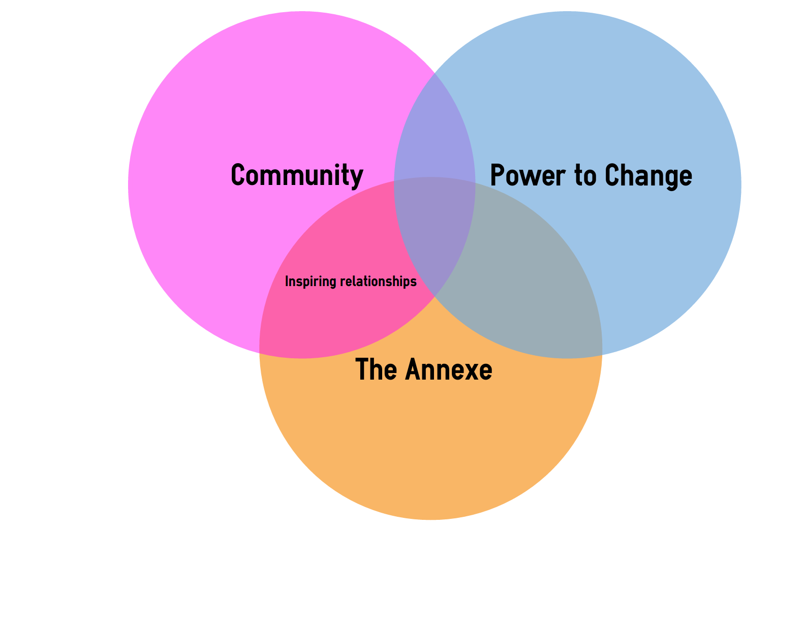
CATALYSING COMMUNITY BUSINESS
Big Local
TVCF

Slide 27
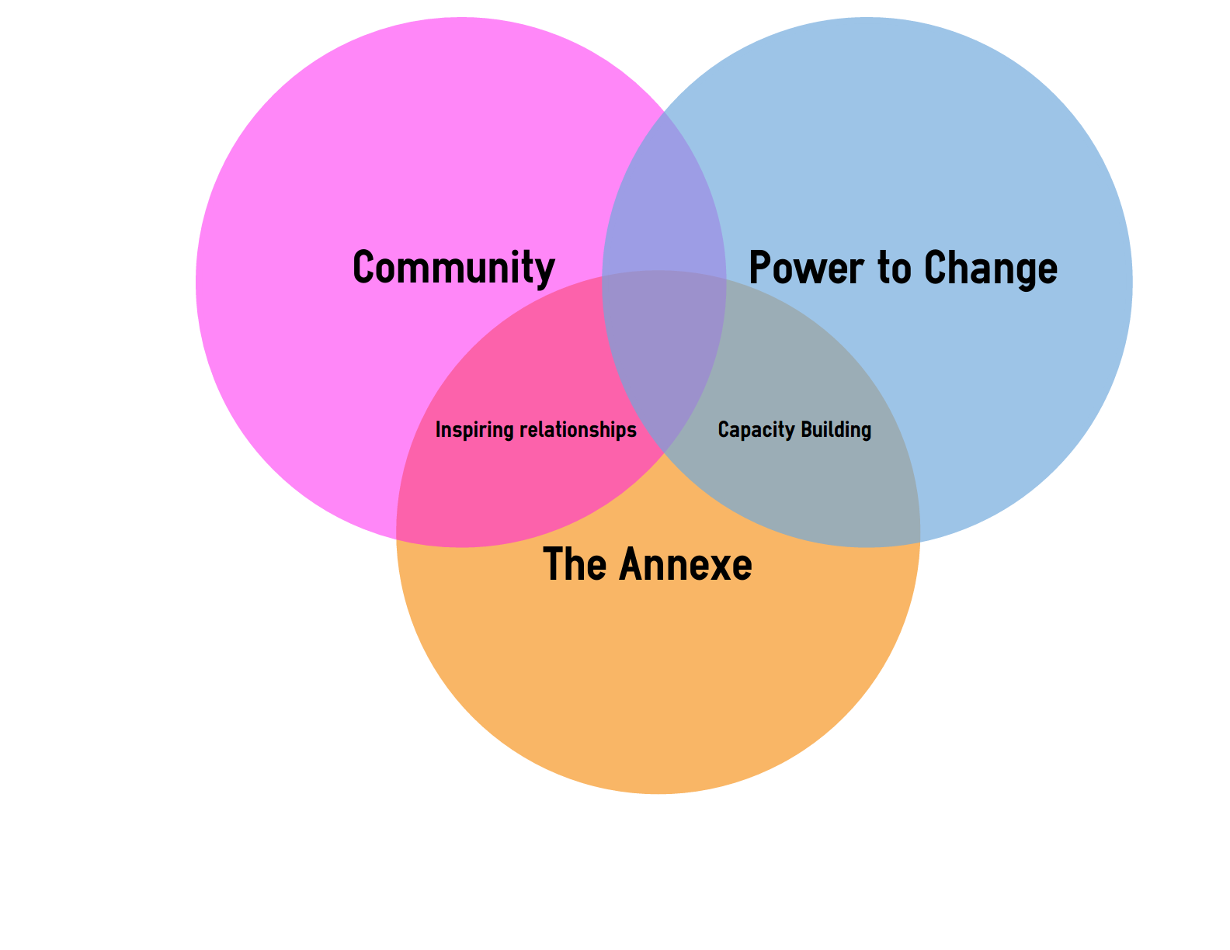
CATALYSING COMMUNITY BUSINESS
Big Local
TVCF

Slide 28
CATALYSING COMMUNITY BUSINESS
CLES
NEF
Coops
Big Local
TVCF

Slide 29
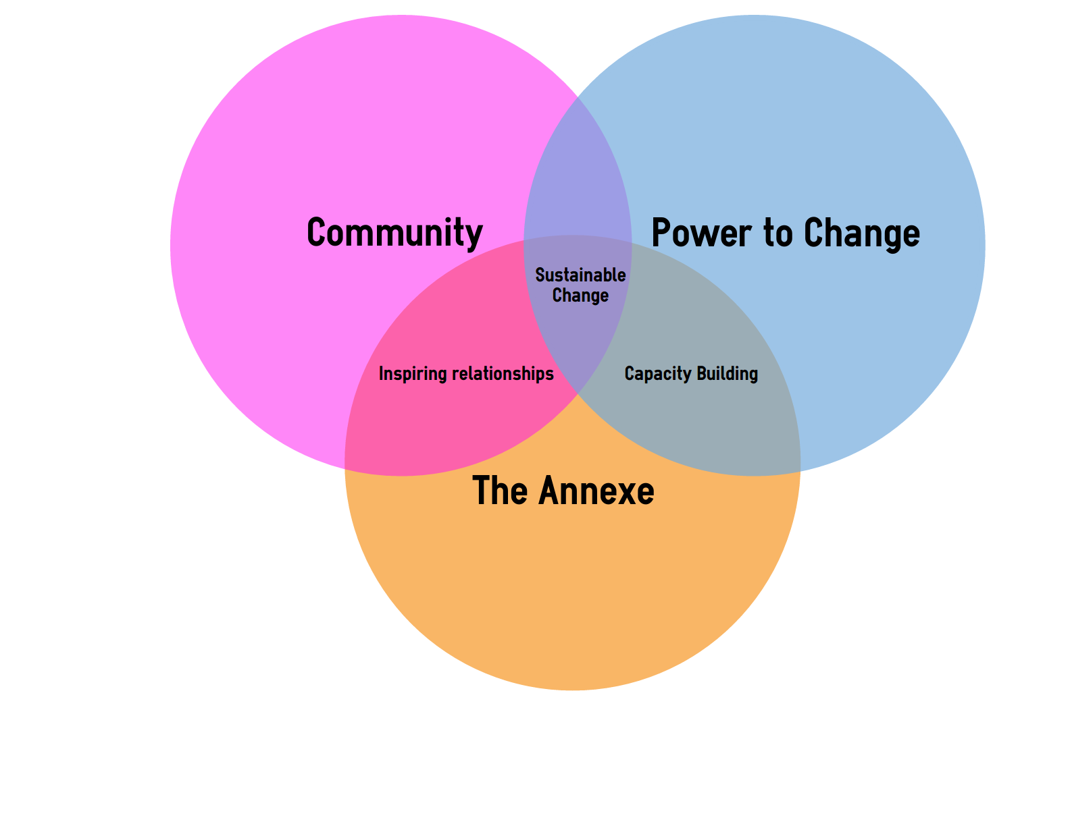
CATALYSING COMMUNITY BUSINESS
CLES
NEF
Coops
Big Local
TVCF

Slide 30
CATALYSING COMMUNITY BUSINESS
CLES
NEF
Coops
Big Local
TVCF

Slide 31
Joining the dots
US
CO Ltd
CLES
DCMS
JRF/HAL
PTC/EP
PBSA
Big Local
Coops UK
NEF

Slide 32
Lessons learned
Work with your allies; solidarity of sector
  Even then it’s not always easy
You have to go at the pace of the individual
Making sense locally
PTC flexibility offered has been great
Organisational approach
There are more people aware of us outside of Hartlepool than inside
Accountability remains a challenge; build it from the start
Transformational; but are we a fad?
Leadership

