Slide 1
The story of the glendale gateway trust

Slide 2
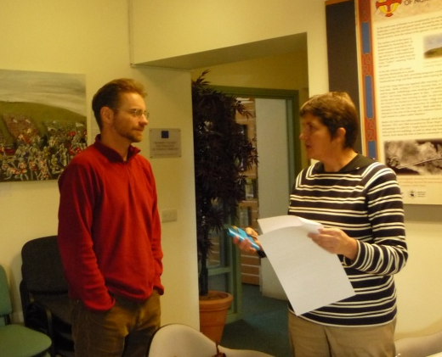
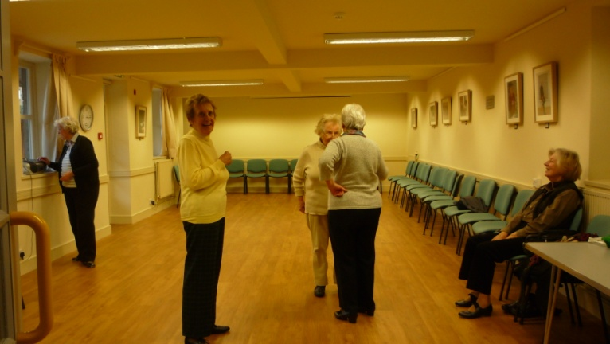
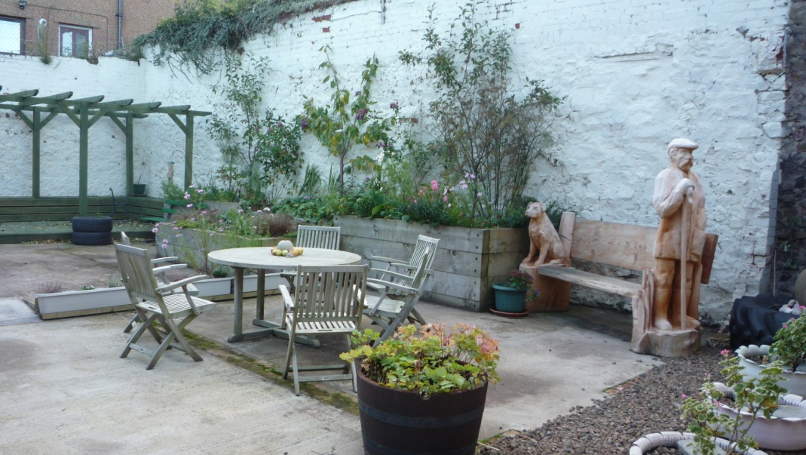
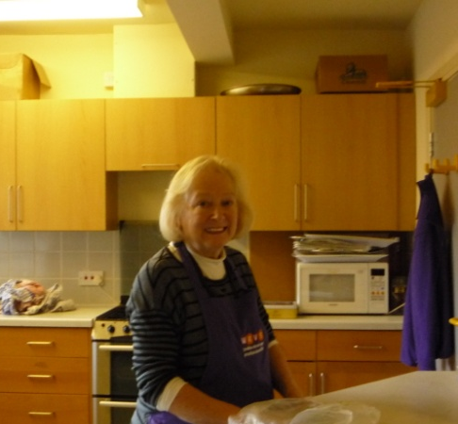
GGT – what IS it and what is it all about??
A Charity and Limited Company
Community regeneration!
Notes:
Community Development Trust
Not there to protect Red Squirrels or supply refurbish bicycles for people in need
Focus Focus Focus
Productivity in a bakery……..
Trustees with different priorities

Slide 3
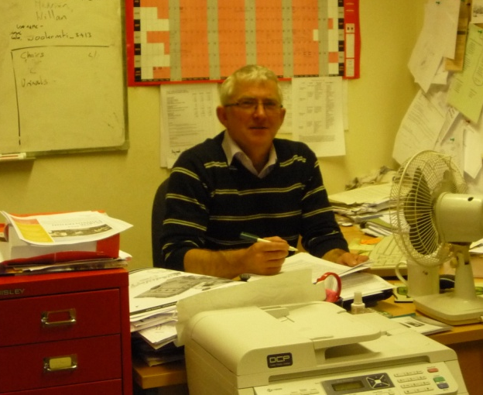
Growth
Village Appraisal 1994/5
Library to CC + conversion of Old Library Building 2009-2012
High St buildings and Butler Court 1999-2002
Converting the Cheviot Centre 1996-2001
GGT founded 1996
Market Town renewal mid-2000s
Business development 2012 onward
Youth Hostel acquired 2006
More affordable Housing
2013-18
Work Web project late 2000s
1995
2000
2005
2010
2018
Notes:
Focus on capital development and enabling
Turnover £260,000 per annum
Assets of around £3M

Slide 4
Reality check
ZRS = IG
ideas
people
cash
Notes:
Ideas:
Laundry
Brewery
Police museum
Warm indoor clothing
Passion – drive
Squaring the circle – how do you deliver projects that regenerate AND bring in income
Also – if it is profitable then the private sector will do it…..
Casualty – fluffy projects – leaflets, celebratory activities

Slide 5
What do we do
People, ideas and enthusiasm
Town Centre Commercial properties
The Cheviot Centre
Benefits for Glendale
Core Management
Town Centre residential properties
The Youth Hostel
Arms length Groups
Public funds
(national + EU)
Borrowing – none until 2013
Donations
Notes:
Focus on Enabling – passion for activity
benefits
Brought a lot of investment to Wooler – upwards of £10M since inception
Fostered a can do approach
Keeping the money in the community – Housing £70k gross £55k ploughed back in
33 Houses delivered/enabled - £35k annually in council tax to the local authority

Slide 6
Accountability
To whom and…… does it matter?
Notes:
Partnership organisation plus trustees
Accountable to the charity commission and companies house
We are not the local authority!
Broughshane experience
We get things done – would it be different if we were private sector

