Slide 1
The distinctiveness of community business
Tony Chapman and Tanya Gray
Policy&Practice, St Chad’s College, Durham University
ILG Seminar, 26th October, 2018, Hartlepool Council Chamber
Securing a Future for Community Business: interactions between businesses, public authorities and charities

Slide 2
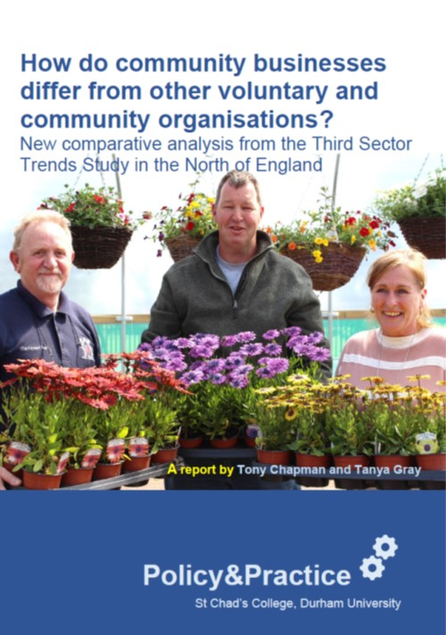

Slide 3
Third Sector Trends
Data are from a study of over 3,500 organisations across Northern England in 2016 – over 600 have characteristics of Community Businesses
Part of a longitudinal study that has been running since 2010
The study will be repeated in 2019 so that trends can be analysed
We’re now exploring the experiences of Community Businesses for Power to Change in Hartlepool, Middlesbrough and Bradford.

Slide 4
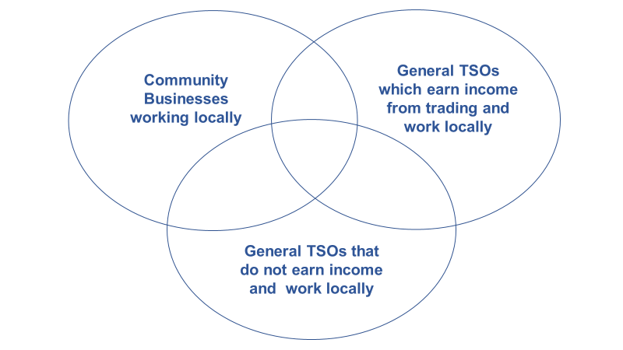
Variations on a theme?

Slide 6
Sources of income

Slide 10
Relationships with other organisations

Slide 13
Planning for the future

Slide 16
The report is now available here: https://www.stchads.ac.uk/research/research-news/how-do-community-businesses-compare-with-other-voluntary-and-community-organisations/
For more information, contact tony.chapman@durham.ac.uk

