Slide 1
Securing a future for community business
Suzanne Perry
suzannep@powertochange.org.uk

Slide 2
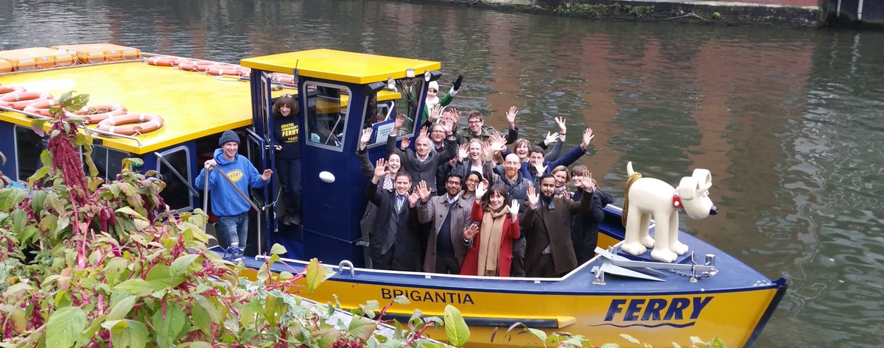
About Power to Change

Slide 3
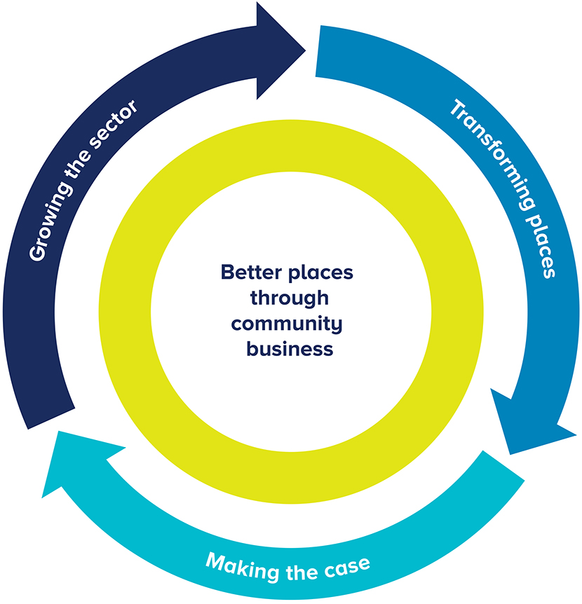
Independent trust aiming to create better places through community business.
Research
Advocacy
Peer networks
Market development
Capacity building
Events
Social investment advice
Funding
Policy work

Slide 4
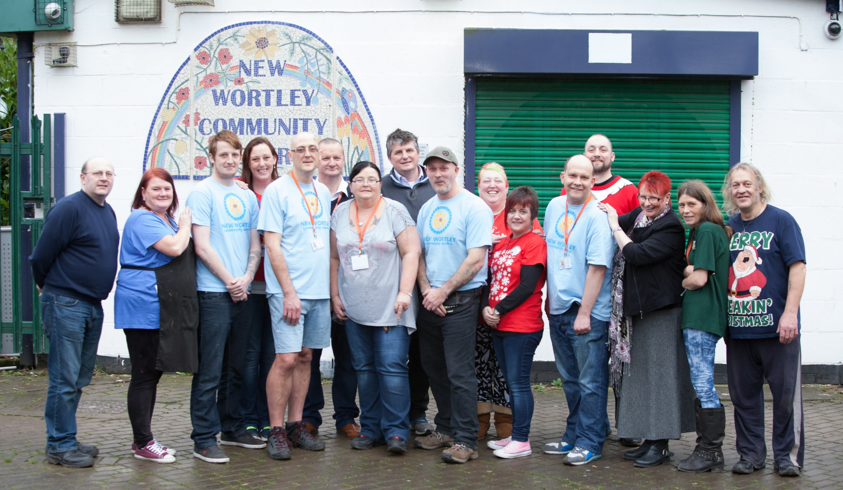
No one better understands the problems of a community than those who live there

Slide 5
What is a community business?

Slide 6
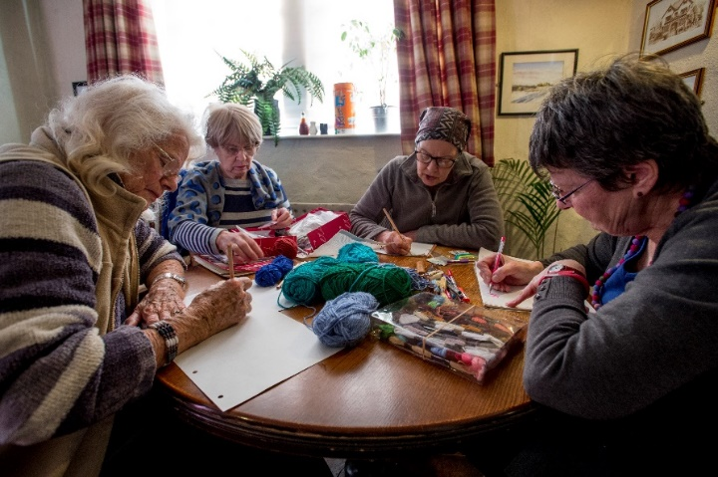
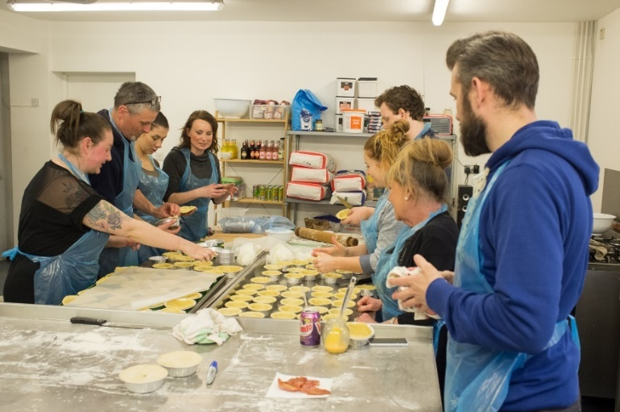
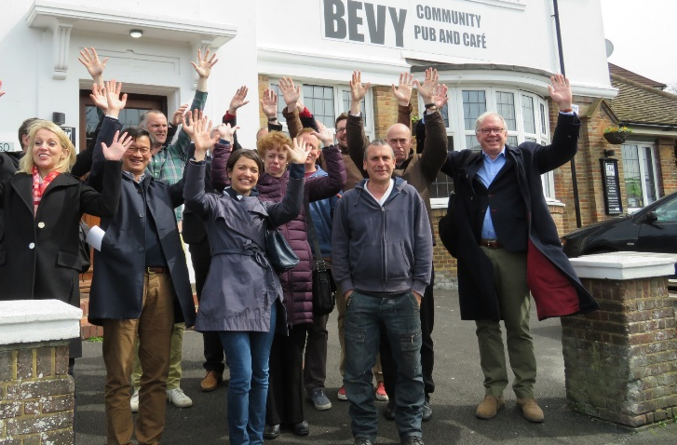
A business run by local people for local people.
Locally rooted
Accountable to the local community
Trading for the benefit of the local community
Broad community benefit

Slide 7
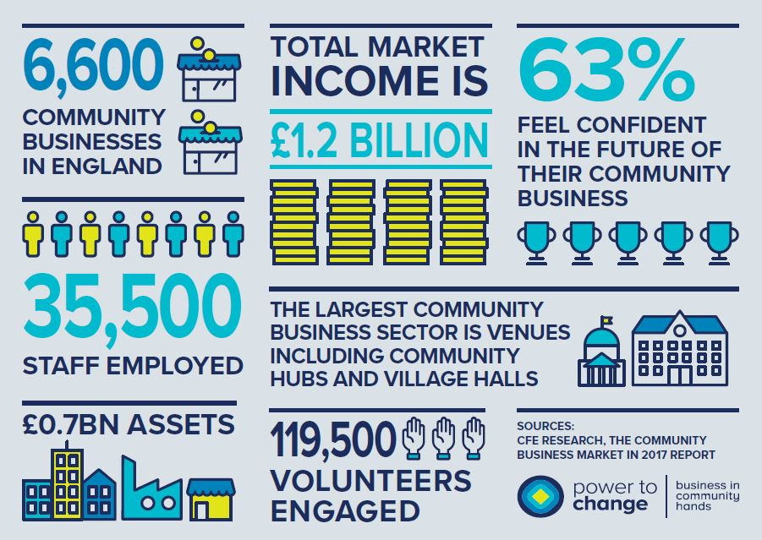

Slide 8
Community business in North East

Slide 9
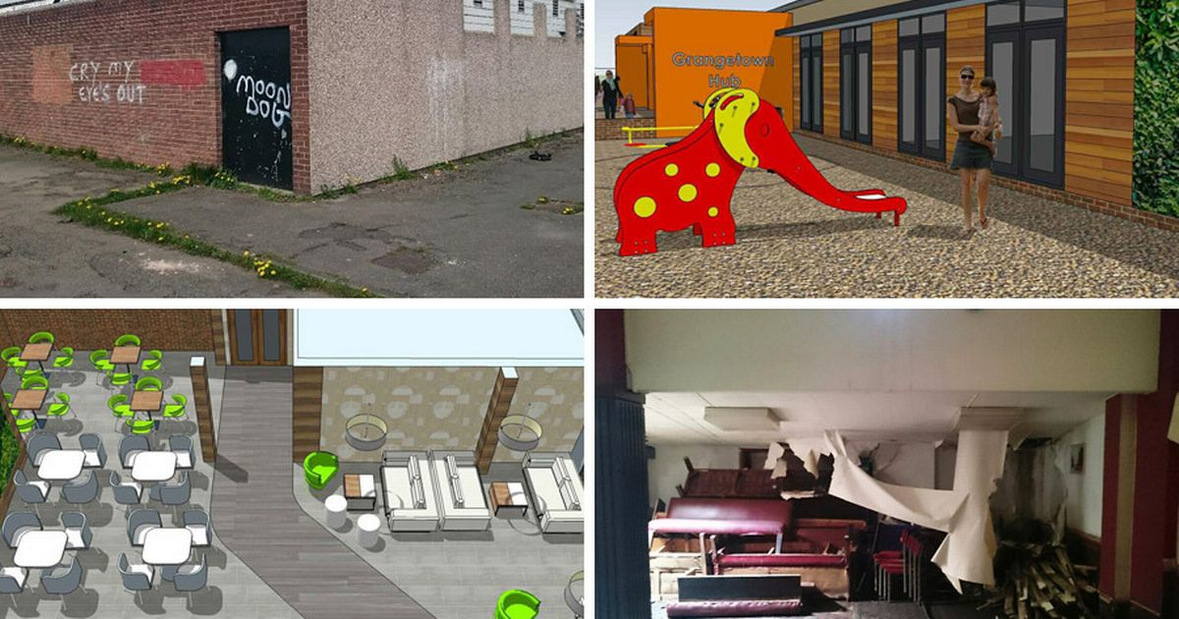
Future Regeneration Grangetown

Slide 10
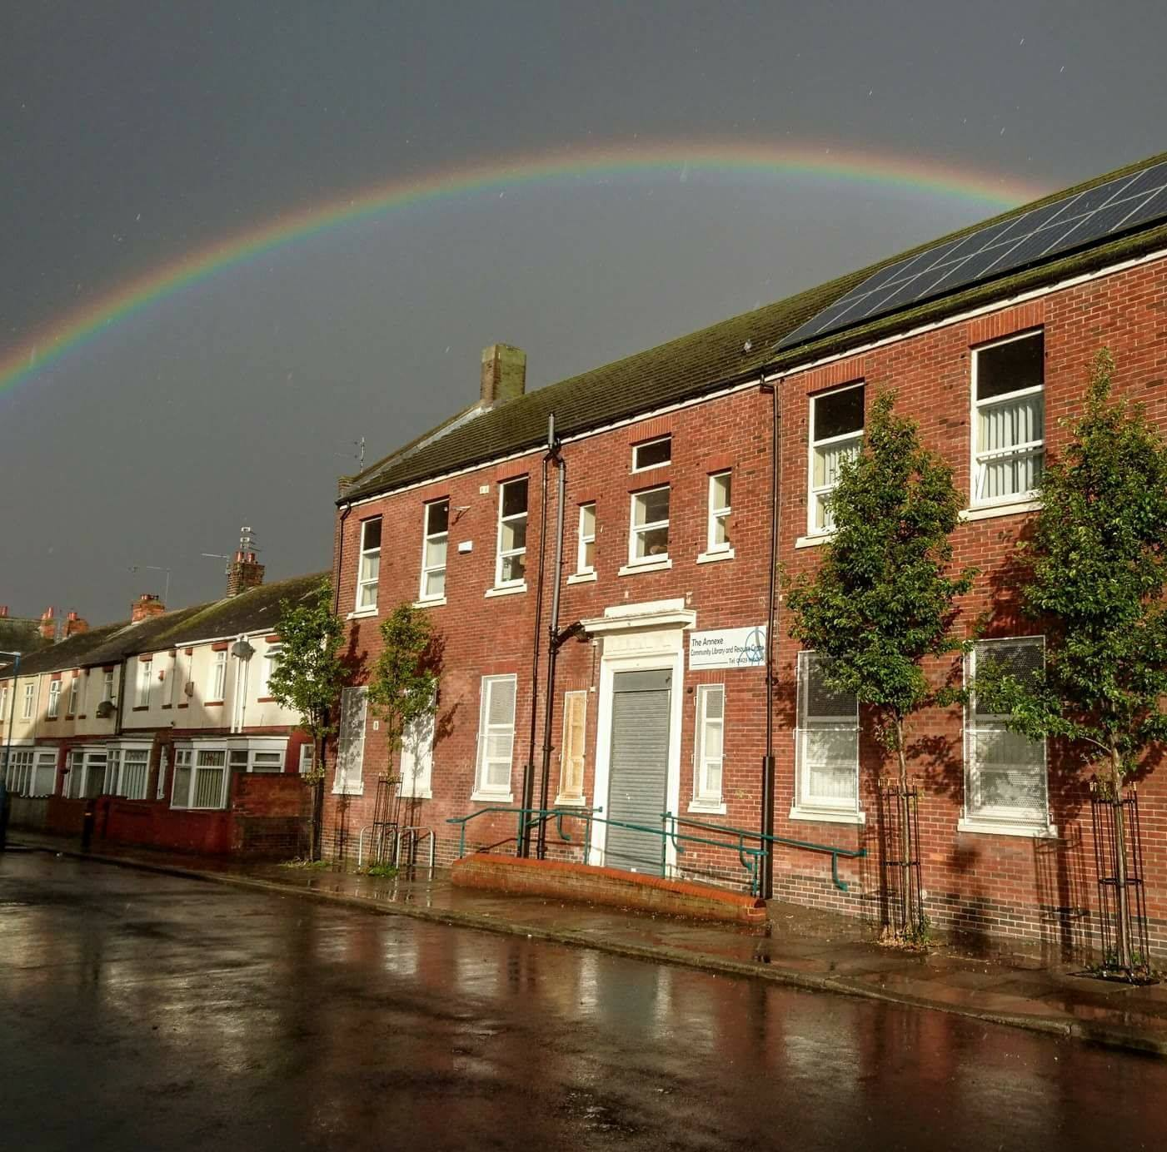
Wharton Trust- Hartlepool Community Catalyst

Slide 11
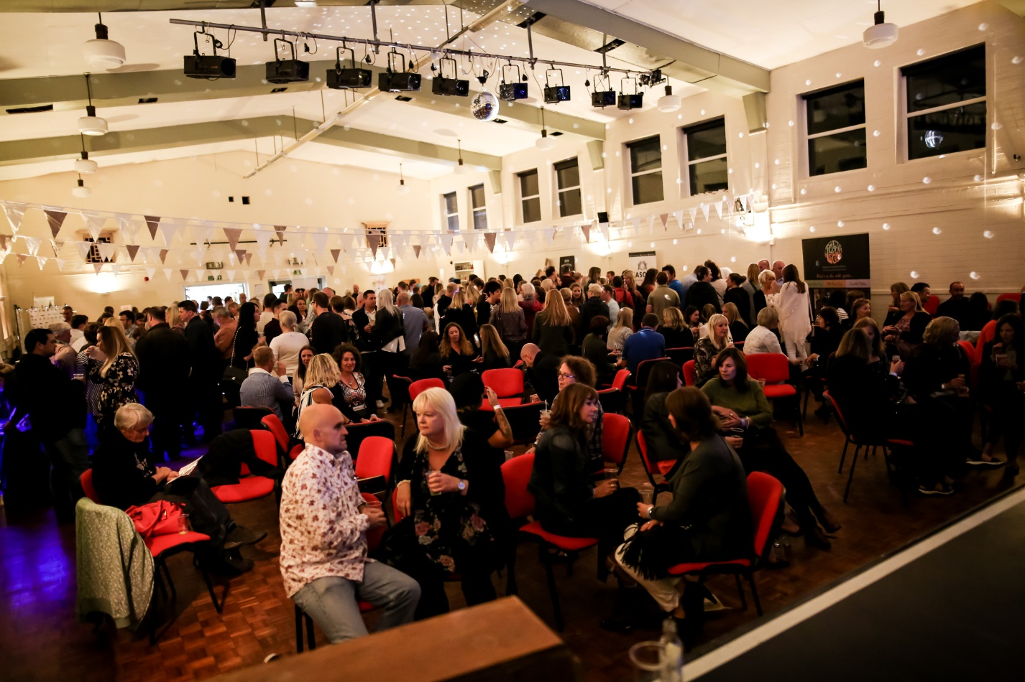
Linskill and North Tyneside community development trust

Slide 12
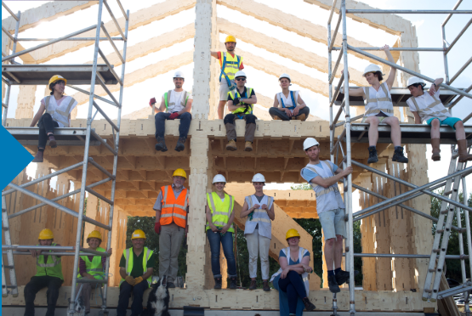
Community-led housing in Tees Valley

Slide 13
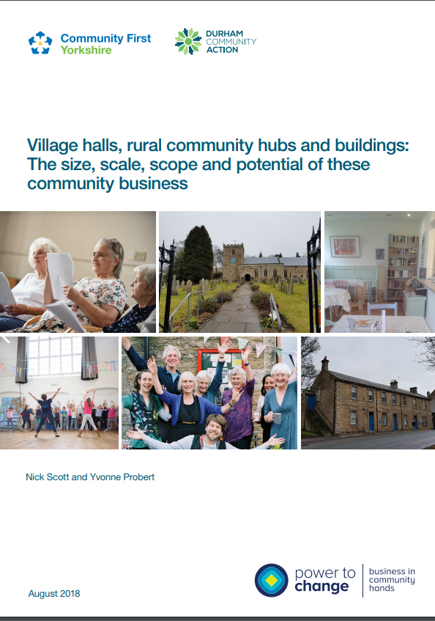
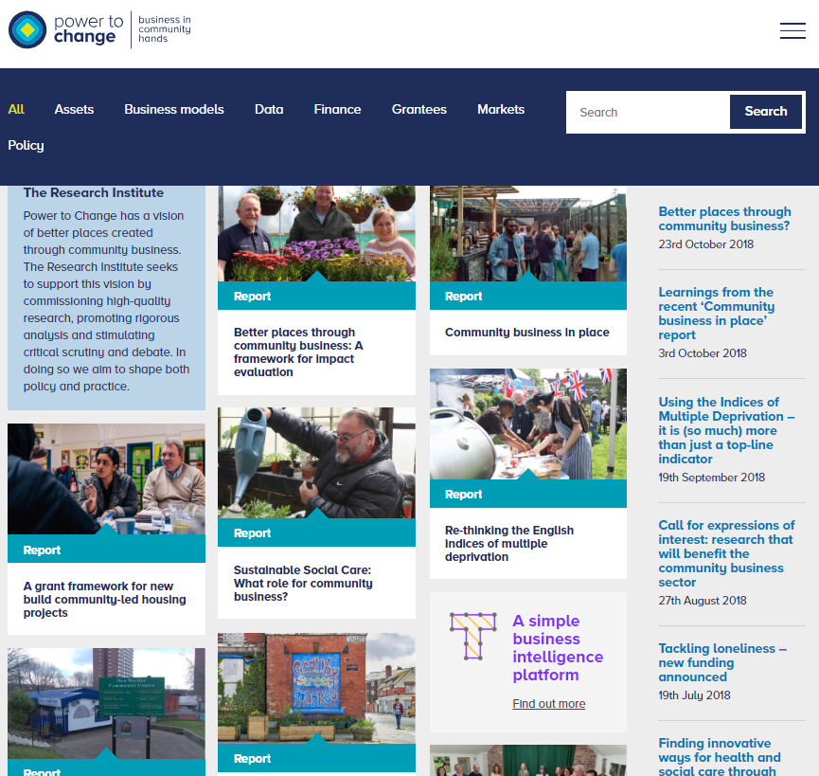
Research

Slide 14
Where next?

Slide 15
Thank you
Please contact:
suzannep@powertochange.org.uk

