Slide 1


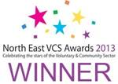

Framing the relationship between public authorities and civil society to effect successful approaches to integration across the North East
Georgina Fletcher, Chief Executive, Regional Refugee Forum North East
With Alison Holland, WCMT Fellow 2017 and Darlington Assistance for Refugees
and Chris Ford, Independent researcher and analyst
Presentation at Institute for Local Governance Seminar 21/09/18
‘Approaches to the Settlement of Refugees and Migrants in Northern England:
Interactions between communities, public authorities and the 3rd Sector’.

Slide 2
Current Policy Window
Widening Dispersal to more Local Authority areas
North East Migration Partnership set up late 2014
Syrian Vulnerable Persons Resettlement Programme hosted by Local Authorities since late 2015
Integrated Communities Strategy. Green Paper. March 2018 MHCLG
  New RASI unit formed (Resettlement, Asylum Support and Integration) focused on developing Refugee Integration Strategy
  Pilots being trialled
    LAASLO (Local Authority Asylum Support Liaison Officers)
    Place based approach
Civil Society Strategy. August 2018 DCMS
The Public Services (Social Value) Act 2012 and Brexit

Slide 3
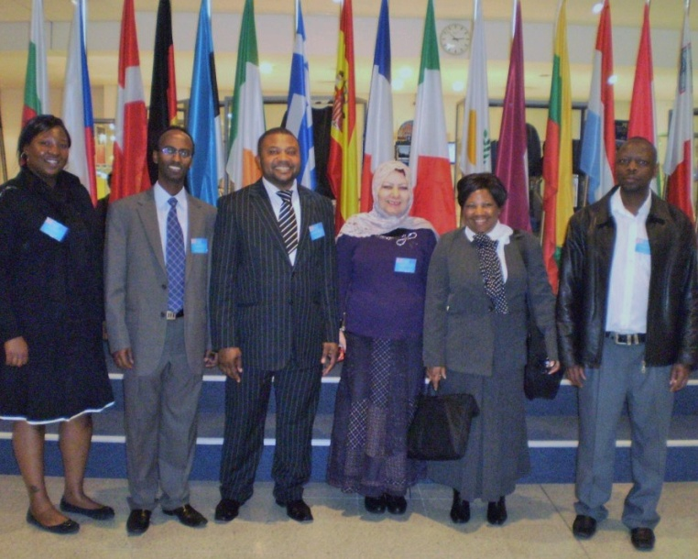
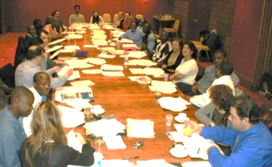




Foundations for an effective integration strategy
‘A Trans-national Network: Hearing the voices of Refugees in Policy and Practice in the European Union’ for the European Commission. NERS, January 2001

Slide 4
Foundations for an effective integration strategy
‘A Trans-national Network: Hearing the voices of Refugees in Policy and Practice in the European Union’ for the European Commission. NERS, January 2001
A central finding identifies that current policy initiatives and resources are primarily focused on the ‘mechanical’ and instrumental aspects of integration to the exclusion of ‘organic’ processes.
Any strategy that is based on a reduction of the definition of integration to its mechanical aspects will not be effective in promoting integration in the fullest sense of its meaning
Unpacking the concept of integration from the perspective of refugees.
It means…
Belonging, union, mixing, gathering, getting together, incorporating, inclusion, becoming part of, completeness, being a real member of society, being active in the community, the ability to interact, to socialise, to participate in a society that is unfamiliar, feel comfortable within the community, to be regarded as human beings, as brother and sisters
The project has identified critical factors in operationalising ‘organic’ integration, which would promote opportunities for reciprocity and active citizenship within local communities

Slide 5
Foundations for an effective integration strategy
‘A Trans-national Network: Hearing the voices of Refugees in Policy and Practice in the European Union’ for the European Commission. NERS, January 2001
Integration, in the fullest sense of the refugee self-definition, must necessarily be a two way process in practice, with intrinsic roles and responsibilities for both refugees and the host community. It is critical that real involvement of both refugees and the host society is engaged
However, the voiced experience of refugees also shows that they are the weakest resourced party to the integration process. They are a wasted resource through lack of practical empowerment to apply their expert knowledge and to use their skills as active agents in the process of their own integration. Their experiences are more typically of objectification and exclusion in the process.
In practice, while refugees are seen as one half of the equation in the two way process of integration, in reality they are not practically enabled and empowered to perform their part.

Slide 6
Foundations for an effective integration strategy
‘A Trans-national Network: Hearing the voices of Refugees in Policy and Practice in the European Union’ for the European Commission. NERS, January 2001
Evidence shows that those who are the target beneficiaries of a policy must be a part of the process through which they receive those benefits in order for that policy to be effective. The inclusion of refugees in integration processes should be recognised as integral to Best Value rather than framed in terms of added value
Evidence shows that integration does not happen on its own. It must be policy driven
Those who search for Good Practice in integration should recognise that Good Practice lies in Process itself. Inclusion derives from a process that is itself inclusive.

Slide 7
Emerging policy 2018
Integrated Communities Strategy Green Paper. March 2018 MHCLG
For generations we have welcomed immigrants to the UK but left them to find their own way in society while leaving host communities to accommodate them and the growing diversity of our nation’ Dame Louise Casey (2016). ‘The Casey Review into Opportunity and Integration’
Many recent migrants have ample opportunity through their work or study or through their everyday life to mix with people and speak English, and will integrate quickly and successfully. However some migrants may lack those opportunities, including some people qualifying for international protection, including refugees.
Our expectation that people who come to live in this country will strive to integrate must be coupled with providing them with the opportunities , expectations and the environment to enable them to do that successfully
For integration to be truly successful we must recognise it is a shared endeavour
Integration is a shared responsibility and is a two way process between migrants and their local communities

Slide 8
Emerging policy 2018
Integrated Communities Strategy. Green Paper March 2018 MHCLG
Integration will not happen on its own. It needs to be policy driven
Requires targeted interventions to support new arrivals
Social integration needs to be supported and planned
‘Meaningful social mixing’ – a deliberate and methodical approach to bolstering social integration
Recognising the benefits that integration activities have had for (resettled refugees), we will work with civil society and others to increase the integration support available to those recognised as refugees after arrival in the UK
Explore what more can be done to assist volunteers supporting refugees to integrate in the UK
Local government should take a ‘whole council’ approach to integration, mainstreaming integration objectives across policy and service delivery

Slide 9
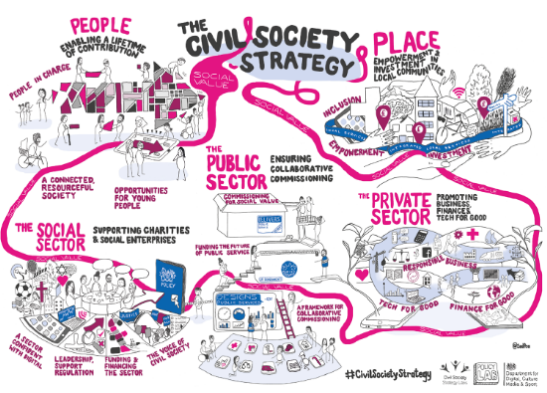
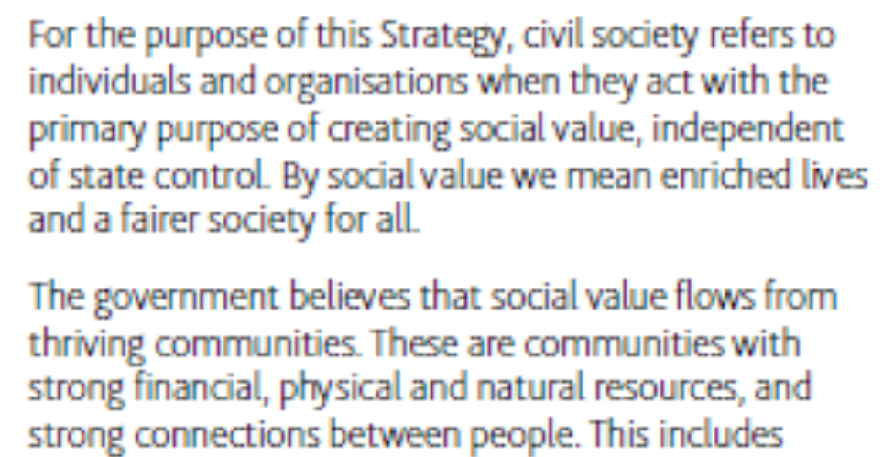
Emerging policy 2018
Civil Society Strategy: Building a future that works for everyone. August 2018 DCMS
Sees People as one of the 5 foundations of social value
Recognises the role that civil society has in tackling some of today’s greatest challenges, and the need to make sure it is involved in developing new solutions.
A vision of collaborative commissioning and working. All the resources of a community need to be deployed to tackle the community’s challenge
Notes civil society advice that ‘the strategy should not be focused on what the government thinks the sector should do…instead (it) should set out how the government can support and enable civil society to achieve its potential’

Slide 10




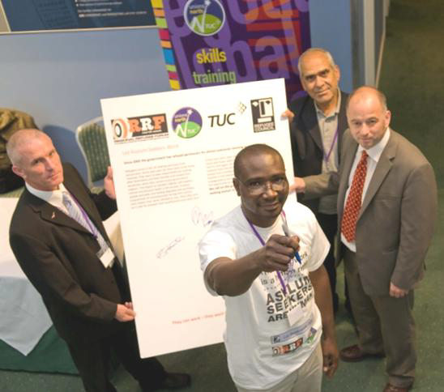
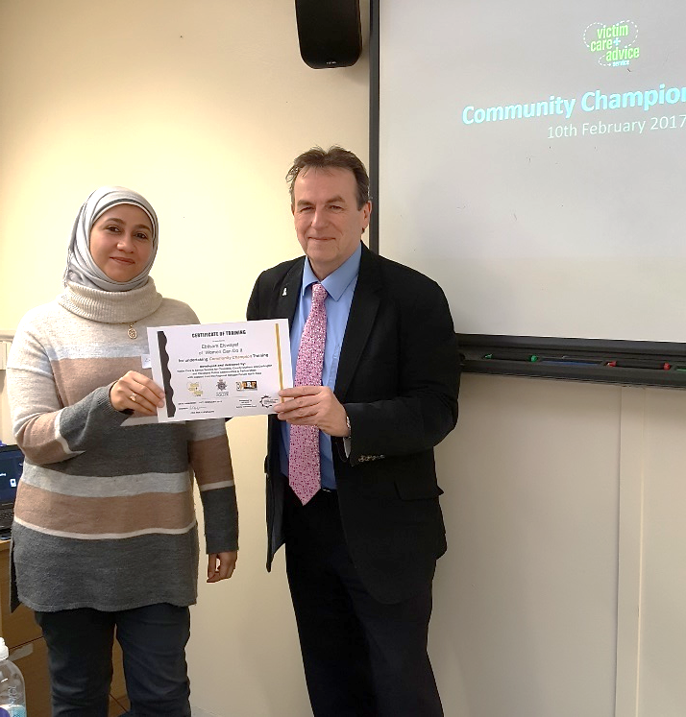
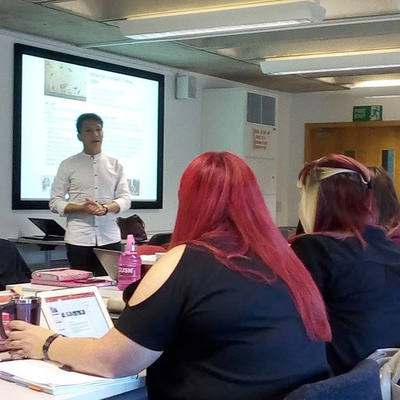
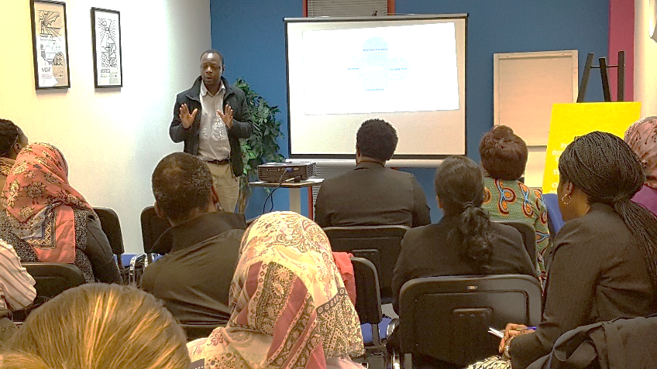
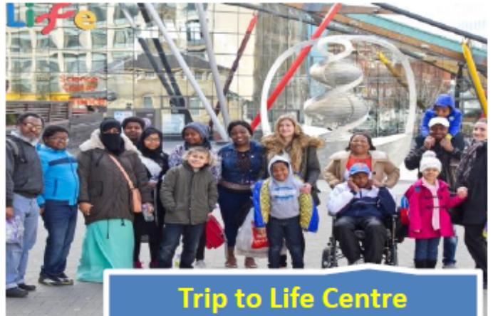
Empowering refugees to be actors
in integration?
Some examples of what can go wrong:
VCS relations
Local Authority relations

Slide 11

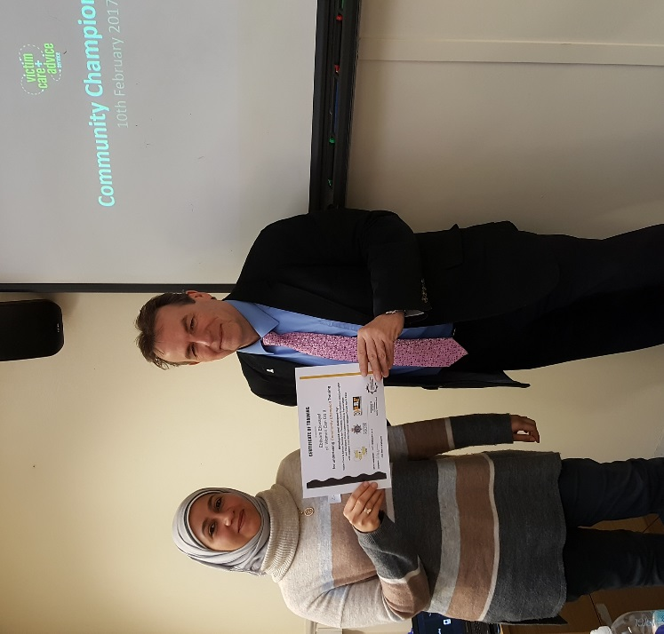
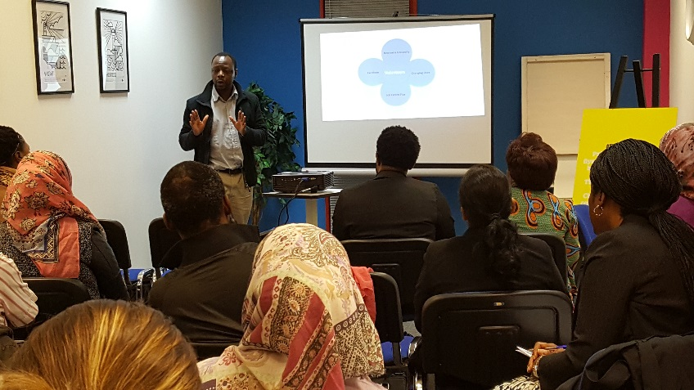
Empowering refugees to be actors
in integration?
“Coming here as an asylum seeker I’ve lost my voice. From working as a journalist on state television, I feel trapped in a system that doesn’t allow us to use our skills and commitments. The community are expecting me to help them in their everyday lives and raise issues that affect them, because they don’t have the confidence themselves. But I don’t know what path to take”
Some examples of what can go wrong:
VCS relations
Local Authority relations

Slide 12
Asset Based Community Development (ABCD)
‘Building Communities from the Inside Out: a path towards finding and mobilising a community’s assets’ McKnight and Kretzmann. Institute for Policy Research 1993 (USA)
1. The Traditional path: focused on a community’s needs, deficiencies and problems
Focuses on ‘needs-mapping’
Leads to ‘Deficiency orientated policies and programmes’
People obscured by a ‘wall of needs’
Results in ‘Needs-Driven Dead End’

Slide 13
Asset Based Community Development (ABCD)
‘Building Communities from the Inside Out: a path towards finding and mobilising a community’s assets’ McKnight and Kretzmann. Institute for Policy Research 1993 (USA)
1. The Traditional path: focused on a community’s needs, deficiencies and problems
Focuses on ‘needs-mapping’
Leads to ‘Deficiency orientated policies and programmes’
People obscured by a ‘wall of needs’
Results in ‘Needs-Driven Dead End’
2. The Alternative path: focused on a community’s assets
‘insists on beginning with a clear commitment to discovering a community’s capacities and assets’
‘Asset-based, internally focused, relationship driven’
A process:
  Map the assets
  Then mobilise them – through an asset-based community development process

Slide 14
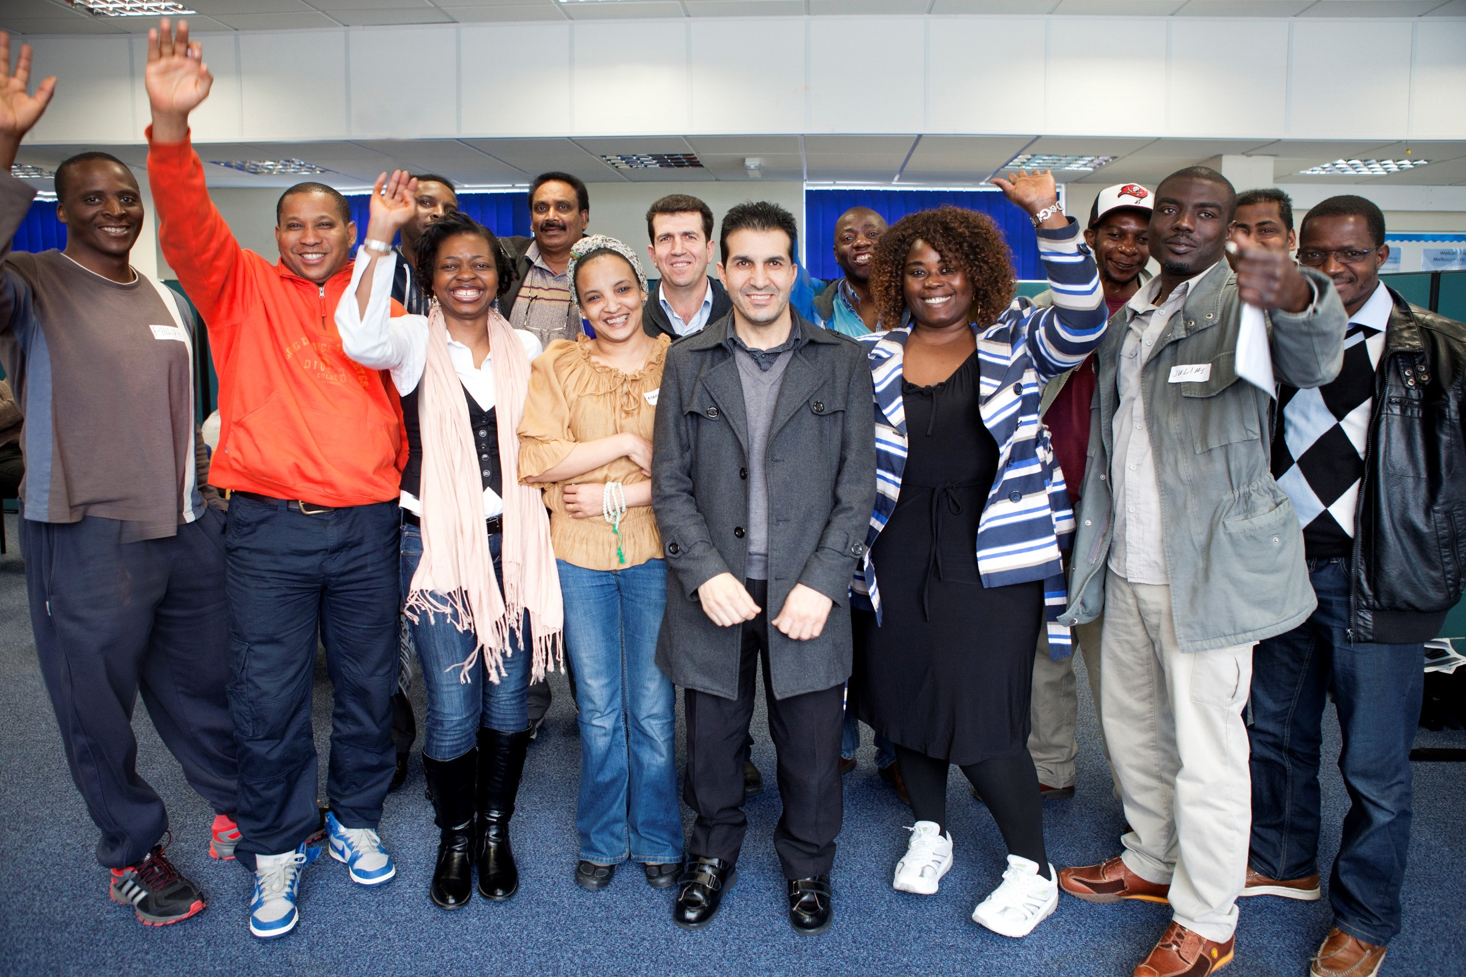
Empowering Community Mobilisers
Be ready! – have a plan that supports asset building
  how you will respond
  what support you / your organisation can give
  referral pathways
Be positive, listen, embrace the idea, be encouraging, be respectful. Let go of the ‘single portal’ notion
Peer learning opportunities
Training: customer advocacy
Messenger as important as the message
Build into local Refugee Integration Strategies
Spirit of collaboration, complementarity, partners
Notes:
Mediating and cascading new and accurate information

Slide 15


Framing the Relationship: Learning from Voluntary Organisations in Germany and Sweden
Alison Holland
WCMT Fellow 2017

Slide 16
Outline
Background
Partnership
Reciprocity and Equality, Agency and Autonomy
Integration and Employment
Conclusion

Slide 17
Winston Churchill Fellowship
Stockholm and Uppsala, June 2017
Berlin, September 2017
44 voluntary organisations working with newcomers, including Syrian refugees
To investigate best practice

Slide 18
Partnership

Slide 19
Relationships
Reciprocity and equality
Agency and autonomy
Interaction
  Ministry of Invitations
  Buddy Sweden
Self-help
  LouLou meeting point for old and new neighbours
  ABF (Arbetarnas bildningsförbund), WEA

Slide 20
Integration and Employment
Orientation
  Exchange and exploration
The Pathway to employment
  Voluntary organisations
    Work shadowing and mentoring
  Employment Office
    Collaboration
The wait for leave to remain

Slide 21
To sum up…
Relationships
Empowerment

Slide 22
My full report can be found on the Winston Churchill Memorial Trust website at:
https://www.wcmt.org.uk
Just search under my name: Alison Holland

Slide 23
Framing Relationships in Terms of Social Value
Chris Ford
Independent researcher and analyst
Notes:
Some thoughts about the process of how we go about deploying resources to do the sort of work outlined by Georgina and Alison.

Slide 24
Starting to think about how…
Public
Of or concerning the people as a whole
Done by or for, representing, the people
Social
Living in companies or organised communities, gregarious…
Concerned with the mutual relations of (classes of) human beings
Notes:
These definitions from Concise OED.
Important differences between public/social – and - values(s)/good(s)/benefit. Perhaps echoing civic/civil distinction. All these words are often used interchangably. And even when using same words we often mean different things. I’m focusing on the second meaning of social in the slide – its about reciprocity, mutuality – see above.

Slide 25
Three assumptions
Grantmaking Tango: Issues for Funders, Julia Unwin, Baring Foundation, London 2004
“That a strong civil society will contain the means to enable organisations to grow and develop independently and that funding systems need to support and not frustrate this development.
That those making grants, whether as their core activity or as a means of delivering some of their objectives, have an interest in doing this effectively.
That the nature of the relationship between the funder and the funded body will have an impact on the effectiveness of both organisations.”
Notes:
Written before Unwin joined Joseph Rowntree Foundation.
I think these assumptions are true – and useful to be aware of (rest of doc has useful stuff as well! – next slide)

Slide 26
Three different intended impacts are identified:
maintenance of services and activities.
build organisations.
systems change.
Three different funding styles:
giving
shopping
investing
Notes:
Focused on grant making trusts but much of the material is relevant to, and some addressed to, statutory organisations.
These distinctions not clean – theres overlap etc – but second set of bullets = useful metaphor

Slide 27
Social Value
“By social value we mean enriched lives and a fairer society for all” Civil Society Strategy: Building a future that works for everyone August 2018 DCMS
Social value is “the benefit to the community from a commissioning/procurement process over and above the direct purchasing of goods, services and outcomes”.
http://www.socialvaluehub.org.uk/
Notes:
Social value is very fashionable.
In civil society strategy is close to meaningless.
Hub is worth being aware of – probably best place to get info about the PS(SV)Act – including Durham CC
But theres a lack of intellectual heft around social value (especially compared with Public benefit, value etc). Honorable exceptions include some work at Third Sector Research Centre (birmingham univ) and ‘Buying Social Justice’ by Christopher McCrudden – interesting he was involved in negotiations with Europe over the social chapter

Slide 28
Public Services (Social Value) Act 2012
(3)The authority must consider—
(a)how what is proposed to be procured might improve the economic, social and environmental well-being of the relevant area, and
(b)how, in conducting the process of procurement, it might act with a view to securing that improvement.
Notes:
Theres an anorakish procurement argument (I’ve got a worryingly large wardrobe of these) here that says PSSV Act does very little - beyond promoting some awareness.
Clause 3 is the key one and we can ‘consider’ things in neural twitches and then move on.
If public sector want to do this stuff, can do it anyway – in procurement a key test is whether the requirement is relevant and proportionate – seems fairly easy to meet if its about relational, reciprosity.
Separately theres something interesting and difficult here: How can we use a transactional process to get a relational product?
Also, perhaps grasping at straws, but post brexit there may be an opportunity to reframe the whole architecture of public sector procurement ….

Slide 29
Deep Value
A literature review of the role of effective relationships in public services. Kate Bell and Matthew Smerdon, Community Links, London 2011
Deep Value: “the value created when the human relationships between people delivering and people using public services are effective.”
Lit review focused on role of effective relationships in employment services, education, health and legal advice
Notes:
If interested in the social (see my first slide, second meaning) in public service provision then this document is useful and interesting.
Following slides are the report headings from the summary – in case you’ll not get a chance to look at it!

Slide 30
Headings from Document Summary
People using public services put great importance on the human relationship with the person providing the service.
The elements of what make for effective relationships are strikingly similar across all areas studied in this review: Understanding, Collaboration, Commitment, Communication, Empowerment, Time [see final slide]
Where relationships are effective, they contribute to achieving a range of valuable benefits: the failure to realise these benefits can be damaging.
Notes:
‘Time’ – quote in final slide comes from this section

Slide 31
There was a clear consensus in the literature about the types of working conditions and practices which were more conducive to building effective relationships.
We conclude that the literature shows that effective relationships are not just a ‘nice to have’ but increase the likelihood of achieving a positive outcome across all of the sectors examined in this review.
This conclusion has some clear implications:
- Effective relationships are not an added extra but are core to the delivery of effective services…

Slide 32
“The effectiveness of relationships is therefore dependent on both parties taking responsibility. Delivering and securing good public services is something of a mutual endeavour and one in where (sic) the citizens’ relationship with the state is established. …”
Notes:
So, if we are interested in the settlement of newly arrived people paying attention to relationships seems relevant ; especially where establishing identity as a citizen is part of the job. If we are going to ‘buy’ (unwin) this provision – who we buy it from and what we concentrate on in the procurement seems important. while it certainly doesn’t end the conversation (eg what does evidencing delivery look like?... ) maybe ‘deep value’ is a way of thinking about this that is helpful.

Slide 33
Thanks for listening
Georgina Fletcher
E: georgina.fletcher@refugeevoices.org.uk
M: 07918765480 www.refugeevoices.org.uk
Regional Refugee Forum North East
Alison Holland E: alisonholland22@gmail.com
Chris Ford E: chrisford@gmx.co.uk
M: 07435 333 436 5 Dales Terrace, Stanhope, Co Durham. DL13 2XH

