Slide 1

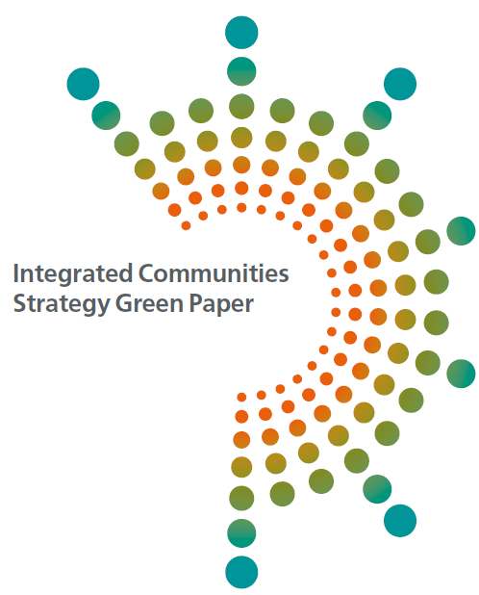
The Integrated Communities Strategy Green Paper
Institute of Local Governance
September 2018

Slide 2


The Green Paper
Whole Government commitment to improve Integration outcomes for all
Response to Casey but also other evidence e.g. Race disparity audit, Lammy, McGregor Smith, APPGs etc.
Consultation (March to June 18)
An opportunity to grasp the nettle
Addressing inequalities and cohesion

Slide 3
The Challenge
Britain is a great place to live and is a well-integrated society on the whole. However, we cannot ignore the fact that in too many parts of our country communities are divided.
Few opportunities for people to mix
Mistrust and misunderstanding to grow,
Increase in hate crime and division
Greater disparity in socio-economic outcomes.

Slide 4
The Vision
We define integrated communities as communities where people - whatever their background - live, work, learn and socialise together, based on shared rights, responsibilities and opportunities.

Slide 5
Drivers of poor integration
Factors linked to integration/ lack of integration
1.
Level and pace of migration
2.
School segregation
5.
Under and un-employment
4.
Residential segregation
3.
English language proficiency
6. Personal, religious and cultural values and attitudes
7.Social mixing

Slide 6
Key proposals
Establish a new Innovation Fund
Develop an area based programme
Strengthen Leadership
Supporting the integration of migrants
Education and young people

Slide 7
Boost English Language
Residential segregation and building strong community spaces
Increasing economic opportunity
Rights and freedoms
Evaluation to learn and share what works

Slide 8
Supporting New Migrants and Resident Communities
We want all people who come from outside the UK and wish to settle lawfully in this country to play a full part in our society and to make the most of the economic and social opportunities available to them. Local resident communities share a responsibility for the effective integration of recent migrants.

Slide 9
Supporting New Migrants and Resident Communities
To support newly arrived migrants to integrate and improve communities’ ability to adapt to migration, we will:
review the impact of English language requirements on visas,
review the Life in the UK test and whether it could be amended to strengthen its focus on the values and principles of the UK
consider providing information to prospective migrants before they arrive in the UK, to give them a clear expectation about life in modern Britain, including our laws, norms and standards;
provide a package of information for recent migrants in the Integration Areas to test what is most helpful to support them to integrate into their communities and to build an understanding of life in the UK;
work with civil society and others to increase the integration support available to help refugees overcome the barriers to integration.

Slide 10
Progress to date
Area based programme established
Innovation fund launched
English language co-ordination fund launched
English Language Fund launched
Evaluation partners identified
Joint Home office/MHCLG unit established looking at opportunities/experience on refugee and asylum seeker settlement
Controlling Migration Fund launched
COIN (Cohesion and Integration Network)

Slide 11
Contact Details
IntegrationStrategy@communities.gsi.gov.uk
Amria.khatun@communities.gsi.gov.uk

