Slide 1
The Voluntary, Community & Social Enterprise (VCSE) Sector’s Role in Supporting Health & Wellbeing & New Models of Funding
Jane Hartley Chief Executive VONNE

Slide 2
Health Inequalities
Due North: Independent Inquiry into Health Equity for the North
Health Inequalities due to differences between socioeconomic groups in poverty, power and resources needed for health
Those who have less influence are less able to affect the use of public resources to improve their health and well-being
Notes:
August 2014

Slide 3

Joint review of role of the VCSE sector in improving health, wellbeing and care outcomes & partnerships
Department of Health, Public Health England, and NHS England

Slide 4

The VCSE supporting health & wellbeing and tackling inequalities
No wrong door -The sector’s strength lies in its holistic, community-embedded and personalised approaches.
Track record of trust – local people trust us!
VCSE organisations promote understanding of the specific needs of their communities.
Its diversity, flexibility and level of innovation helps it reach and support those hardest to engage
Builds emotional resilience and promotes self-care and independence
Facilitate asset based approaches and co-production
Expertise of lived experience in designing more effective, sustainable services
Notes:
Jane
These are the findings of Joint review of role of the VCSE sector in improving health, wellbeing and care outcomes & partnerships
Commissioned by the Department of Health, Public Health England, and NHS England in March 16
These stengths really help to support people who are often isolated and may face a lot of challenges

Slide 5
VCSE Supporting Prevention,
‘5 Ways to Wellbeing’ & Empowering Communities
Connect – supporting individuals to connect and engage, building social networks and social capital
Be Active – encouraging individuals to be physically active and active within their local communities
Take Notice – Supporting individuals to be more aware & building capacity to influence local decision making
Keep Learning – linking individuals into learning opportunities to improve their knowledge, skills and confidence
Give – Peer support & volunteering

Slide 6
Participation & Volunteering
Participation in a group cuts a person’s chance of dying in the next year by half, and joining two groups cuts the risk by 75 per cent. Putnam (2000)
Volunteering can improve the wellbeing of volunteers particularly those from most marginalised groups
People who volunteer spend 38% less time in hospital. Harvard School of Public Health

Slide 7
VCSE role in Health, Wellbeing & Care
‘VCSE sector has significant expertise that is invaluable in helping us achieve improvements across the health, social care and public health system’ Department of Health, NHS England and Public Health England
Support focus on early intervention, prevention & self care/management – NHS & LA (Care Act)
Key to NHS strategic shift - acute care > prevention, community based care & support & self management

Slide 8

VCSE organisations are integral part of the prevention agenda
Notes:
So to conclude
VCS can help
People and their families to help each other
prevent people having problems and the need for statutory services
Help people get the right support when they need it
Facilitating co-production and partnership with individuals and families
Promoting leadership among individuals and family carers
Work in partnership with specialist services , saving the system money
We need to be fully involved! We need to work together.

Slide 9

The challenges: the sector is struggling
More demand for services & support
Less money and fewer staff
National Living Wage
Activity not funded through contracts
Larger contracts
Gov Grant/EU programmes prohibitive to smaller orgs
Payment by results type contracts
Procurement process prohibitive
Notes:
Jane
There is strong evidence that charities are facing increased demand for services as well as a decline in resources.
Payment by Results type contracts prohibitive for smaller organisations from applying
Many of the activities the VCSE sector specialises in – such as engaging overlooked groups - not funded through contracts.
Drive to reduce costs – increase in large-scale provision & larger contracts.
Tender or procurement processes prohibitive to smaller organisations.

Slide 10
Developing services and policies together
Many small organisations are struggling to make links with and gain acceptance among local GPs and commissioners.
For health and wellbeing to be community-based and collaborative, statutory systems need to learn to work with the VCSE sector- large and small
Co-production requires “mutual respect between commissioners and VCSE organisations”

Slide 11

Social Investment & Social Prescribing

Slide 12
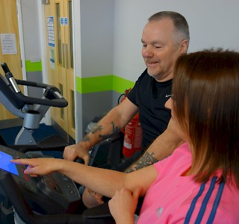
The cost of Long Term Conditions
30% of the population have a long term health condition.
They account for:
50% of all GP appointments
64% of outpatient appointments
70% of all inpatient bed days
70% of the total health and care spend in England
Source: Dept. of Health, Long Term Conditions Compendium of Information Third Edition 2012

Slide 13

Ways to Wellness provides help to people with Long term health conditions who live in the west of Newcastle upon Tyne
Non-medical ‘link workers’ help them to have better quality of lives and, as a result, to reduce the cost of their care to the NHS

Slide 14
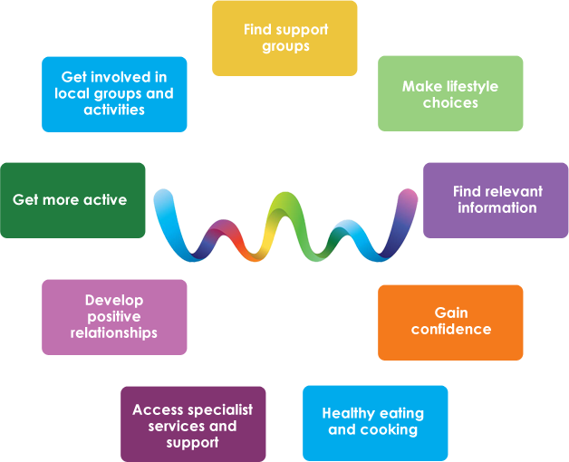
The Service
Link workers
Help people with non-medical lifestyle, emotional and practical matters that affect their health and wellbeing
On average support lasts for 21 months
Eligible conditions
COPD or Asthma
Diabetes (Type 1 or Type 2)
Heart Disease
Epilepsy
Thinning of the bones (osteoporosis)
Any of the above with depression and/or anxiety

Slide 15
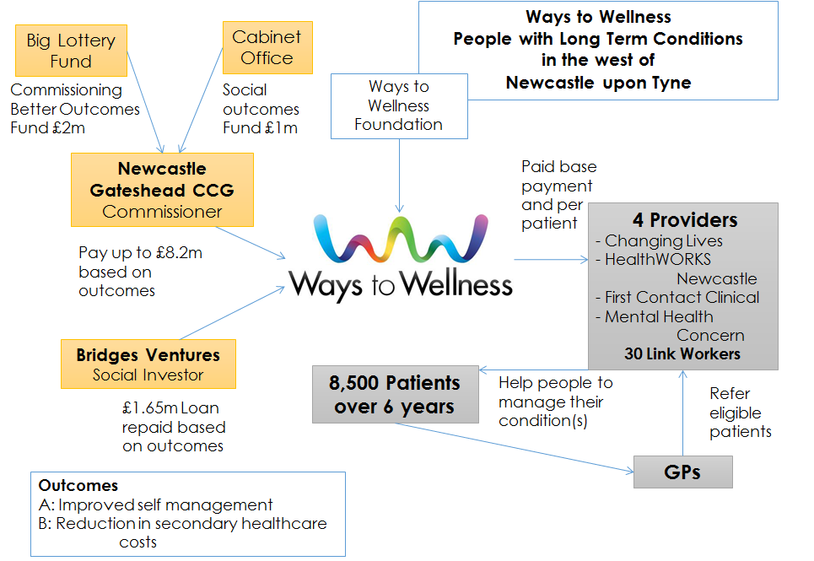

Slide 16
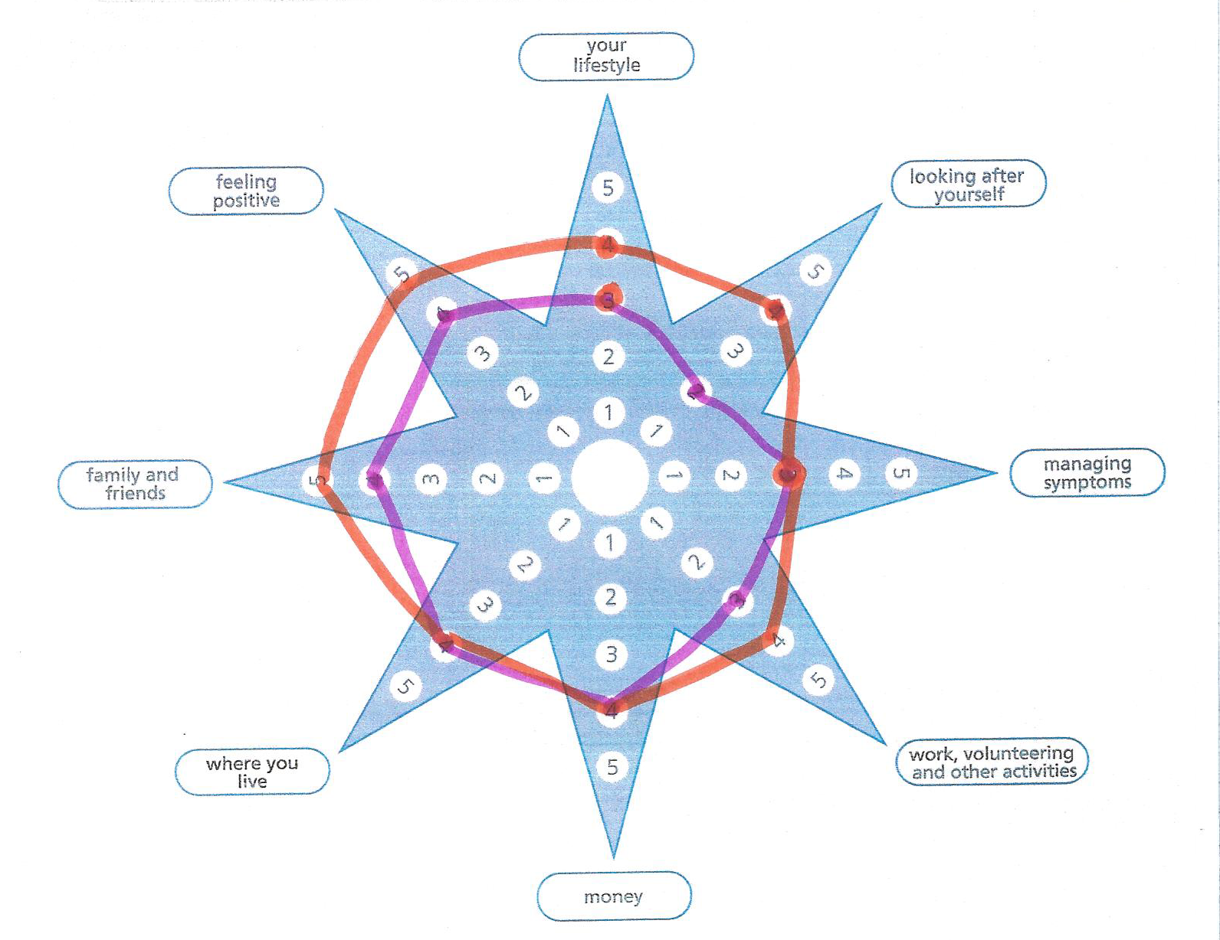
30% of outcome payments
Initial star and every 6 months
Average difference across the cohort
Notes:
£492.50 per patient
1.4 points 100% to 0.5 points 0%

Slide 17
Measuring Outcome B
70% of outcome payments
Cost of use of hospital services
  Planned and unplanned admissions
  Use of out-patient and A&E services
Measured using hospital episode data (HES)
Compared with a similar cohort in North and East Newcastle
Notes:
Max £332.50 per patient p.a. if there is a
22% reduction in secondary care costs
Providers payments not linked to this

Slide 18
Aligning risks and benefits
 | Risk | Benefit
Patient | Time, effort, bravery | Healthier, happier
GPs | New service Challenges medical model | Healthier happier patients A good service they can refer to
Providers | Low referrals = lose money Lack of long term engagement = lose money | Expand service Relationship with GPs Pioneering service = learning
CCG | Effort in development | Pioneers a service with minimal risk Reduces long term costs
Investor | Effort in development Service fails = lose money | Pioneering service and investment in a nationally replicable Financial return if it works well
BLF/CO | If it doesn’t work = waste of money | Important exemplar in health sector
Ways to Wellness | Effort in development It may not work | Social investment attracted development funds and made the deal possible by de-risking it

Slide 19
Successful New Referrals
Actual Successful New Referrals 1125
Target Successful New Referrals 1094
103%

Slide 20
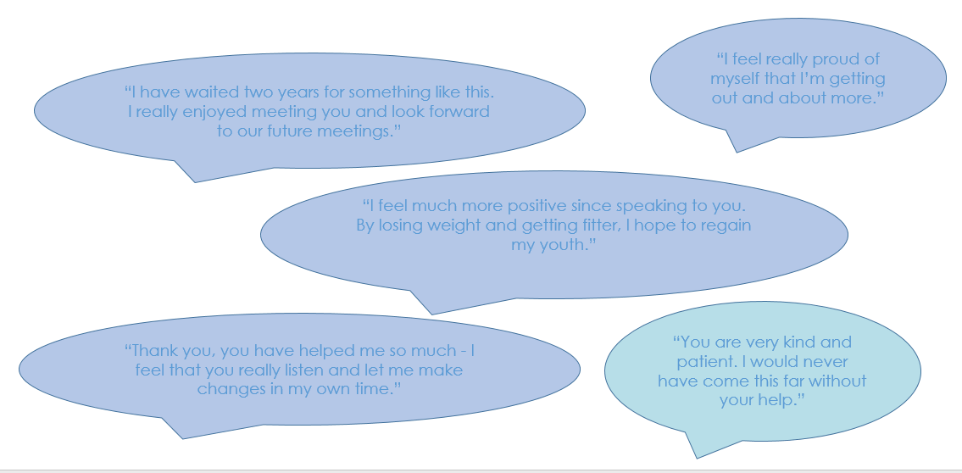
Patient Testimonials

Slide 21
The development of Ways to Wellness
It took a long time (4 years) and a lot of resource (£500,000, plus pro bono)
It concerns a national problem
It was rooted in many years of ‘pilot’ experience
It isn’t just about the money, but it is a lot about the money
Key strengths of the development team: Stick-ability, resilience, nerve, personal credibility, the right skills mix
Newcastle is a small place – well placed individuals
It was essential to understand clearly the drives, risks and benefits for each stakeholder: ‘to sit in their shoes’

Slide 22
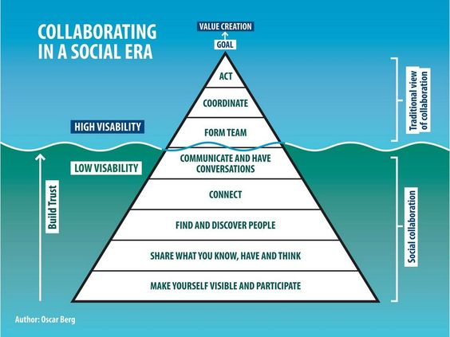
Notes:
This slide is about collaboration...
We are all used to
forming a team to achieve our goals –
we co-ordinate or plan our activity, then we act
What we need to do now to make collaboration work is all about talking to people who would not be in our team, connecting with each others, lots of others – sharing what you know and what you have....being visible and taking part. These are the things which we might do behind the scenes, and some people are very good at it.
Here it is called Social Collaboration, and of course social media can help....importantly it helps to build Trust which is something we really need to make Transforming Care happen.
This message works for all of us I think
It can be difficult for voluntary organisations to know who they should speak to about a programme of this size; and it can all seem very confusing and intimidating, where to spend valuable time when there are so many long and complicated meetings....and it can be difficult for commissioners and project team members to connect with such a range of varied organisations, when everyone is so busy, and how to find them, but I think we have to try and do more of this, as it is the only way the collaboration will work.

Slide 23

Jane.Hartley@vonne.org.uk
www.vonne.org.uk
www.waystowellness.org.uk

