Slide 1
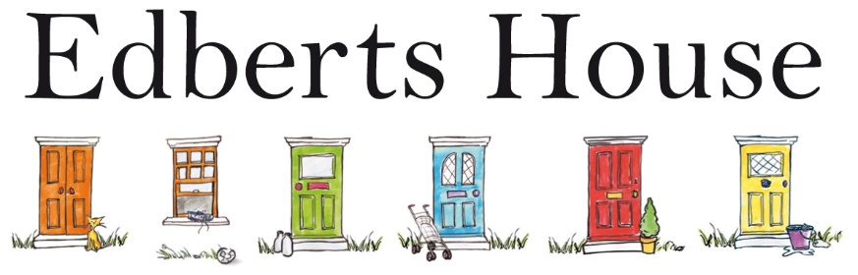

Slide 2
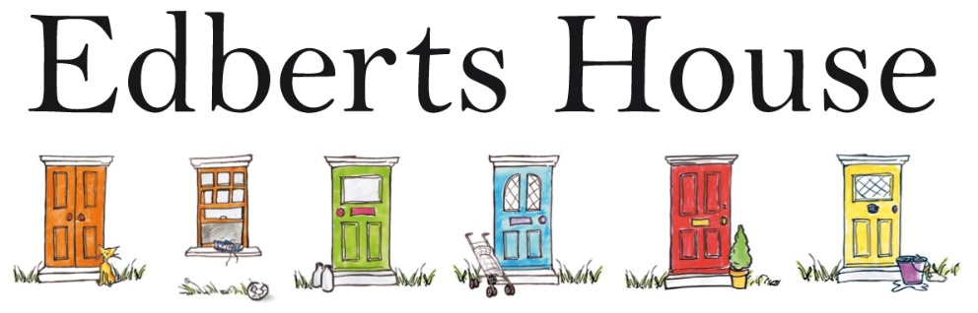
Managing 4 thriving community projects in East Gateshead
“Edberts House has made a real difference in our community, particularly supporting older people and the children. Edberts is good, because they are used to listening to people in the local community – they don’t just do what they want but they try to do what the community want."

Slide 3
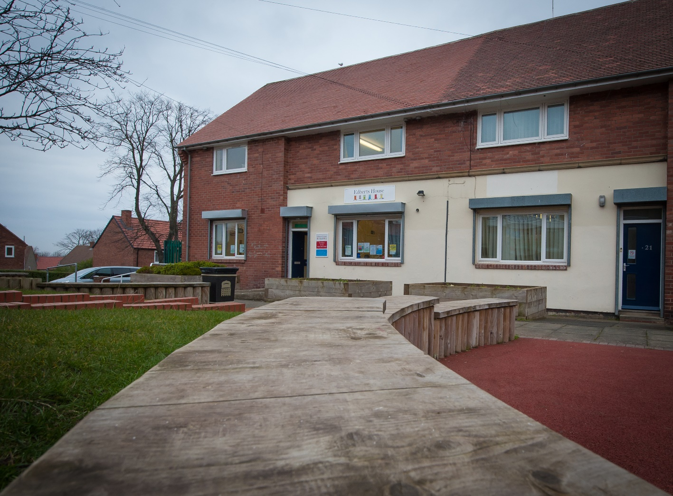
Edberts House on High Lanes

Slide 4
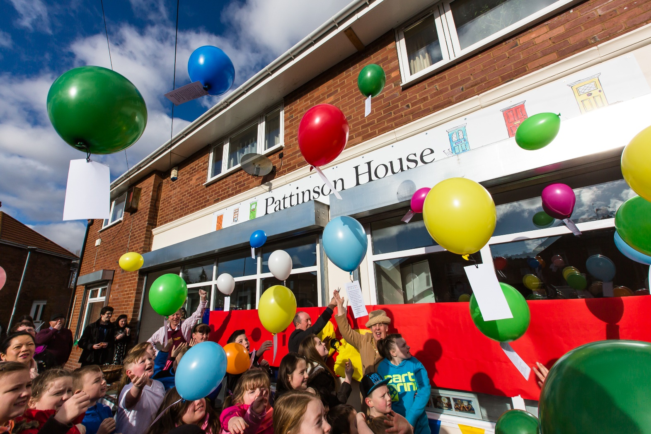
Pattinson House on Old Fold and Nest

Slide 5
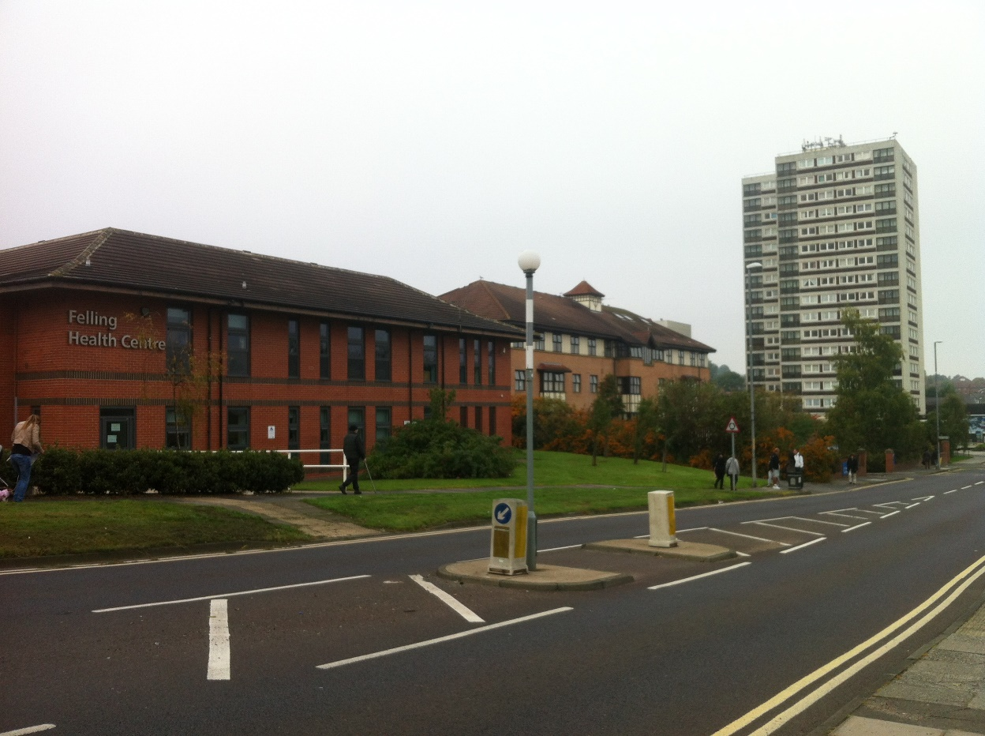
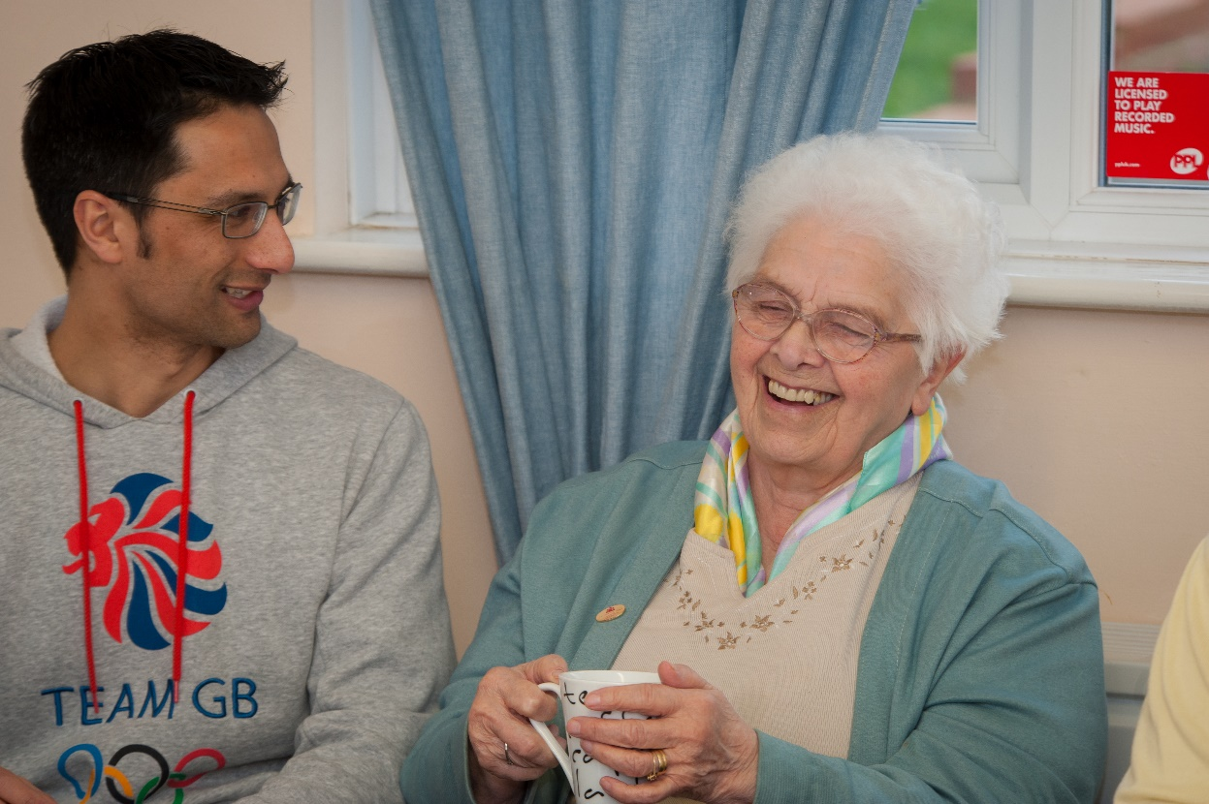
Community Linking Project

Slide 6
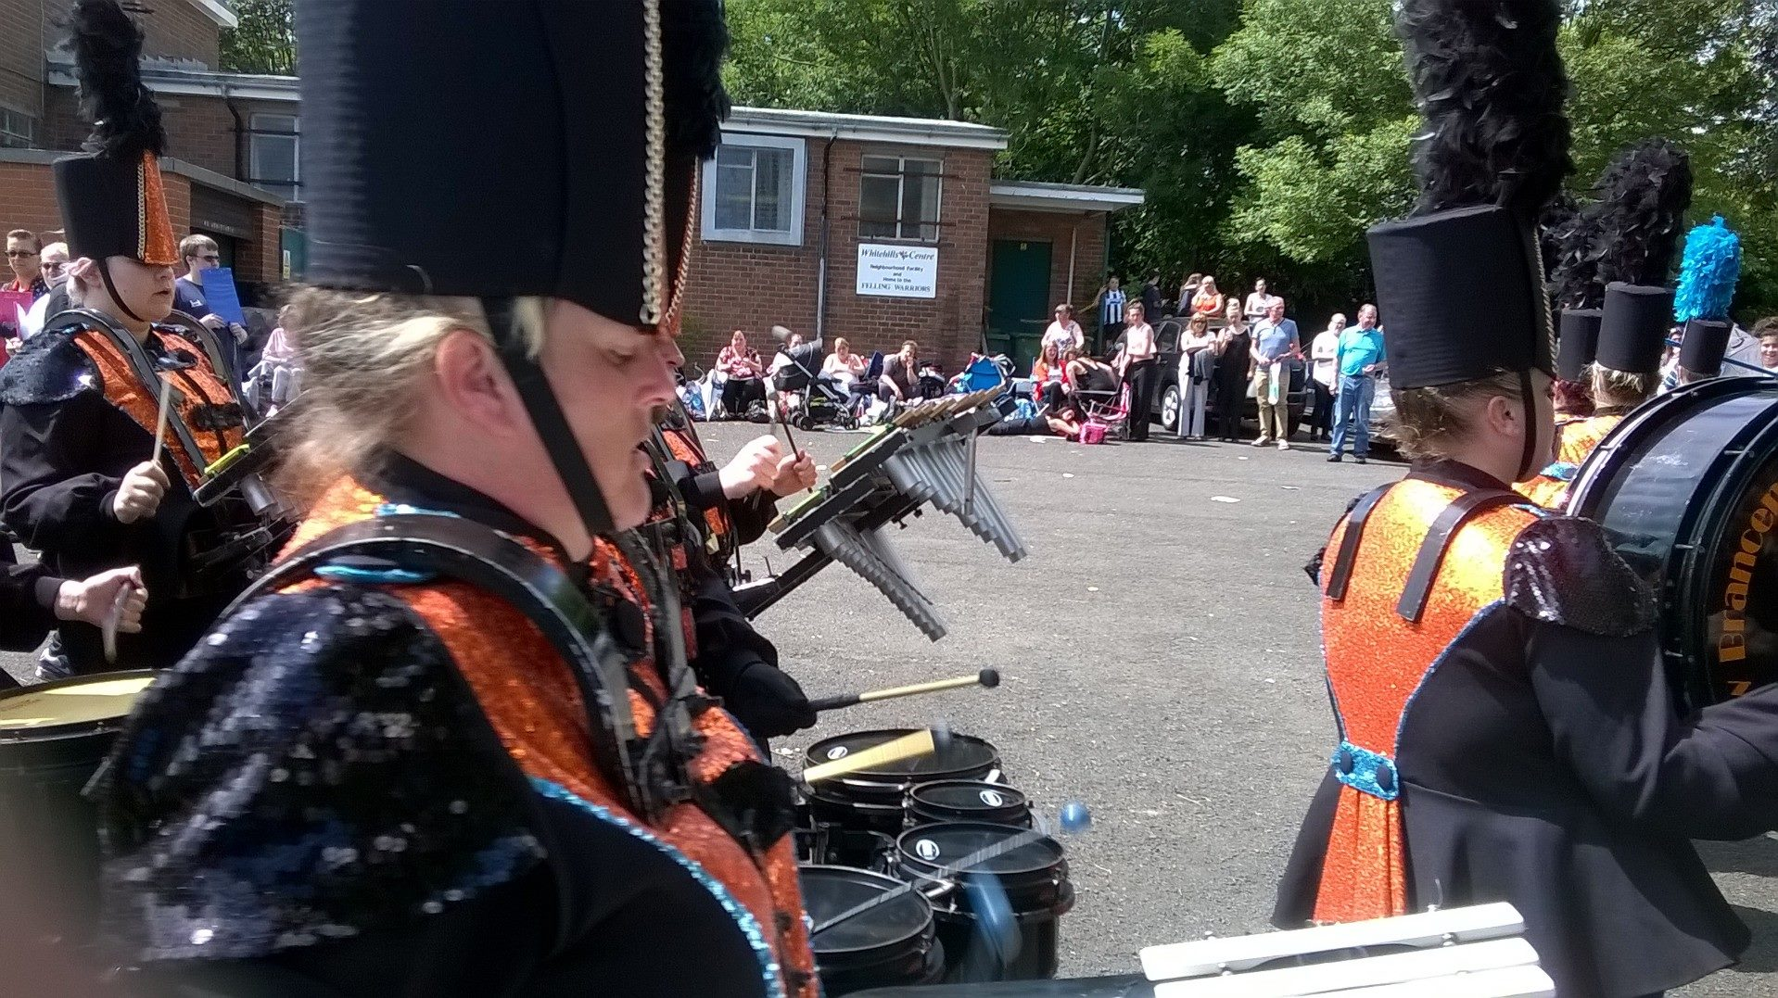
Support capacity of local organisation

Slide 7
Strong partnership through Neighbourhood Management Area Co-ordinator
Edberts get:
The Council get:
Vision
Networking
Building agreements
Advice and support
Opportunity to apply for Council Grant Funding
Service provision
Community intervention
Income streams
Community engagement
Cost savings

Slide 8
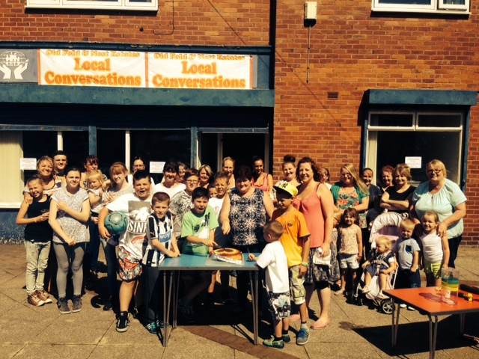
Community Development & Volunteering
Members of our local community (positive discrimination)
People from region who come to join in and support our community
sixth form students
university students
local professionals
unemployed
retired

Slide 9
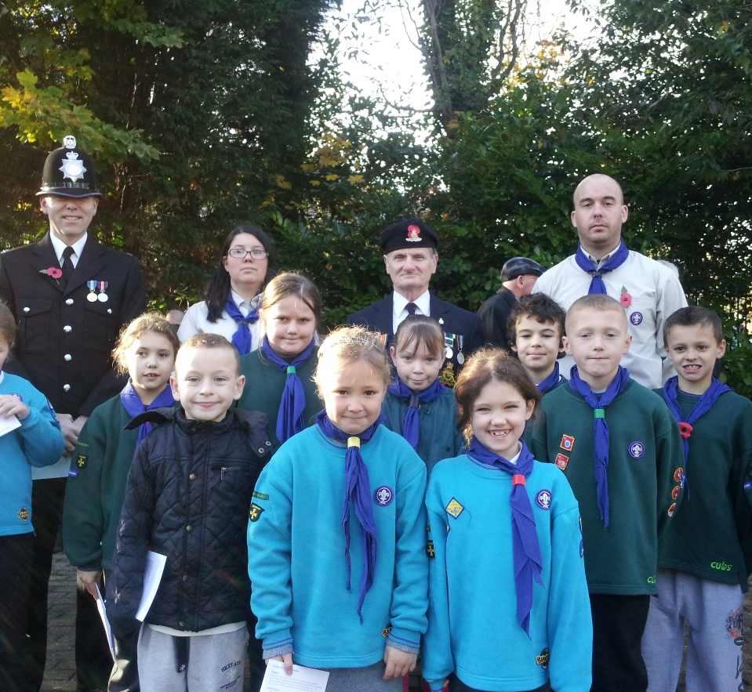
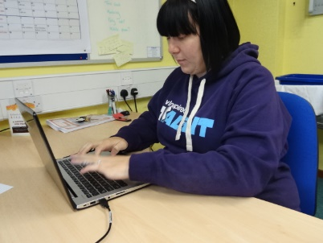
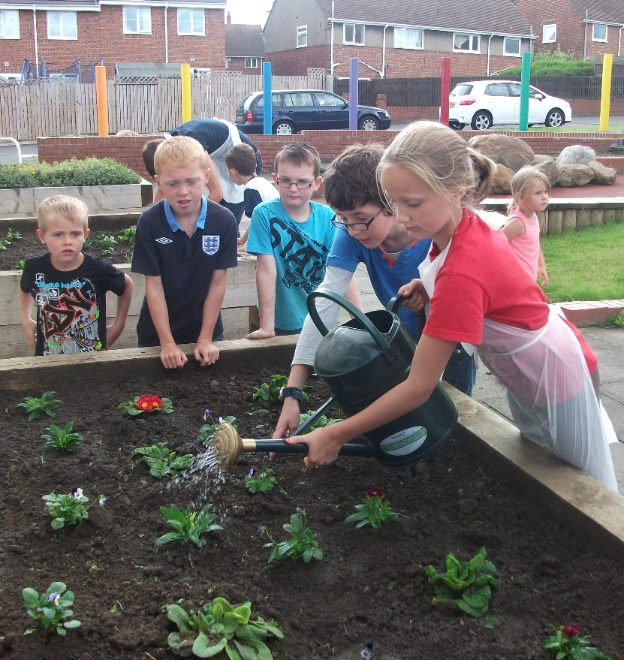
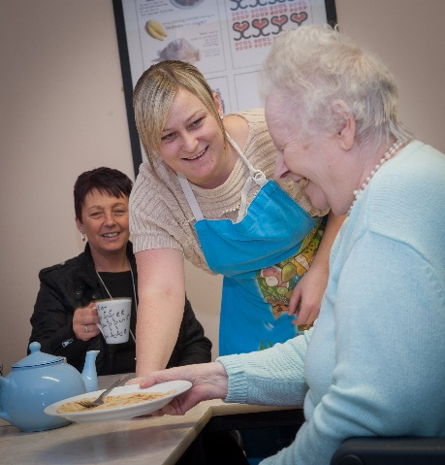
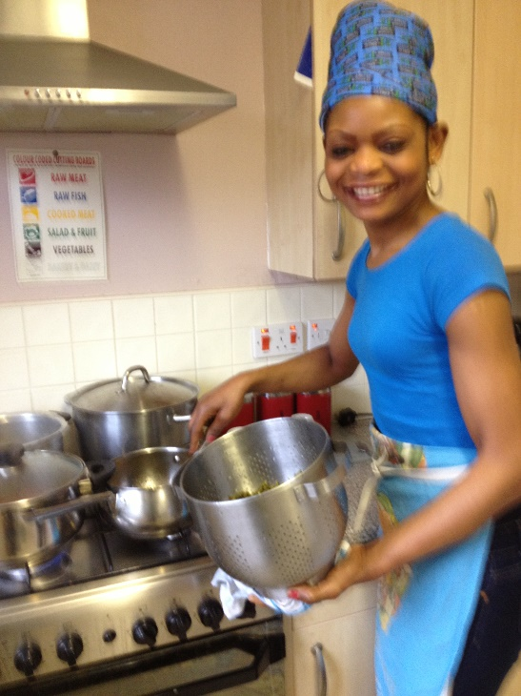
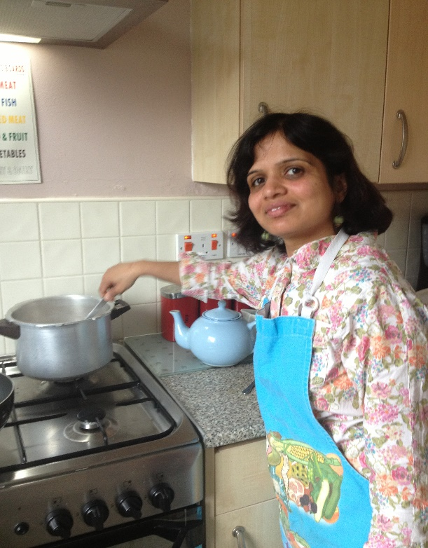
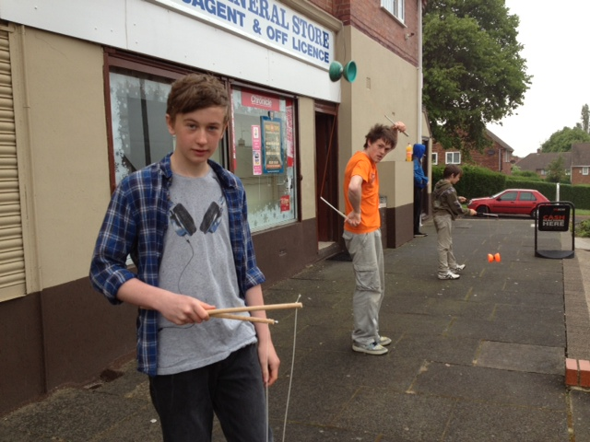
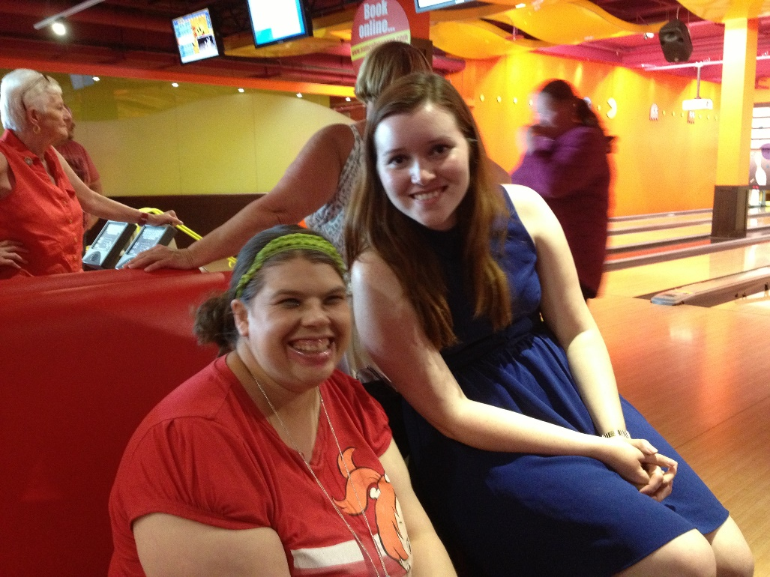
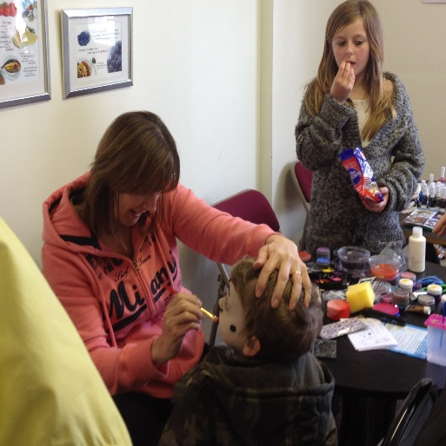
Edberts Volunteers

Slide 10
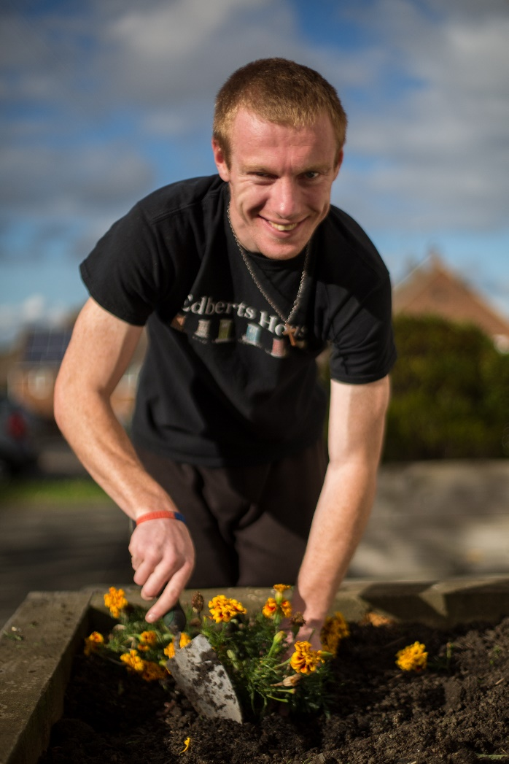
Martin’s story
Needs structure
Needs sense of purpose and belonging
Needs to build skills
Needs to learn about team work and working through relationships
Needs clear boundaries
Needs lots of second chances

Slide 11
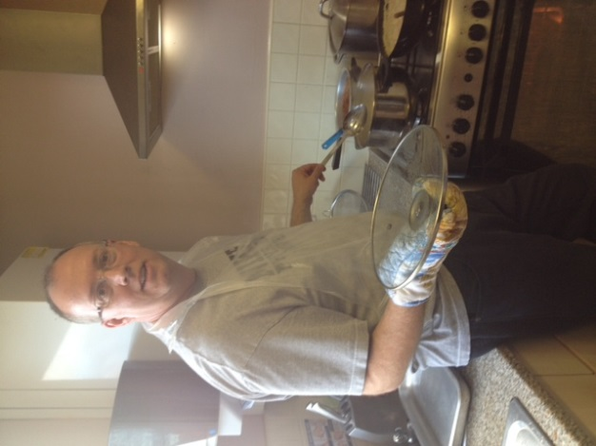
John‘s Story
Wants to be involved on Board of voluntary organisation
Wants to share skills with the community
Wants to broaden knowledge and understanding of the area in which he works
Wants to be involved not just on Board but also meet community members

Slide 12
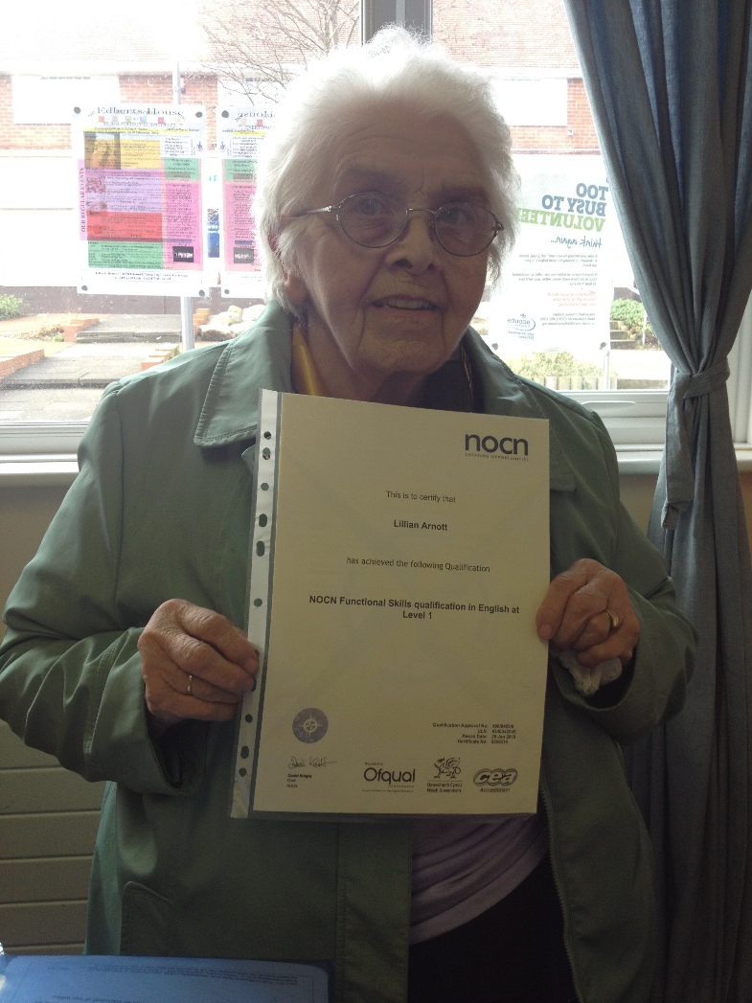
Lillian’s Story
Overcrowded house
Complex family
Loves meeting people
Loves children
Limited mobility
Wants to support next generation
Wants to share skills

Slide 13

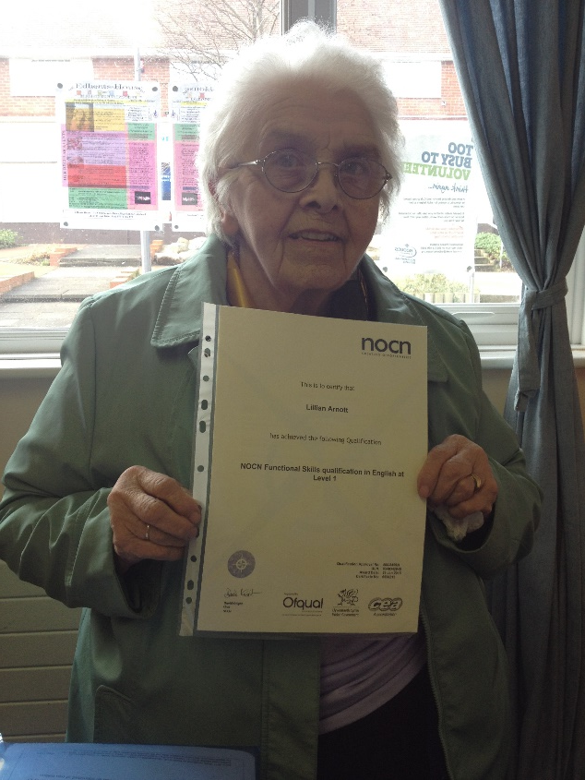
Keep out of trouble
No big form or job description
Volunteering
Happy to complete paperwork and make clear commitment
Helping out
Based on relationship and reliant on health

Slide 14
Sense of purpose and satisfaction
Improving health and wellbeing
New experiences
Gaining new skills
Increasing knowledge and understanding
Enhancing employment prospects
Meeting new people

Slide 15
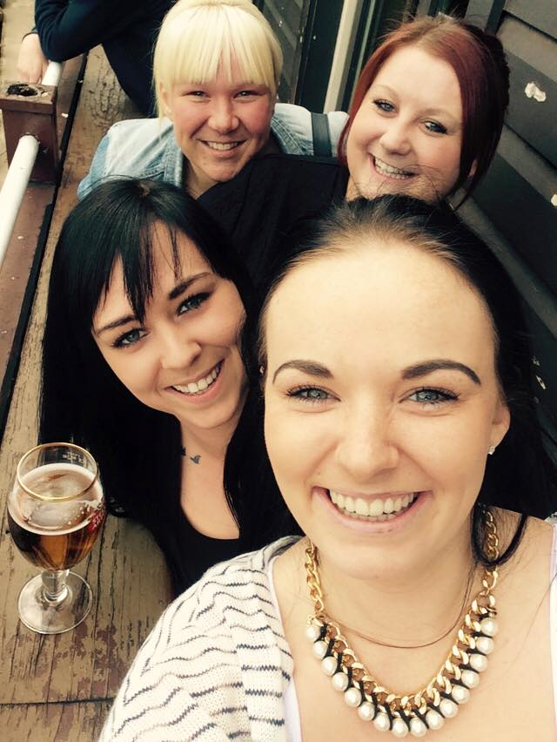
Retaining and Developing Volunteers
Valuing each unique contribution
Training and new opportunities
Support, genuine care, praise and encouragement
Passionate and committed staff team

Slide 16
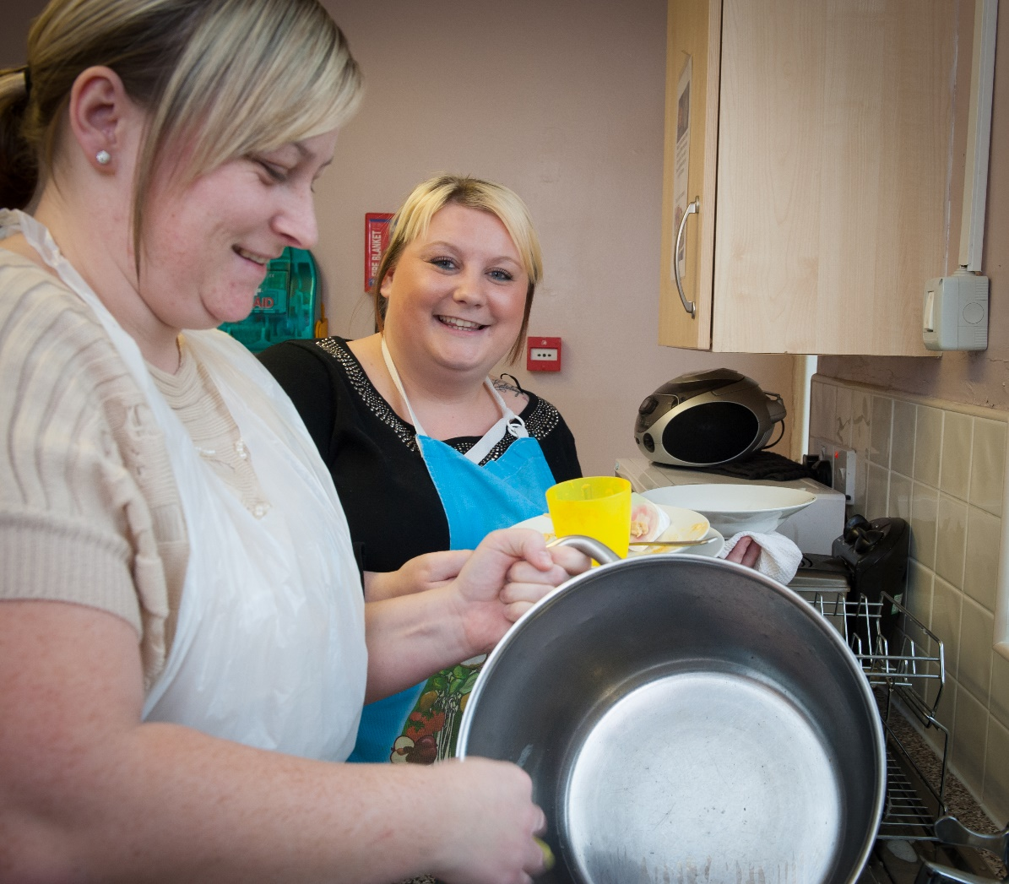
So what’s the result?
Shift in mindset
Decrease in anti social behaviour
Growth in confidence
Increase in health and wellbeing
Strengthened qualifications
Better employment prospects
Generational involvement in civic core

