Slide 1
CREATING THE CONDITIONS FOR CHANGE
Innovation and Capacity Building in
Gateshead Communities
Lindsay Murray, Service Director, Culture, Communities, Leisure and Volunteering
Institute for Local Governance
15th April 2016

Slide 2
Growing the Civic Core: a Gateshead Perspective
Voluntary and Social Action
Empowered Communities
Community Resilience
Delivering bespoke services in communities

Slide 3
Agenda
Vision and priorities in Gateshead
Creating resilient communities
Creating a sustainable market
Enabling innovation
Strong community and voluntary sector providing services in Gateshead

Slide 4
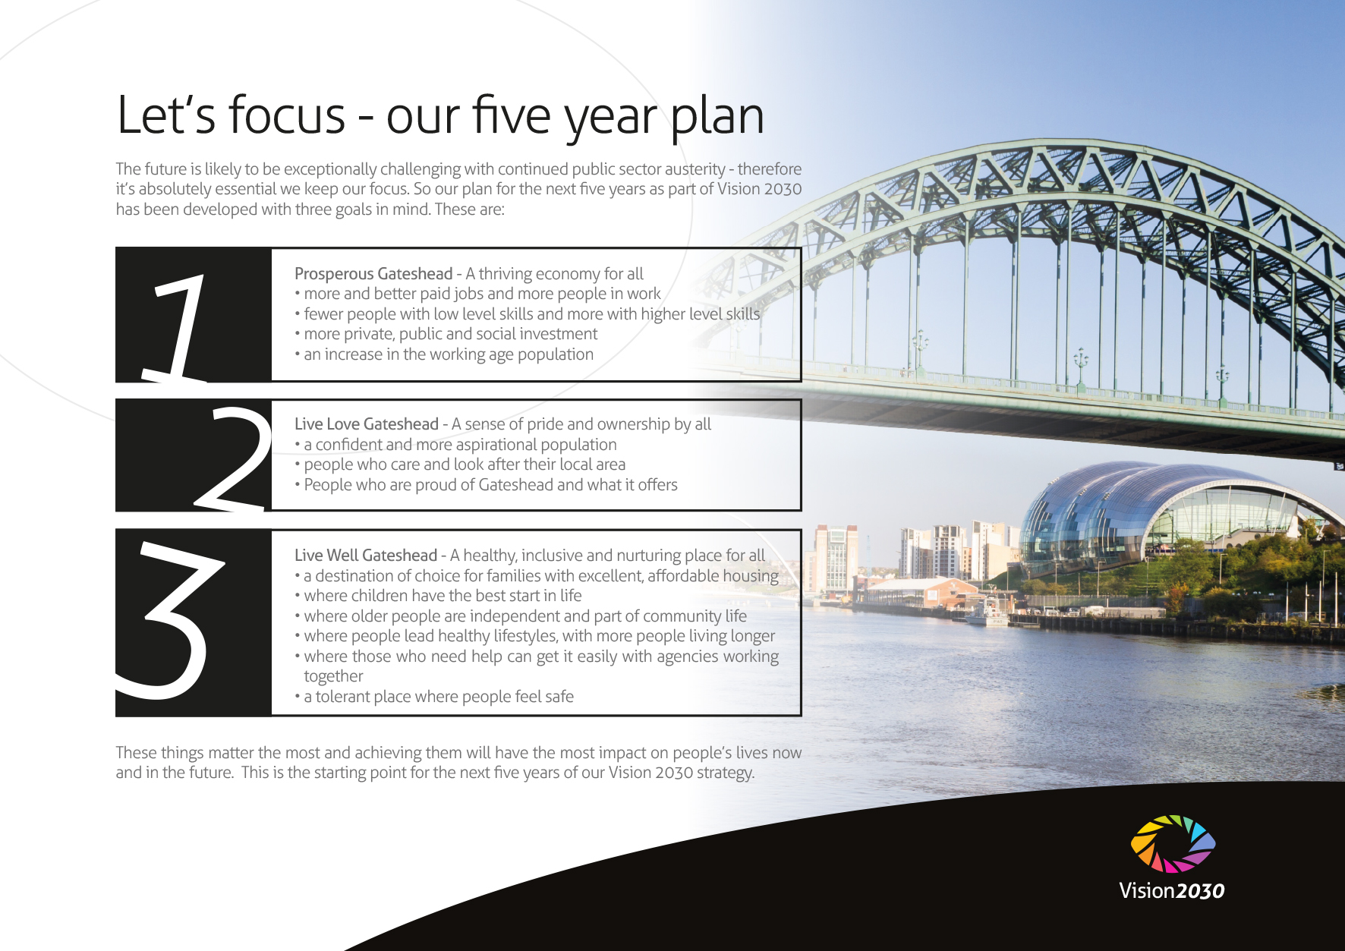
Notes:
Council Plan 2015-2020
Increasing community, individual and council resilience
Local people realising their full potential
Sense of pride and local identity
Collective/shared responsibility-working together with partners and communities
Making the most of what we have
Increased ownership in developing solutions
Promoting, supporting and encouraging positive behaviours

Slide 5
Creating Resilient Communities

Slide 6


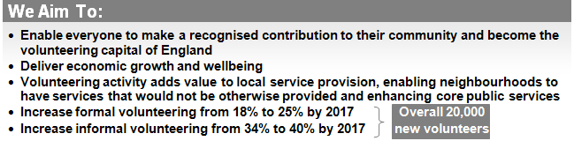
Policy Context
Gateshead Volunteers Plan 2013

Slide 7
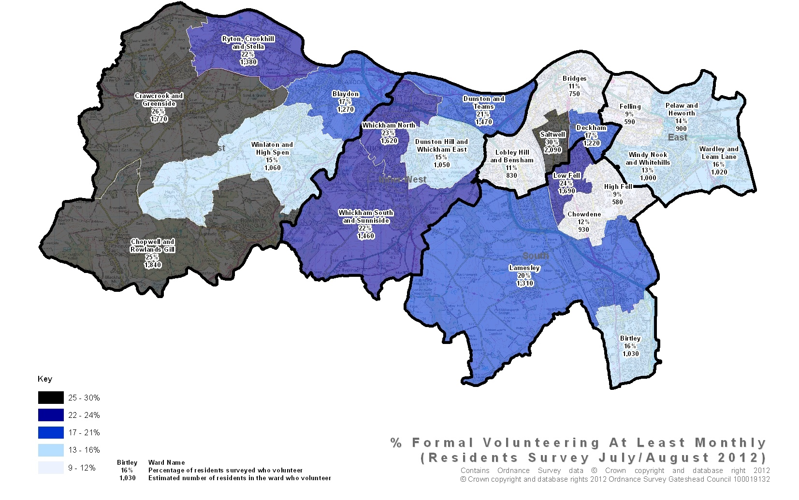
Residents Survey 2012
Formal Volunteering

Slide 8
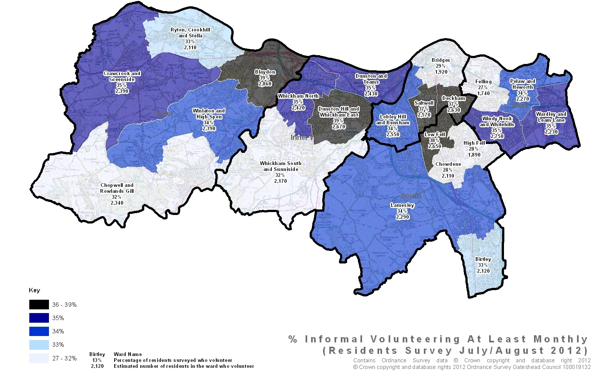
Residents Survey 2012
Informal Volunteering

Slide 9

Outcomes
The community and voluntary sector thrives within Gateshead
Vibrant, sustainable communities through a culture of supporting community and voluntary sector organisations in the delivery of local services
Volunteering recognised as important in career development
Volunteering frameworks that help volunteers develop their skills
Gateshead known as a national leader in promoting and supporting volunteering
Social responsibility is achieved through local businesses participating in supporting volunteers

Slide 10

Accelerate numbers volunteering in Gateshead and diversify type of volunteering activity
Meet the demands of volunteers – ‘single front door’ for volunteering opportunities
Build on strengths and build resilience in communities

Slide 11

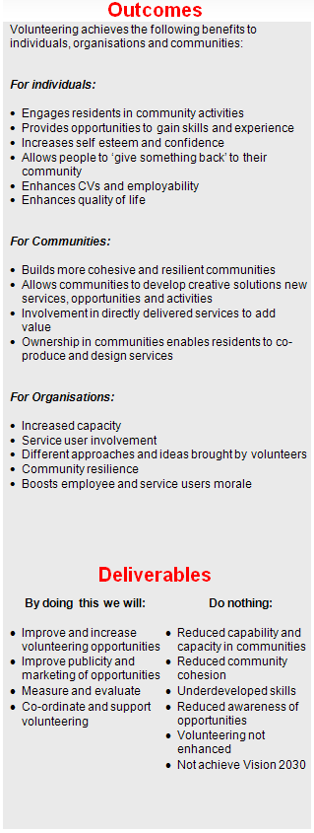
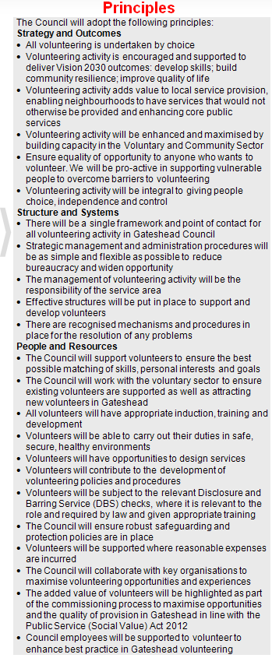
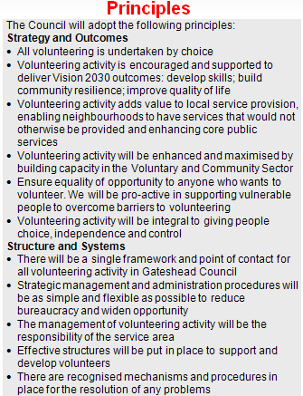
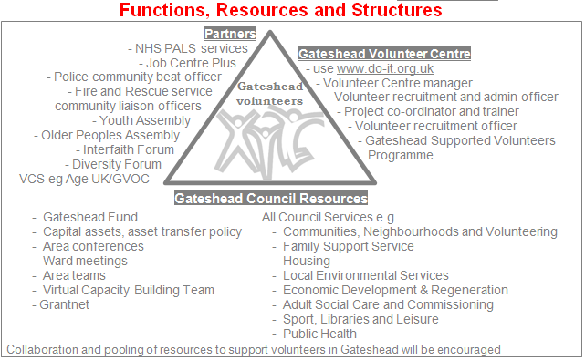
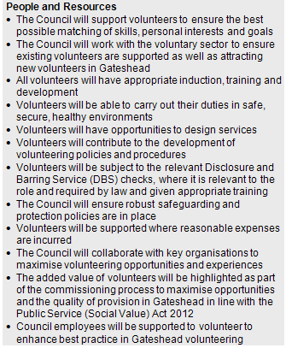
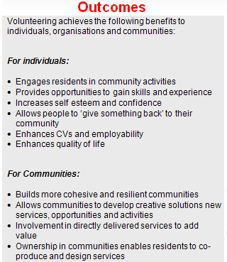
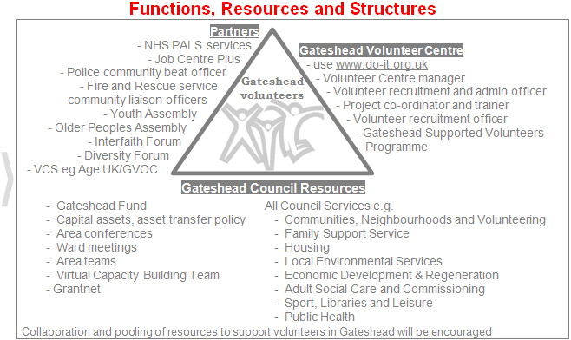
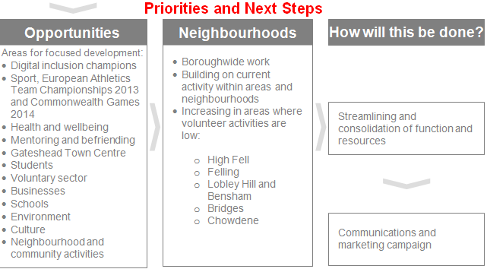
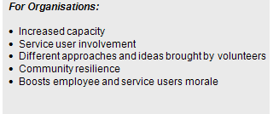
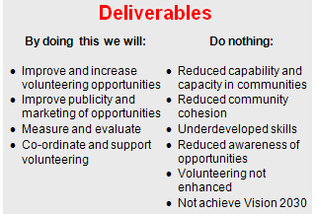
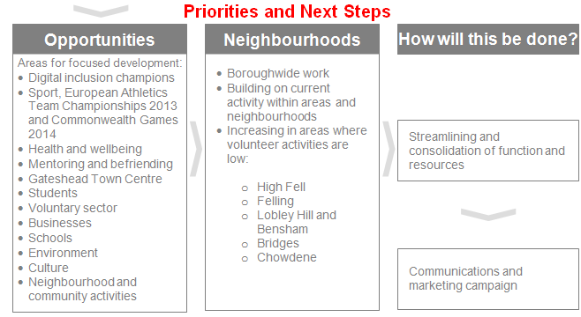
Gateshead Volunteers Plan
Notes:
11

Slide 12

Volunteers Month 2013, 2014 & 2015
2013 ,the first Volunteers Month, saw nearly 10,000 people take part in or attend events across Gateshead, and 35,000 hours of volunteering took place.
2014 national campaign to all local authorities to become involved in Volunteers Month. 30 authorities signed a pledge to become involve through the UK.
2014, 61 organisations took part in organising events in Gateshead
7,000 people took part and attended the events
38,244 hours of volunteering took place.
Equates to £531,592

Slide 13
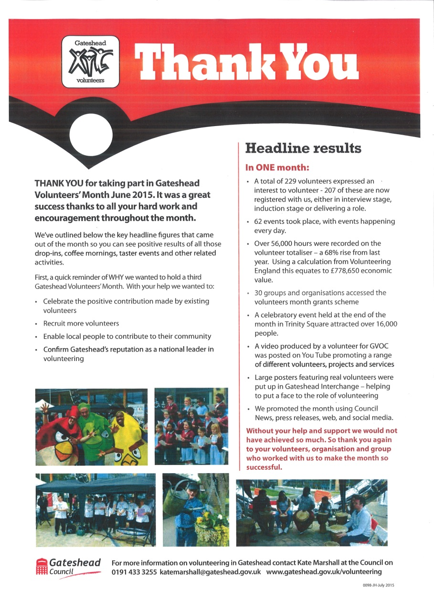
Volunteers Month 2015
Volunteers month recorded over 56,000 volunteers hours throughout June
68% increase from last year (38,244) equates to £778,650 economic value.
229 Volunteers recruited
62 events throughout volunteers month, with events happening every day
Celebration event at Trinity square on 26th June; 16,450 people through Trinity Square

Slide 15




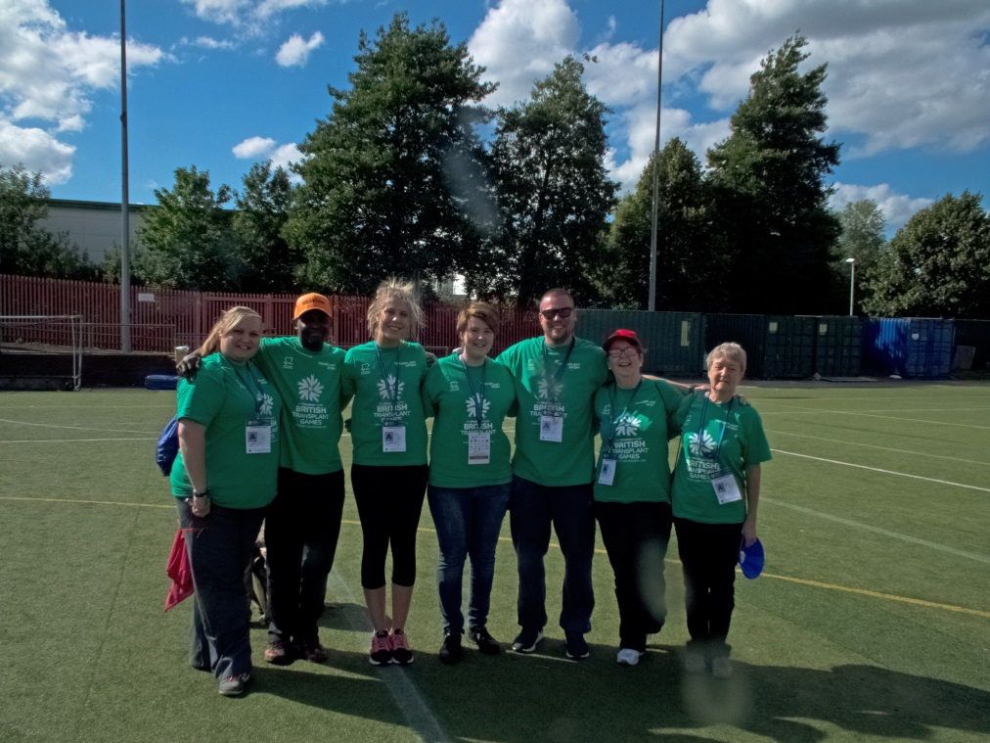








NewcastleGateshead 2015
Over 300 Volunteers
25% Aged under 25yrs
Delivered over 3000 hours
Economic value of £42,000
Volunteers are not paid, not because they are worthless,
but because they are priceless. Elizabeth Andrew 2008

Slide 16

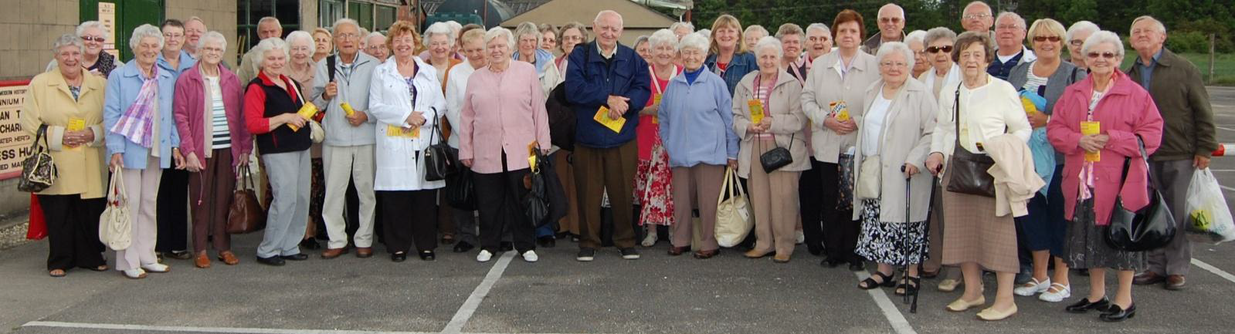
Case Study – Volunteering with Gateshead Older People’s Assembly
Gateshead Older People’s Assembly supports older people across the borough with a range of activities and groups aimed at improving their wellbeing.
Their work could not be achieved without their loyal volunteer network
The value of volunteering with Gateshead Older Peoples Assembly generates in excess of 1500 hours annually, a net value of circa £19,000 per annum.
Notes:
Through capacity building within the organisation this will potentially grow substantially in the coming year as a series of new projects are developed. These will also attract new members and attendees to their activities as well as increase further the number of voluntary hours undertaken by members

Slide 17
Creating a Sustainable Market

Slide 18
Capacity Building in Gateshead
Gateshead Council has been working with communities for many years to build capacity
450 voluntary and community groups
Gateshead Fund £500,000
  Capacity Building Fund
  Local Community Fund
Capacity building team integral part of the Gateshead Fund
Officers from across the Council and infrastructure organisations combined expertise and support under The Gateshead Offer

Slide 19
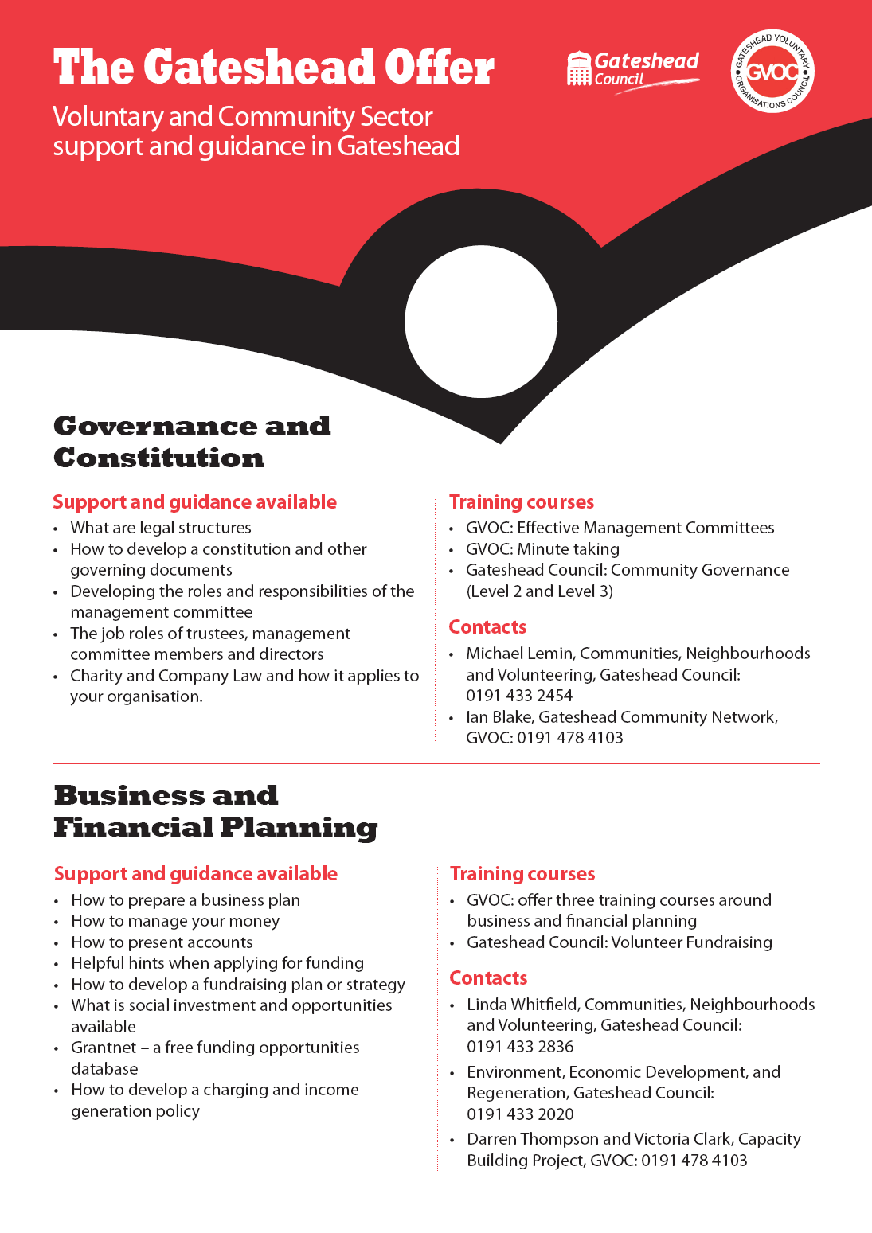
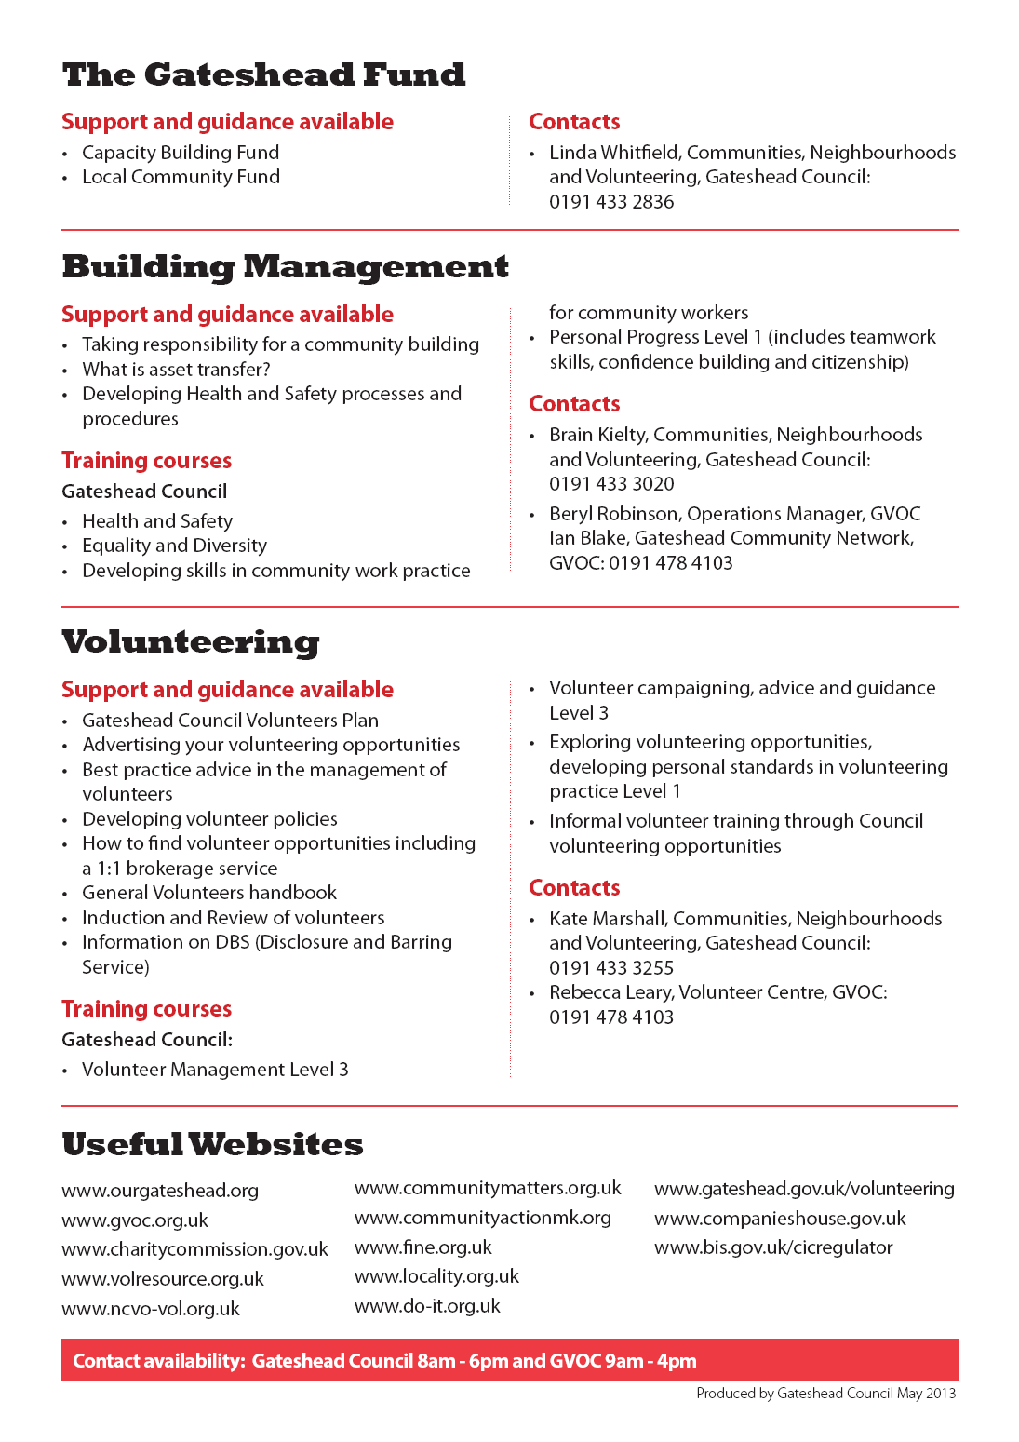
How to develop a constitution and other governing documents
How to prepare a business plan
How to manage your money

Slide 20

Stimulating demand
Vision for Community Centres
We had 42 Community Centres supported by the Council
Our vision :
Sustainable network of community owned buildings
Maximised community use of council assets by providing clear leasing and letting arrangements
Enable communities to take responsibility and ownership of facilities to the level they require and have the capacity to sustain.
Support to build capacity in the Community and Voluntary Sector
Encouraging volunteering in Gateshead, to achieve Vision 2030 and Gateshead Council Volunteer Plan aims of strong, sustainable communities.

Slide 21
Stimulating demand
19 Community Centres
Birtley Hub (Asset Transfer 2006)
Whickham Community Centre (Asset Transfer)
Eighton Banks Village Hall (Asset Transfer)
Mary Sanders Hall (Asset Transfer)
Lobley Hill Community Centre (Asset Transfer)
Dunston Drop In (Asset Transfer)
Allerdene Community Centre (Asset Transfer)
Highfield Community Centre (closed)
Dunston Community Centre (Asset Transfer)
Ryton and Crawcrook Community Centre (Asset Transfer)
Marley Hill Community Centre (Asset Transfer)
Winlaton Mill (Asset Transfer)
Clara Vale Community Centre (Asset Transfer)
Swalwell Community Centre (Asset Transfer)
Stargate Village Hall (Asset Transfer)
Teams Community Centre (Asset Transfer)
Brandling Community Centre (Asset Transfer)
Whitehills Community Centre (Asset Transfer)
Dunston Activity Centre (Asset Transfer)

Slide 22
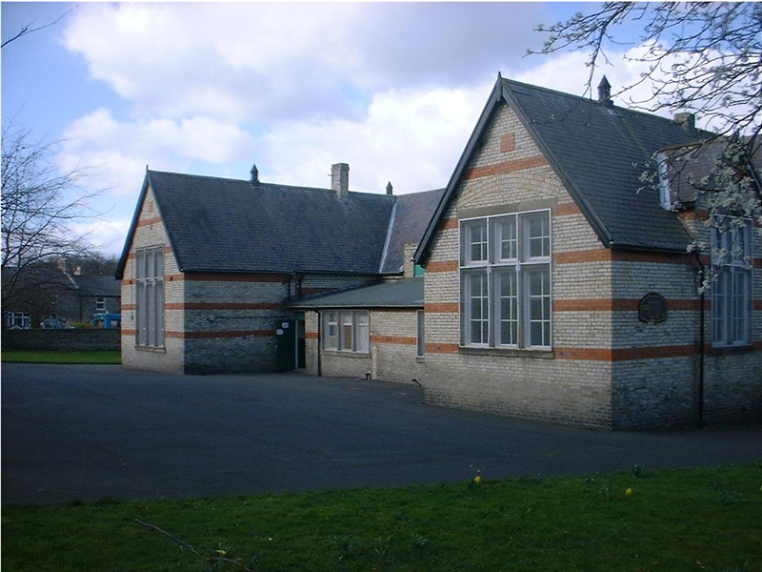
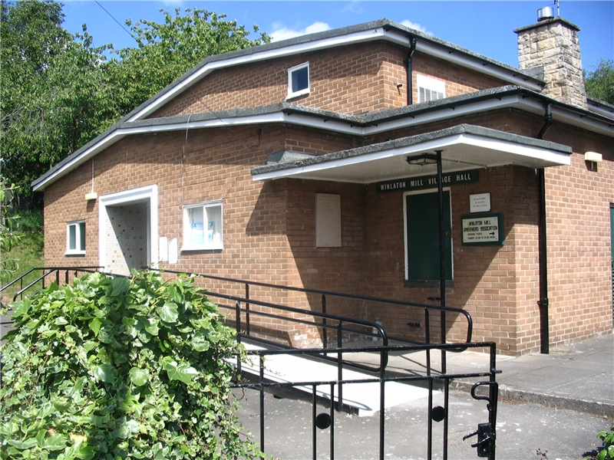
Stimulating Demand and Innovation
Asset Transfer
Winlaton Village Hall
Clara Vale Community Centre

Slide 23
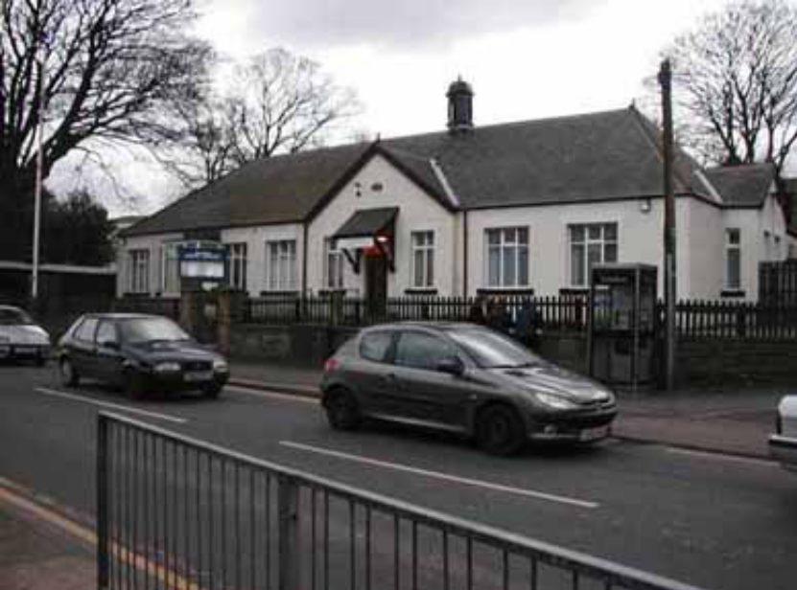
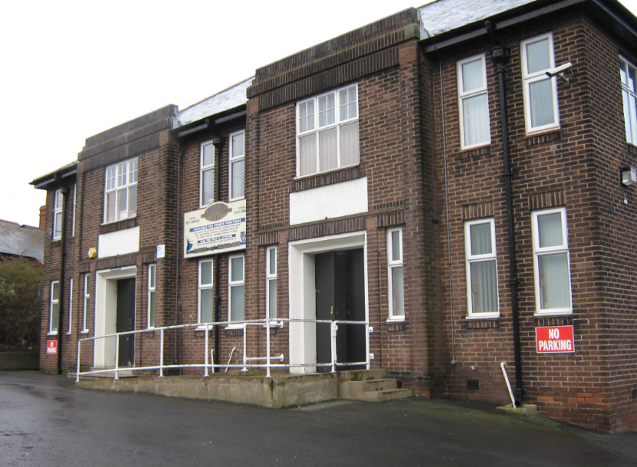
Stimulating Demand and Innovation
Asset Transfer
Whickham Community Centre
Marley Hill Community Centre

Slide 24
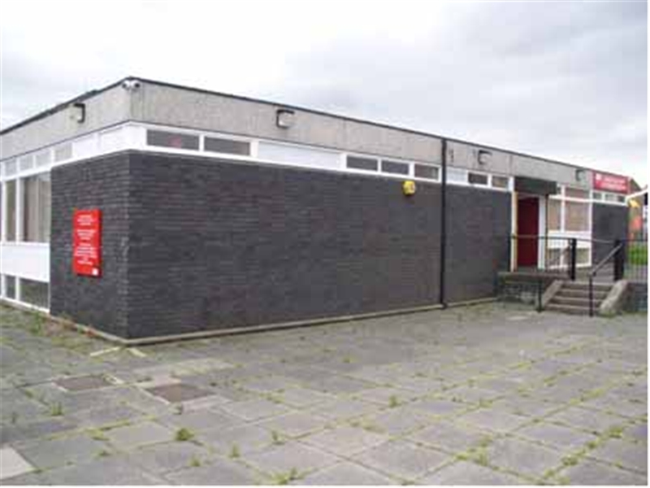
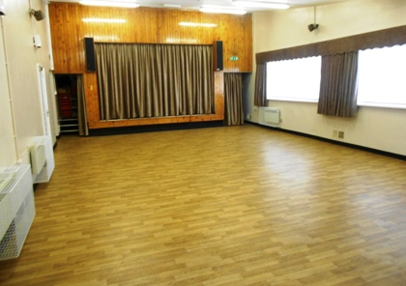
Stimulating Demand and Innovation
Asset Transfer
Lobley Hill Community Centre
Mary Sanders Hall

Slide 25
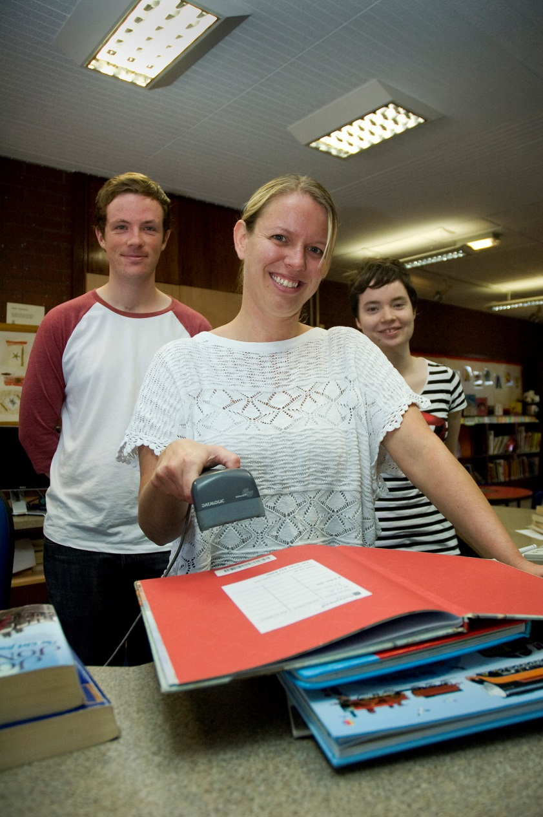
6 Community Libraries
Low Fell
Winlaton
Sunderland Road
Lobley Hill
Ryton
Dunston
120 Volunteers

Slide 26
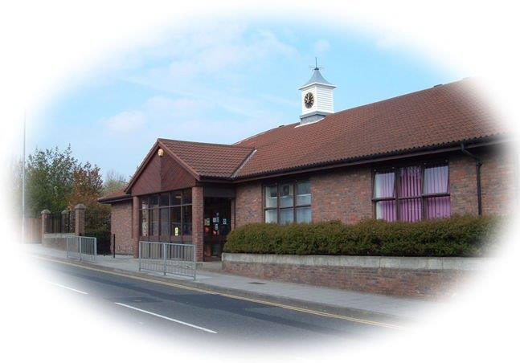
Dunston Activity Centre
Leisure Centre
Library
Gymnastics
Housing Company
Net budget circa £300,000
Asset transfer to Dunston Family Church
timescales to implement: 6 months

Slide 27
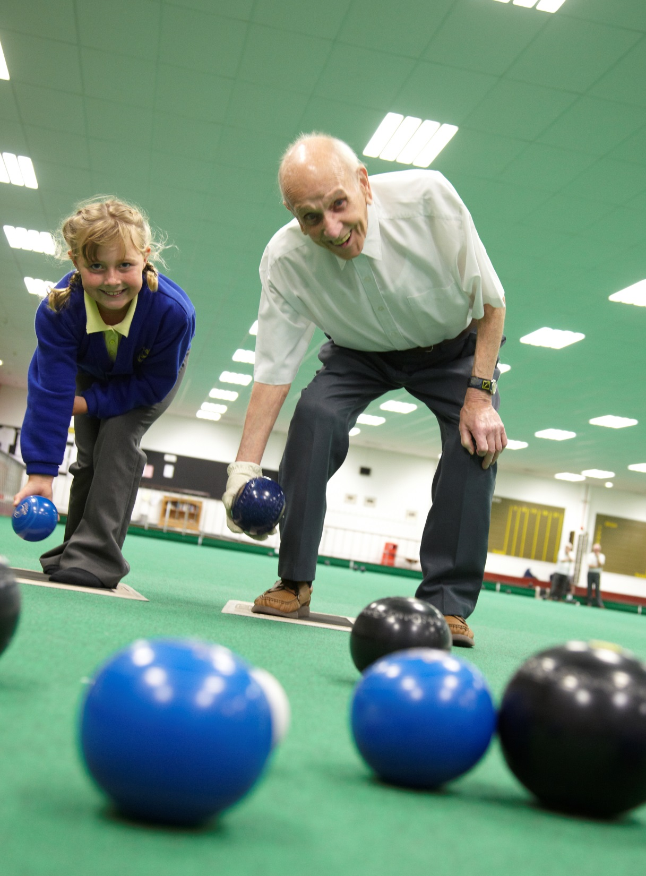
Gateshead Indoor Bowling Centre
Indoor Bowling Centre
400 members
Membership increasing as many surrounding local authorities closed their bowling centres
Net budget of £90,000
Asset transfer to Gateshead Indoor Bowling Association
Timescale to implement : 6 months

Slide 28
Conclusions
Stimulates demand and results in service innovation
Demand and capacity across a range of very different communities
Capacity building support is crucial
Type of support required is changing e.g. business planning, volunteers
Consolidate and strengthen capacity building support to ensure properly resourced
Strong, resilient communities and a strong VCS
Creating community businesses.

