Slide 1
Barclays
How we are building our civic core
15 April 2016
Unrestricted

Slide 2
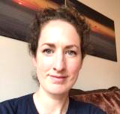
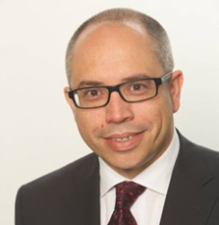
Introductions
Katie Hyson
Citizenship Employee Engagement
Julian Batson
Corporate banking NE Relationship Director

Slide 3
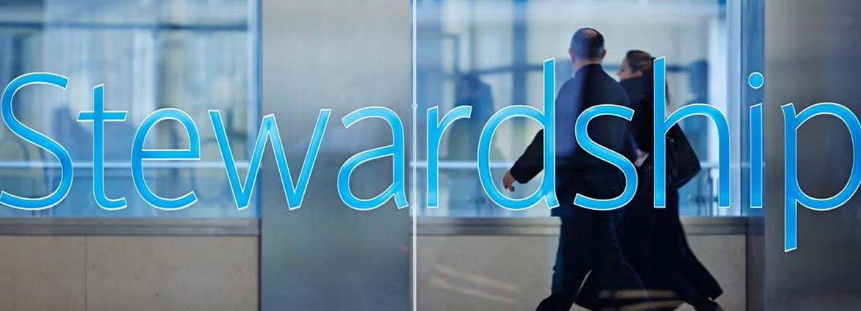
The civic core, is central to Barclays values
Notes:
Why volunteering at Barclays is encouraged
Set from the top
Citizenship is one of our 5 considerations
Barclays Values and Purpose – Stewardship is one of these
And volunteering is a demonstration of these in action

Slide 4
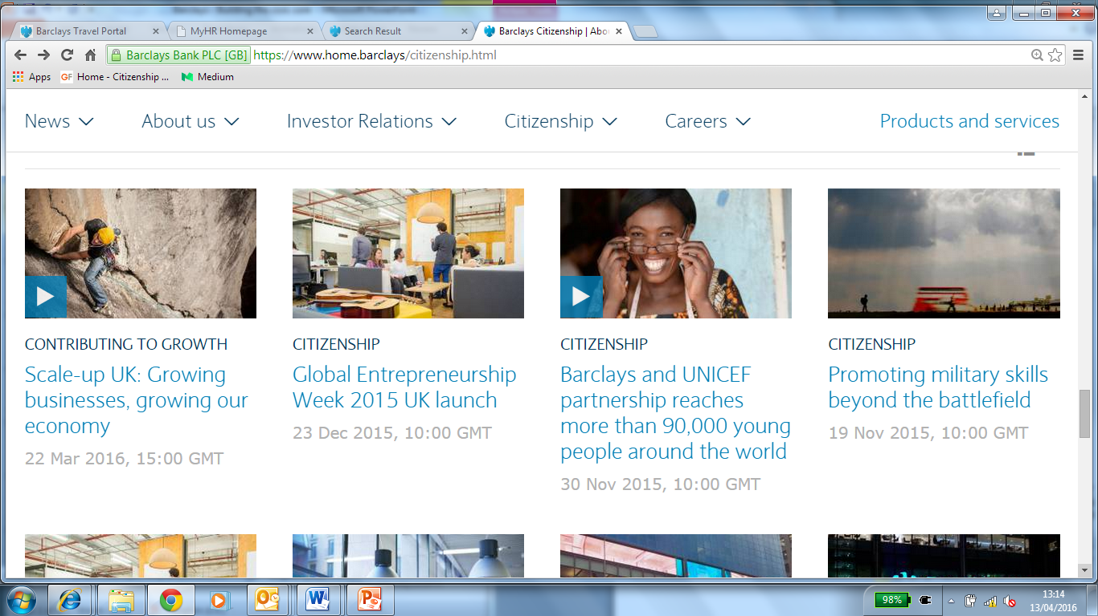
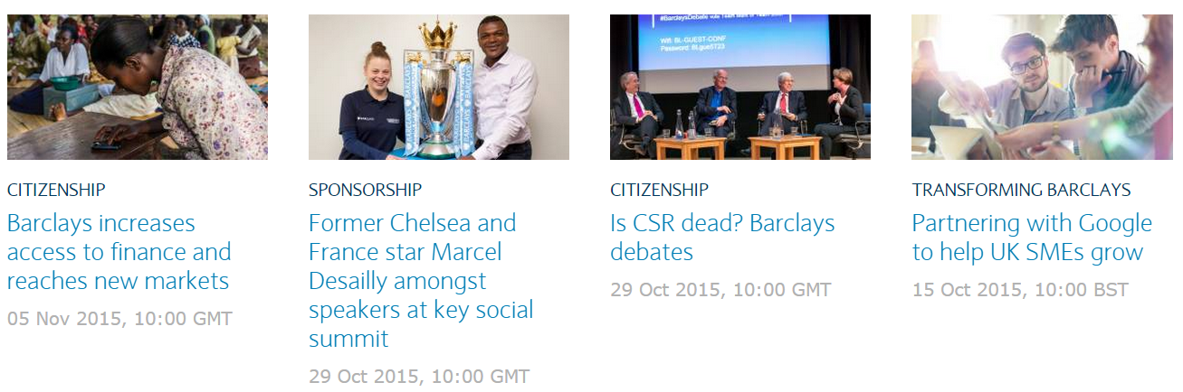
Getting involved in Citizenship comes in many forms
Notes:
At Barclays our CSR and volunteer programmes are called Citizenship.
34,000 + individuals volunteered through our programmes in 2015
Giving over 116,000 hours of work hours
During 6,230 different volunteering events
Examples of some activities –
Digital eagles, (started in May 2013, specially trained members of staff who provide free technology advice to both customers and non-customers. Originally launching with 18 members of staff, Barclays now has over 15,000 Digital Eagles across the UK.
LifeSkills – 13,000 of our employees signed up to deliver LifeSkils, helping young people be better prepared to make the difficult move from education to employment.
Digital drivers licence, MoneySkills, Board programme, Pilot light, LeadersQuest and the list goes on

Slide 5

We encourage people to bring their teams
Notes:
Citizenship and volunteering for our business is not about going it alone,
Encouraging those who’ve not volunteered before:
Team activities – ‘if they are all doing it, perhaps I’ll have a go too’
Team mentality is very important, and something businesses in general can offer – when ‘Building the Civic Core’
We encourage people to volunteer:
Demonstrate why volunteering is good for you - we find it helpful to articulate, why volunteering is good for society, good for individuals and good for business
Our messages are leader led – with locally backed up encouragement
At Barclays we see our volunteer programmes consistently backed up with business wide communication
We make it easy - What we can see as volunteer programme coordinators is that a clear framework of CSR themes and practical tool kits to help the delivery of volunteering activities allows our colleagues flexibility to lead their own activities, to react to the requests from their own communities, whilst feeling supported to do so.

Slide 6

To share their learnings with others
Notes:
The articulation of benefits:
Findings show that those who have a tradition of volunteering from their family or have volunteered from a young age can articulate why volunteering is good for them (work I have previously done with Prof Tony Chapman)
Those who are volunteering for their first or second time don’t have this phrase book – it builds over time
What we can do as a business is help give people that articulation: for example: help point out what skills they have learnt, encourage them to add these skills to their personal development plans. Provide communications platforms for them to share their stories and see what others are doing.

Slide 7
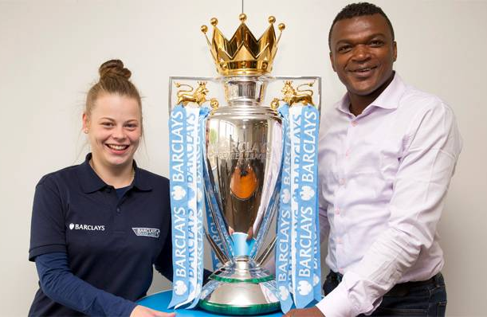
We reward and recognise great work
Notes:
Reward and recognition:
Our annual Citizenship Awards – recognise colleague contributions across the world. We make videos, have a ceremony and generally hero these people (because they are great stories – authentic and true demonstrations of the values and passion we want to see in all our people)
Some of our programmes are the ‘reward’ – Leaders’ Quest programmes we worked with our HR colleagues to identify high performing leaders from our business and immersed them in community leadership activities. The programme is such a success that now our junior star talent is also taking part in some locations.

Slide 8

And encourage people to give skills as well as time
Notes:
Skilled vs unskilled volunteering
Is the day of fence painting and gardening over? – For some of our volunteers, the choice to do this is very important. For us to place a barrier and stop volunteering activities by casting judgement on what is a worthy activity can be counterproductive to our overall goal: to engage people in their societies.
Saying that, we want volunteering to be taken seriously, not just a skiving day off. Therefore we do encourage skills based volunteering, and volunteering for our core CSR themes
What we can see with skill based volunteering – we can provide services to others in areas we are expert (fraud prevention for example, managing money, getting on to the housing ladder, debt and credit support).
We also work very closely with other organisations and businesses – so our gift can often be to bring groups together and form collaborations.
Julian will share with you shortly, a programme of how he recently did this just this.
If you are a first time volunteer, could volunteering on something you know you are good at, to help those you know need help, lower the barriers to volunteering? Yes we think so. So we do encourage this.

Slide 9

So that everyone gets the benefits
Notes:
The symbiosis between social benefit, people benefit and business
We can see that volunteering is good for business: We see higher retention, high colleague satisfaction, higher productivity and higher engagement with our overall business from those who are volunteers
By articulating this further into our business activities, communications and processes – we hope that we can continue to open the doors to colleagues. Encouraging them to volunteer and keep volunteering
And then once they have volunteered a few times, we will help them to articulate these benefits for themselves, and engage others to do the same
Thereby increasing our Civic Core.

Slide 10
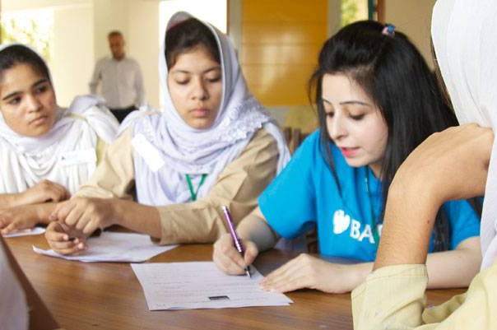
And then we repeat
Notes:
Call to action
Finding your leaders
Forming your teams
Help people articulate the benefits
Thank you and hand over to Julian

Slide 11
Julian’s case study
Julian Batson
Corporate banking NE Relationship Director
Notes:
A Barclays Citizenship event life cycle
Late 2015, a fraud awareness event was held in West Midlands and reported in internal Barclays newswires
Seen by local relationship team who had actively been looking for a relevant template to deliver into one of their portfolio customers
In parallel, approached by the another customer, the Police, who had seen our fraud campaign information and wanted support in delivering prevention strategies to wider community
Approach Gateshead Council Trading Standards and Inclusion Officers to discover if indeed relevant and required
Engage my own team and resources
Brought Barclays, the Police and Gateshead Council together to deliver a bespoke cybercrime and fraud awareness workshop to local residents
Report and repeat….

