Slide 1


On the fringes of the ‘Northern Powerhouse’?
Tackling the challenges facing rural areas in Northern England
Prof Mark Shucksmith OBE
Newcastle University Institute for Social Renewal

Slide 2

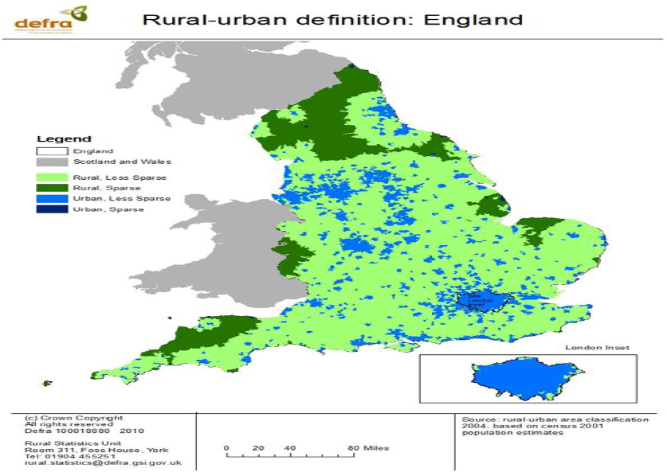
What are the challenges?
Less sparse rural areas: poverty and disadvantage hidden amongst affluence.
(most of rural England)
Sparse rural areas: much lower average incomes than other rural or urban areas... More in the North.

Slide 3
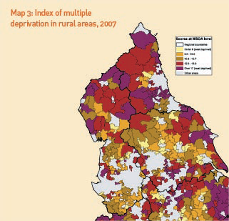
Rural Deprivation in the North
Rural wards in the north are rural areas most likely to have high deprivation scores.

Slide 4
Household incomes and wages by settlement size and sparsity, 2009/10
Household incomes are systematically higher as settlement size decreases, as smaller settlements are colonised by richer households.
Contrast also between sparse and less sparse rural areas; and between wage by place of work and by place of residence.

Slide 5

Rural economies today
The UK rural economy
80% of UK is rural
12m people live in rural UK
£400 billion GVA pa
1/2 a million businesses
15% of workforce is in farming, forestry and fishing
70% of workforce in small and micro enterprises
A dynamic rural economy contributing to national growth – not just a pastoral playground

Slide 6


What Prospects for Rural Growth?
Although typically small, many rural businesses have growth potential:
High rates of business formation.
Microbusinesses often have high turnover – eg. In £250-499k turnover category, 88% and in £500-999k, 59% were microbusinesses.
Half had introduced recent innovations.
Even in the economic downturn, 43% were looking to expand (2009).
Growth: manufacturing; professional, scientific & technical; accommodation & food services; and wholesale & retail.
(Source: Newcastle University CRE: NE Business Survey)
But, need a supportive economic context...

Slide 7
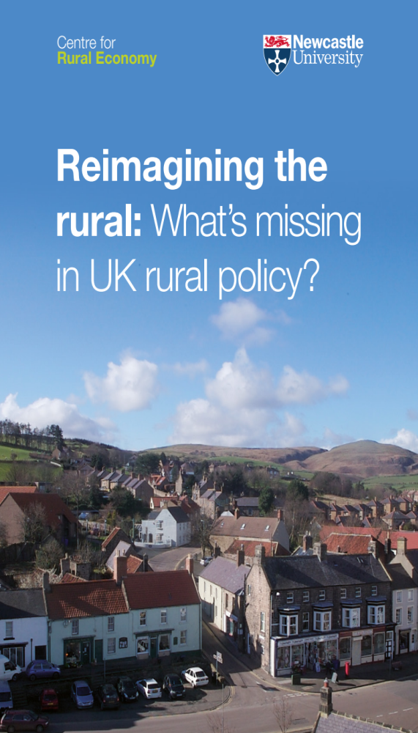
Policies to support rural business
Rural businesses contribute £400bn pa (19% of GVA) but policy rests on myth that growth driven by cities.
Effective rural-proofing
Recognise rural potential in local, regional and national policies.
Rural growth policies that include but look beyond farming/ food.
Investment in infrastructure: broadband, mobile coverage, etc
Supportive planning practices
Build on lessons of pilot RGNs.

Slide 8

Supporting micro-businesses and home-based businesses
2/3 of England’s rural enterprises are micro-businesses, but typically fall below the radar of policy. Research suggests these may be incubators for growth if supported by policy.
Many are home-based. On average these have fewer employees but display higher profits and have higher broadband use.
They can be supported by:
  enabling planning policies
  shared facilities at enterprise hubs
  broadband
  help in recruitment
  better business advice
  tax and rate simplification
  collaborating and sharing services

Slide 9
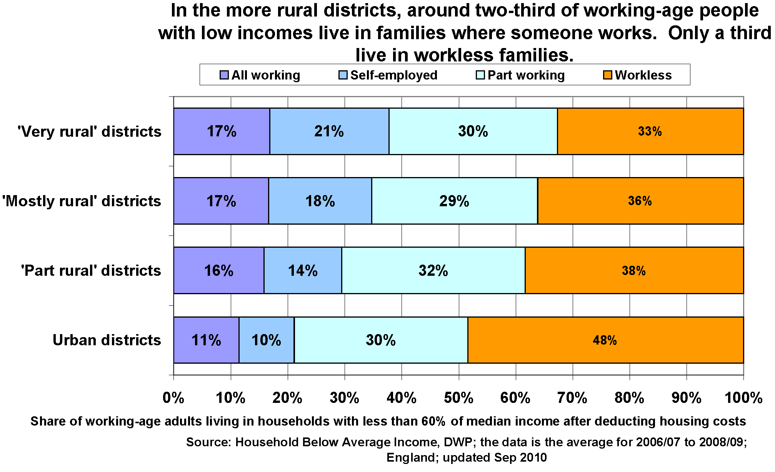
‘Poverty in work’
How will rural poverty be affected by cuts to tax credits offset by national living wage?

Slide 10
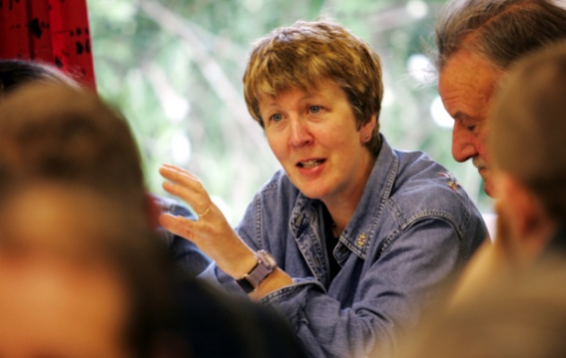
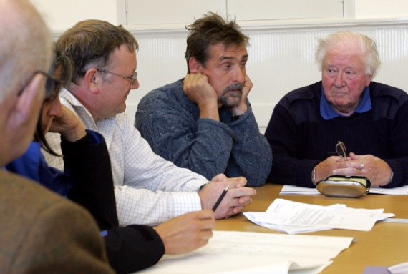
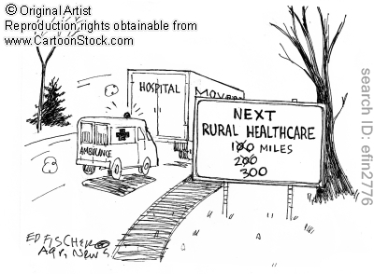
Policies to support communities
Rural areas are diverse and benefit from local solutions; but it is insufficient to leave local actors without support.
Some rural communities will rise to this challenge; but most will not.
Capacity-building is needed - with the most marginalised individuals; and with less active places. Without this, inequalities will widen
Affordable housing, public services, etc.
Supporting the Voluntary and Community Sector – crucial role in building capacity

Slide 11
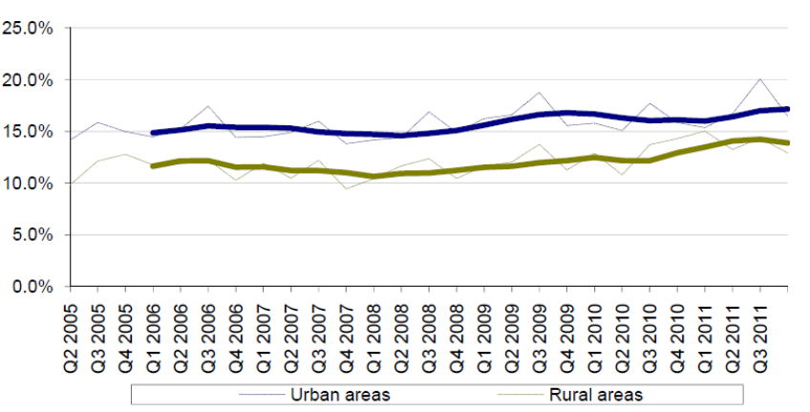
Youth unemployment
Rural areas of England have a lower % of young people not in education, employment or training – but still 13% and rising faster than in urban areas.
Young people in rural areas face:
Poor access to transport
  Lack of public transport, and the high cost of private transport is a major barrier to finding work.
Careers advice lacking
  Schools have a new duty to access independent careers advice, but no additional funding for this
Employment and training
  Low wage, low skill economy
  Withdrawal of ERM
Youth services disappearing
  Public services are being withdrawn (especially in more remote areas) and voluntary services are also losing much of their funding.
The Commission for Rural Communities called for the Government to create a Minister for Youth Affairs, and to develop a coordinated rural youth strategy.

Slide 12
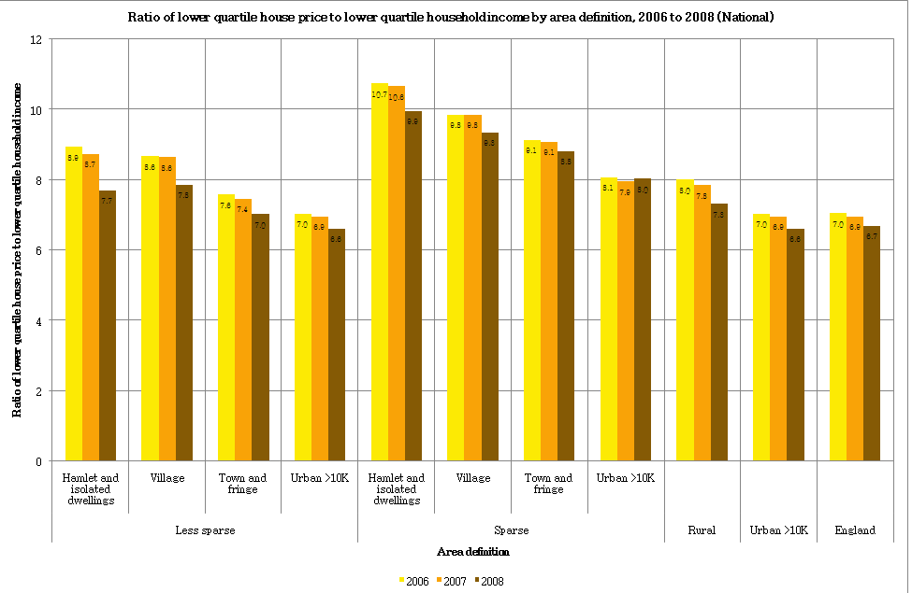
Housing Affordability, 2006-08

Slide 13
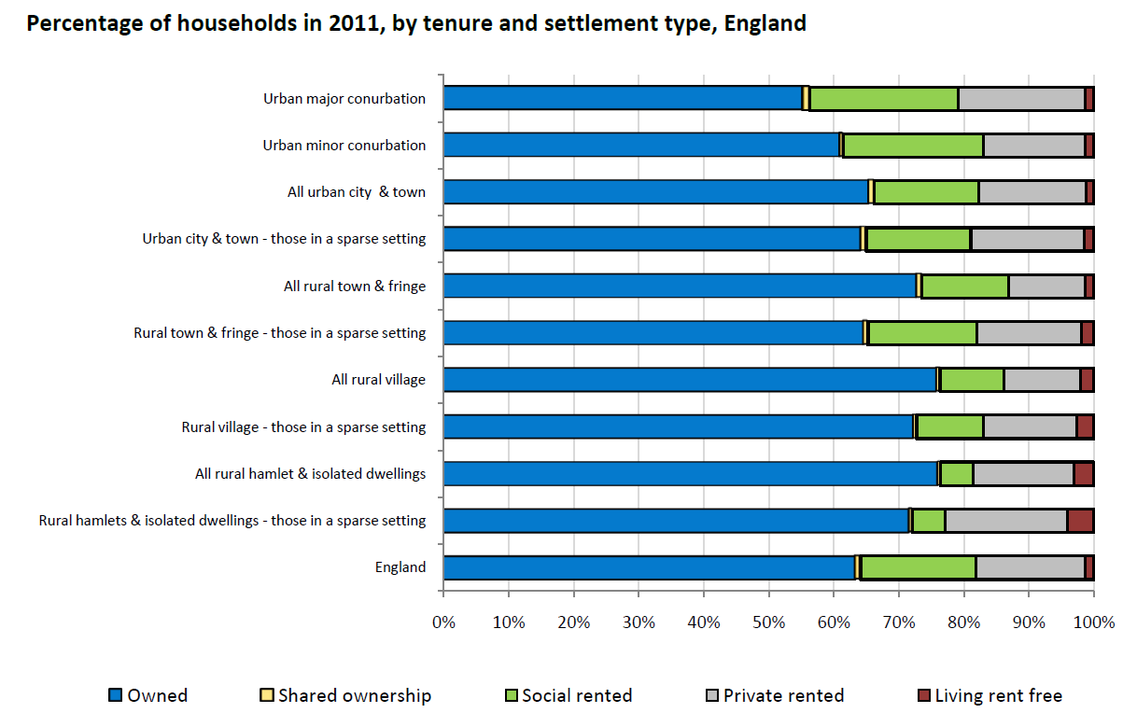
Housing Tenure, 2011

Slide 14
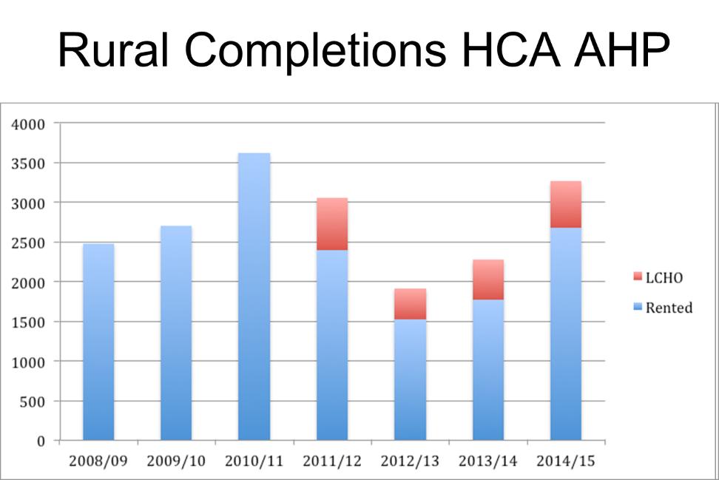
Rural housing policy?
Demise of affordable rented housing in rural areas?
No affordable housing quotas for schemes of fewer than 10 homes.
Extension of Right To Buy to housing associations:
  Land supply; planning policy; community support; financial risk
  Will this extend to community trusts?
  What rural exemption?
Exception sites instead to be used for starter homes where discount captured by first occupier?
How will anyone but the most wealthy be able to afford to live in an ever more ‘exclusive countryside’?

Slide 15
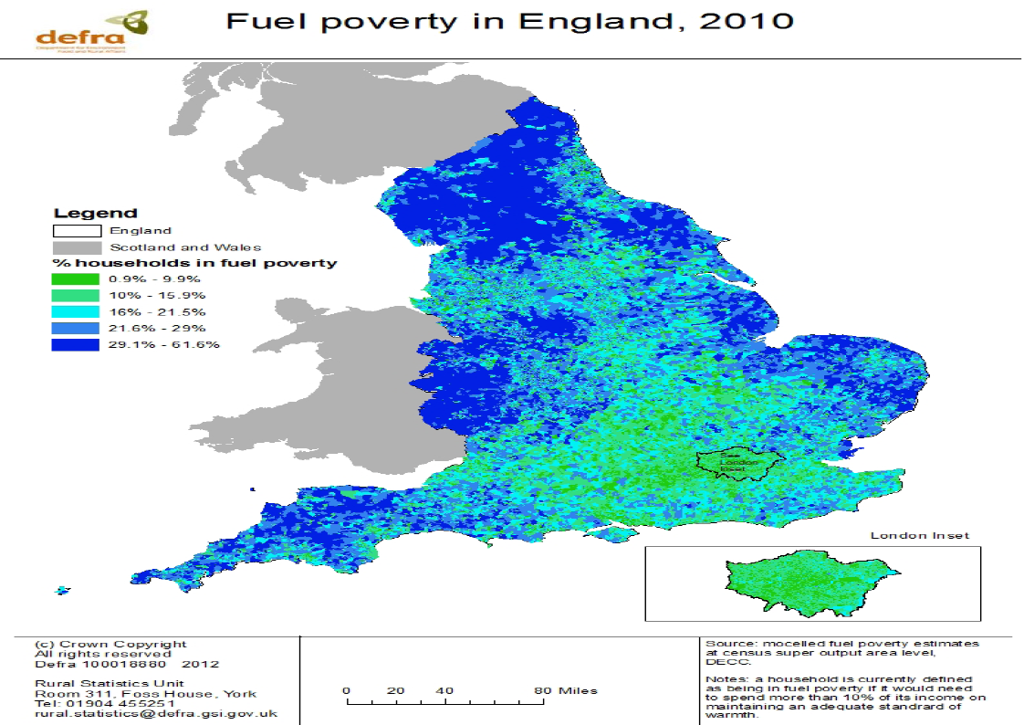
Fuel Poverty
Rural households are more likely to suffer fuel poverty, and are more vulnerable to future energy cost rises – especially in sparse areas.
JRF Min Income Standard study revealed higher fuel costs of rural living:
  No mains gas
  Older, poorly insulated homes
  Transport to distant services

Slide 16
Rural Productivity Plan
Rural areas fully connected to the wider economy
Extensive, fast, reliable broadband service
High quality, widely available mobile communications
Modern transport connections
A highly skilled rural workforce
Access to high quality education and training
Expanded apprenticeships in rural areas
Strong conditions for rural business growth
Enterprise zones in rural areas
Better regulation and improved planning for rural businesses
Easier to live and work in rural areas
More housing
Increased availability of affordable childcare
Greater local control
Devolution of power
DEFRA/ HM Treasury, August 2015

Slide 17
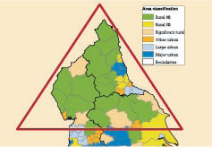
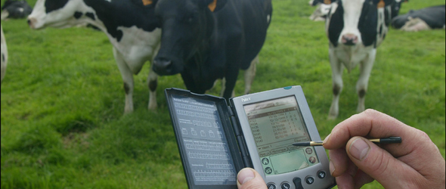
On the fringes?
How central are our rural economies and communities to Northern LEPs and Combined Authorities.. And to a ‘Northern Powerhouse’?
Our rural communities are so often marginalised.
  A policy ‘Bermuda triangle’
Is there any possibility of a concerted approach to NE rural development?

Slide 18
Question for today
How will rural and remote areas be affected by proposed devolution to ‘Northern Powerhouse’ LEPs?
  How are rural and remote areas faring in a period of public sector austerity?
  What should people in rural and remote areas do about it, and how to get their voices heard?

