Slide 1

Who cares for the carers ?
Institute for local governance
Friday the 27th of November, 2015

Slide 2
The challenges facing carers almost always come second place...... How can society better respond to the needs of young carers?

Slide 3
Second Place......
If carers almost always come second place, where do young carers come?

Slide 4
The problem we are aiming to address....................
“The problem is that being a young carer or young adult carer can lead to a lifetime of disadvantage and unmet potential, significant risk of poor mental health, inability to access opportunities and an increased likelihood of experiencing significant social, economic and financial disadvantage. The costs to individuals and society are unacceptable.” The Junction

Slide 5
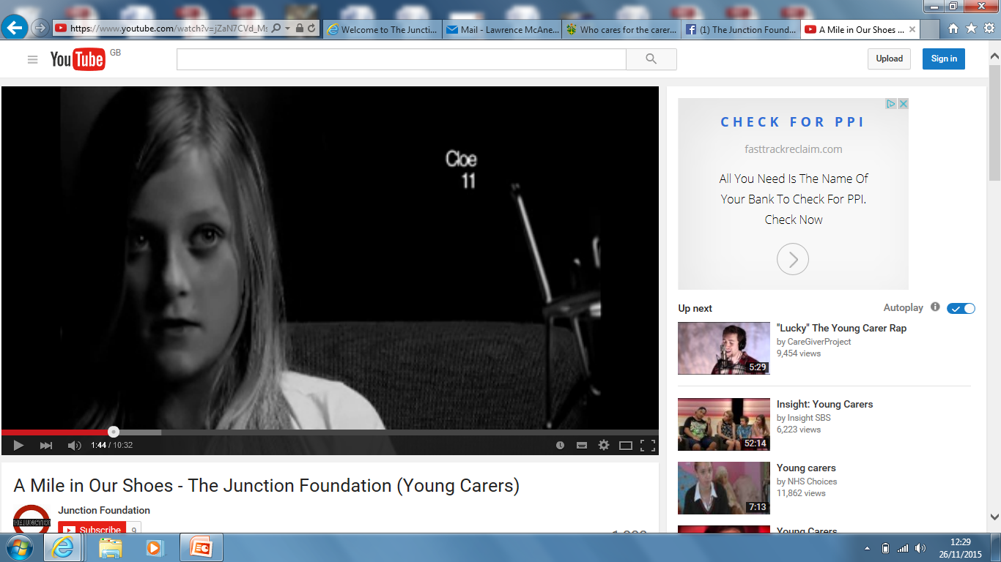
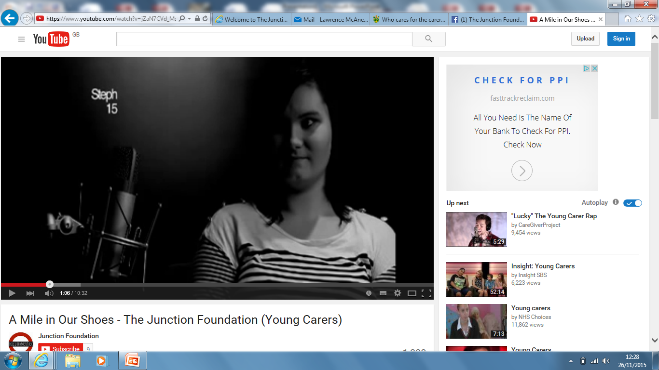
A Mile in Our Shoes-5 years ago

Slide 6
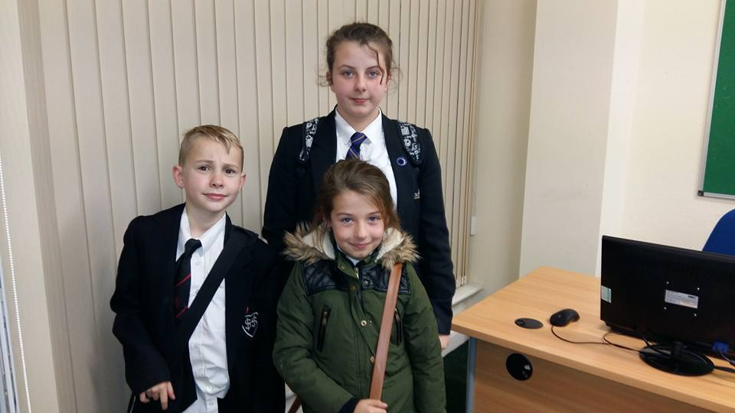
The 24th of November 2015

Slide 7
The Junction
One to one support
Peer Mentoring
Therapeutic groups
Social groups
Whole family support
Create opportunities

Slide 8
“The staff at The Junction are always smiling”

Slide 9
How can society better respond to the needs of young carers?
Earlier help
Identify
Be aware
Hidden young carers
Support for long term and continuity
Listen

Slide 10
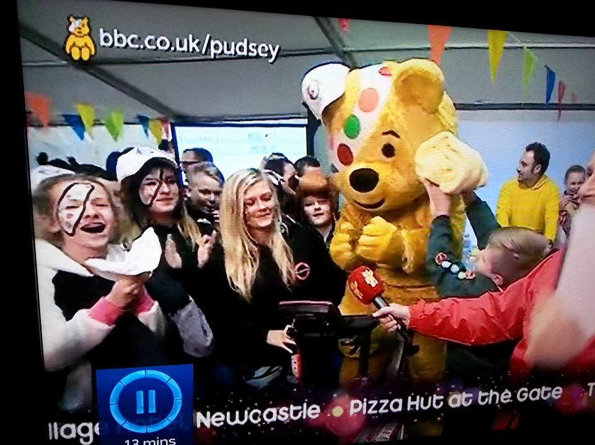
Always smiling???
A mix of funding streams.......................

Slide 11
Is this why we are always smiling?
21-2012

Slide 12
How society can better respond to the the organisations that support them?
Join up funding, resources and working together
Long(er) term and stability
Maintain excellent relationships with commissioners
Promote raising awareness everywhere
Identify hidden young carers
Ask the next question-acknowledge young carers
Keep supporting
Prioritise

Slide 13
The Junction
Making a difference to the lives of children, young people and families
Lawrence McAnelly, Chief Executive Officer
lawrence.mcanelly@thejunctionfoundation.com
077384 22230
01642 756000
www.thejunctionfoundation.com

Slide 14
Thank You!

