Slide 1

On the fringes of the “Northern Powerhouse”?
Tackling the challenges facing rural areas in Northern England
Friday 16 October 2015
Doff Pollard & Rita Lawson

Slide 2
Doff Pollard & Rita Lawson,
Tees Valley Rural Community Council, making the case for tackling social and economic challenges in isolated and post-industrial deprived rural areas in the context of economic crises on Teesside.

Slide 3
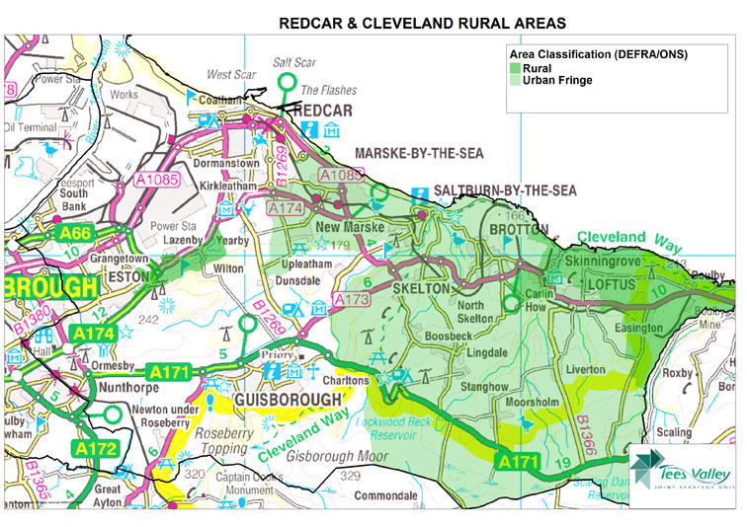

Slide 4
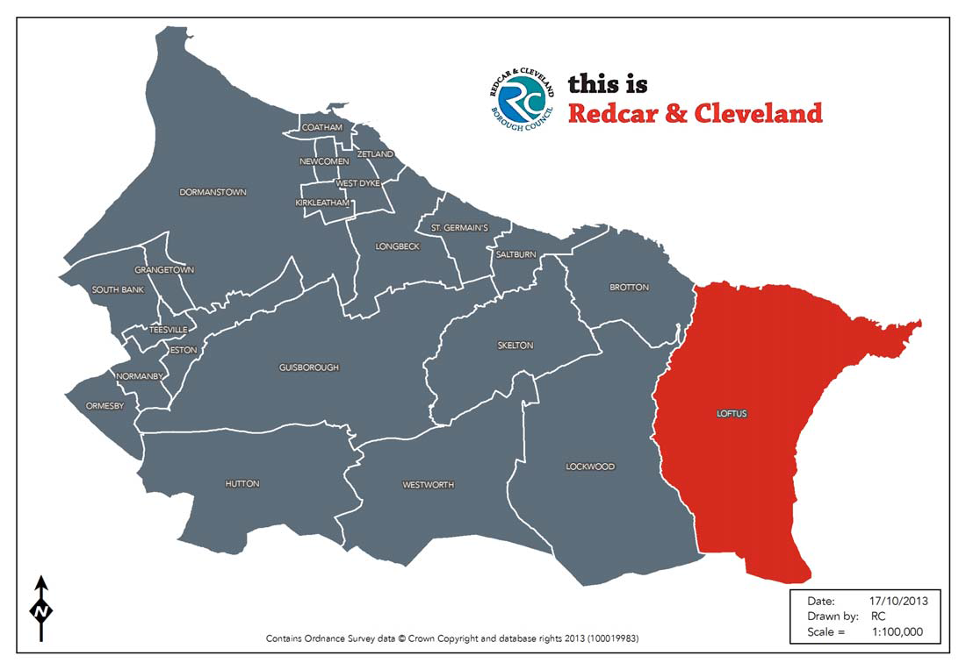

Slide 5
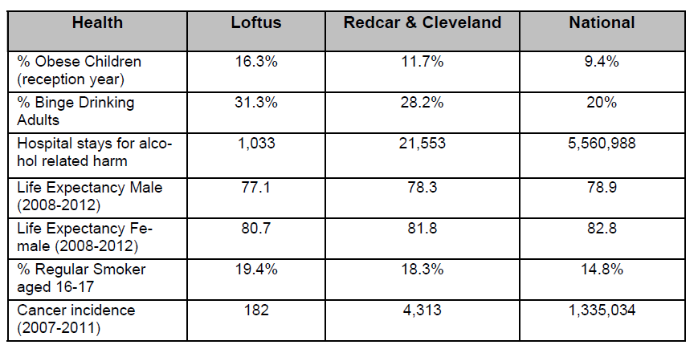
16th October 2015

Slide 6
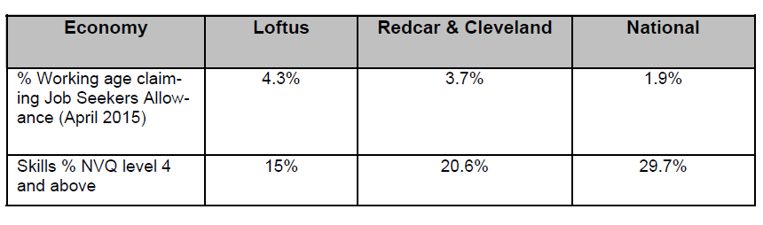

Slide 7
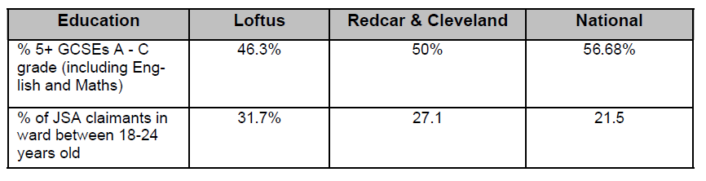

Slide 8
Loftus Community Plan Jan 2012
In the introduction latest information showed less than 60% of population are economically active with less than 10% of the population being managerial or professional and that over a third of Children live in income deprived Households.
Action plan
Encouraging tourism, looking after environment, empty properties housing & shops, Community Cohesion, Transport, reduce unemployment
Improve communications between residents and service providers

Slide 9
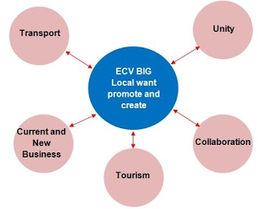
OUR VISION
OUR VISION
Eleven rural communities in East Cleveland are working together through the BIG Local programme to improve opportunities and facilities within the area. We want our area to be able to meet the challenges it faces and this is a chance for a range of new and existing groups and individuals to grow and flourish. The partnership see this as an investment which will enable them to build on their local heritage and be a means to attracting, jobs, local business and much more local activity for the benefit of the community. We are aware of the strengths and weaknesses within our communities and the opportunities and challenges we intend to pursue to make East Cleveland the place to be.
East Cleveland Villages
BIG Local partnership

Slide 10
What does it mean? And What can be done?
Can’t ignore the history and context. A culture of skilled manual labour .. Former ironstone mining.
Low expectations and low achievement
Limited capacity to carry forward initiatives within the community
Limited resources within the community
Poor environments in terms of the fabric of the places.

Slide 11
Questions and Comments

