Slide 1
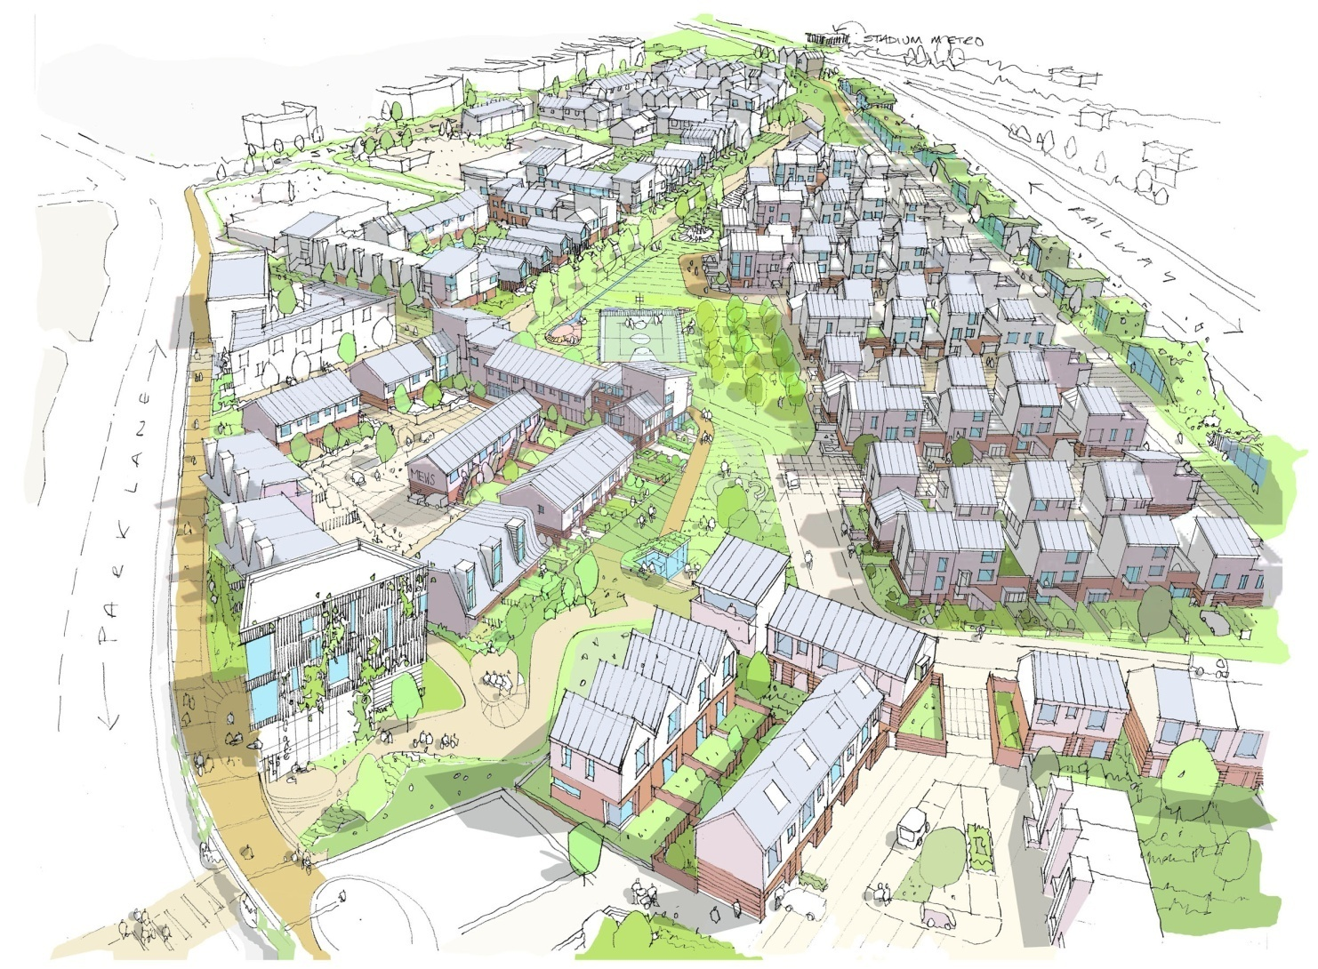
Who cares for the carers
---- the potential contribution of Lifetime Neighbourhoods
Colin Haylock

Slide 2
Who cares for the carers
The changing demographic profile
Where are the “carers” going to come from ?
and
--- who is going to fund them to care ?

Slide 3
Who cares for the carers
Hurricane Sandy and the Rockaways Peninsular communities
Natural social support and caring from within the community
--- reducing the need for care and broadening the base of caring ?

Slide 4
Who cares for the carers
The extended, multi-generational family
---- the meeting of “care” needs at various lifecycle stages
------ child care / the school run / school holidays to broken leg shopping and “dementia sitting”

Slide 5
Who cares for the carers
Fragmented families --- baby boomers and first generation University students
The personal experience of raising a family far from “home”
---- a “replacement family” through common needs, common benefits and common ability to supply the needed caring.

Slide 6
Who cares for the carers
The more complex challenge of sharing needs and “supply” across generations in our more fragmented non-nuclear society
The geographic fragmentation of families
-- less clear generational roles with grandparents still working full on etc.

Slide 7
Who cares for the carers
Changing housing requirements over the life cycle and the “geographic sectorisation” of our housing stock
The implications of this in the need to relocate at many, and often key, stages of life

Slide 8
Who cares for the carers
and flowing from this
-- broken previous neighbour networks
-- limited awareness of and sensitivity to needs of others around us
and, away from the pre-school bit,
-- probably limited capacity to negotiate and trade caring needs and ability to respond with supply

Slide 9
Who cares for the carers
The vital importance of breaking this pattern
--- hugely damaging of social networks and social contact generally
--- even more hugely damaging of cross-generational social networks

Slide 10
Who cares for the carers
“Stopping driving” work
--- the “rural” responses
--- the playing out of the equivalent in intensely urban settings
Supportive social networks v isolation and loneliness

Slide 11
Who cares for the carers
The Government and the encouragement of “Lifetime Homes”
------ and the differing approach of “Lifetime Neighbourhoods”

Slide 12
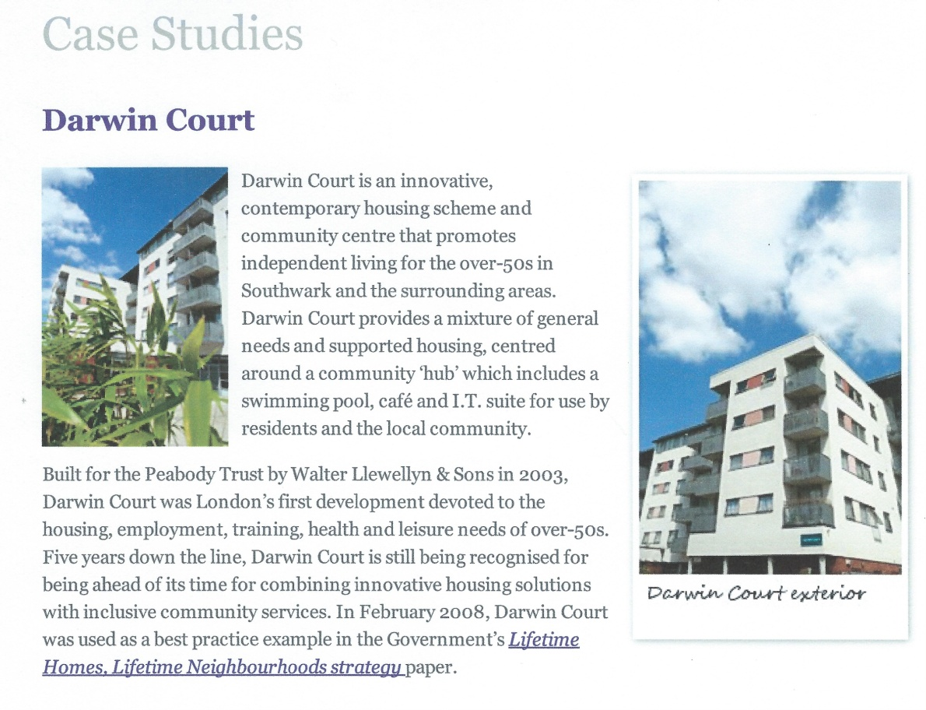
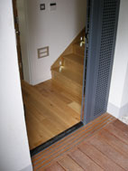
Who cares for the carers
The Government and the encouragement of “Lifetime Homes”

Slide 13
Who cares for the carers
------ and the differing approach of “Lifetime Neighbourhoods”

Slide 14
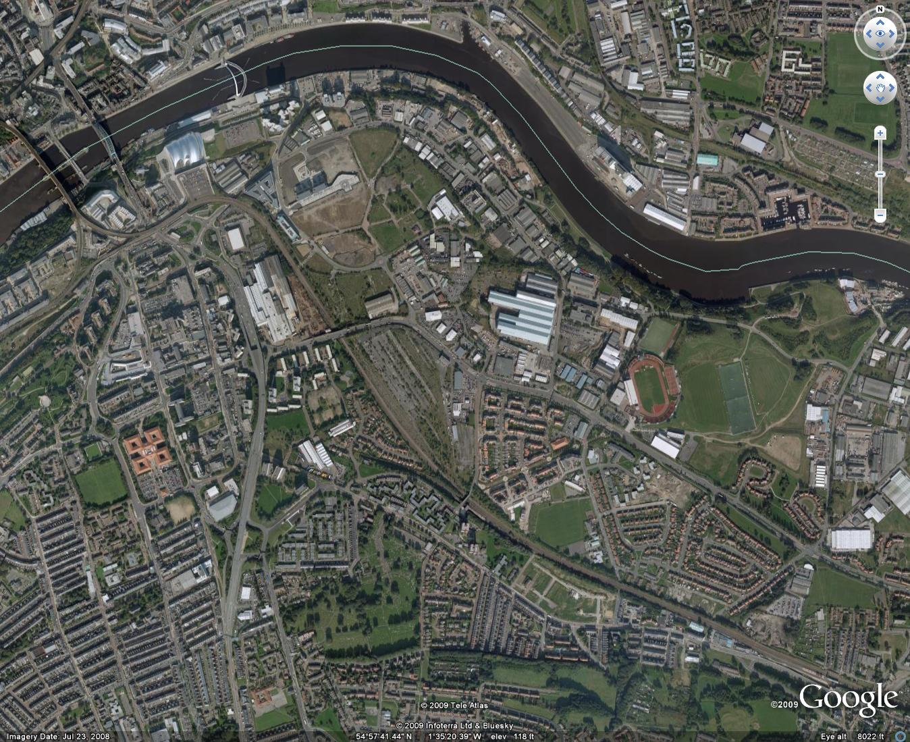
Who cares for the carers
Exploring a potential Lifetime Neighbourhood in Gateshead

Slide 15
Who cares for the carers

Slide 16
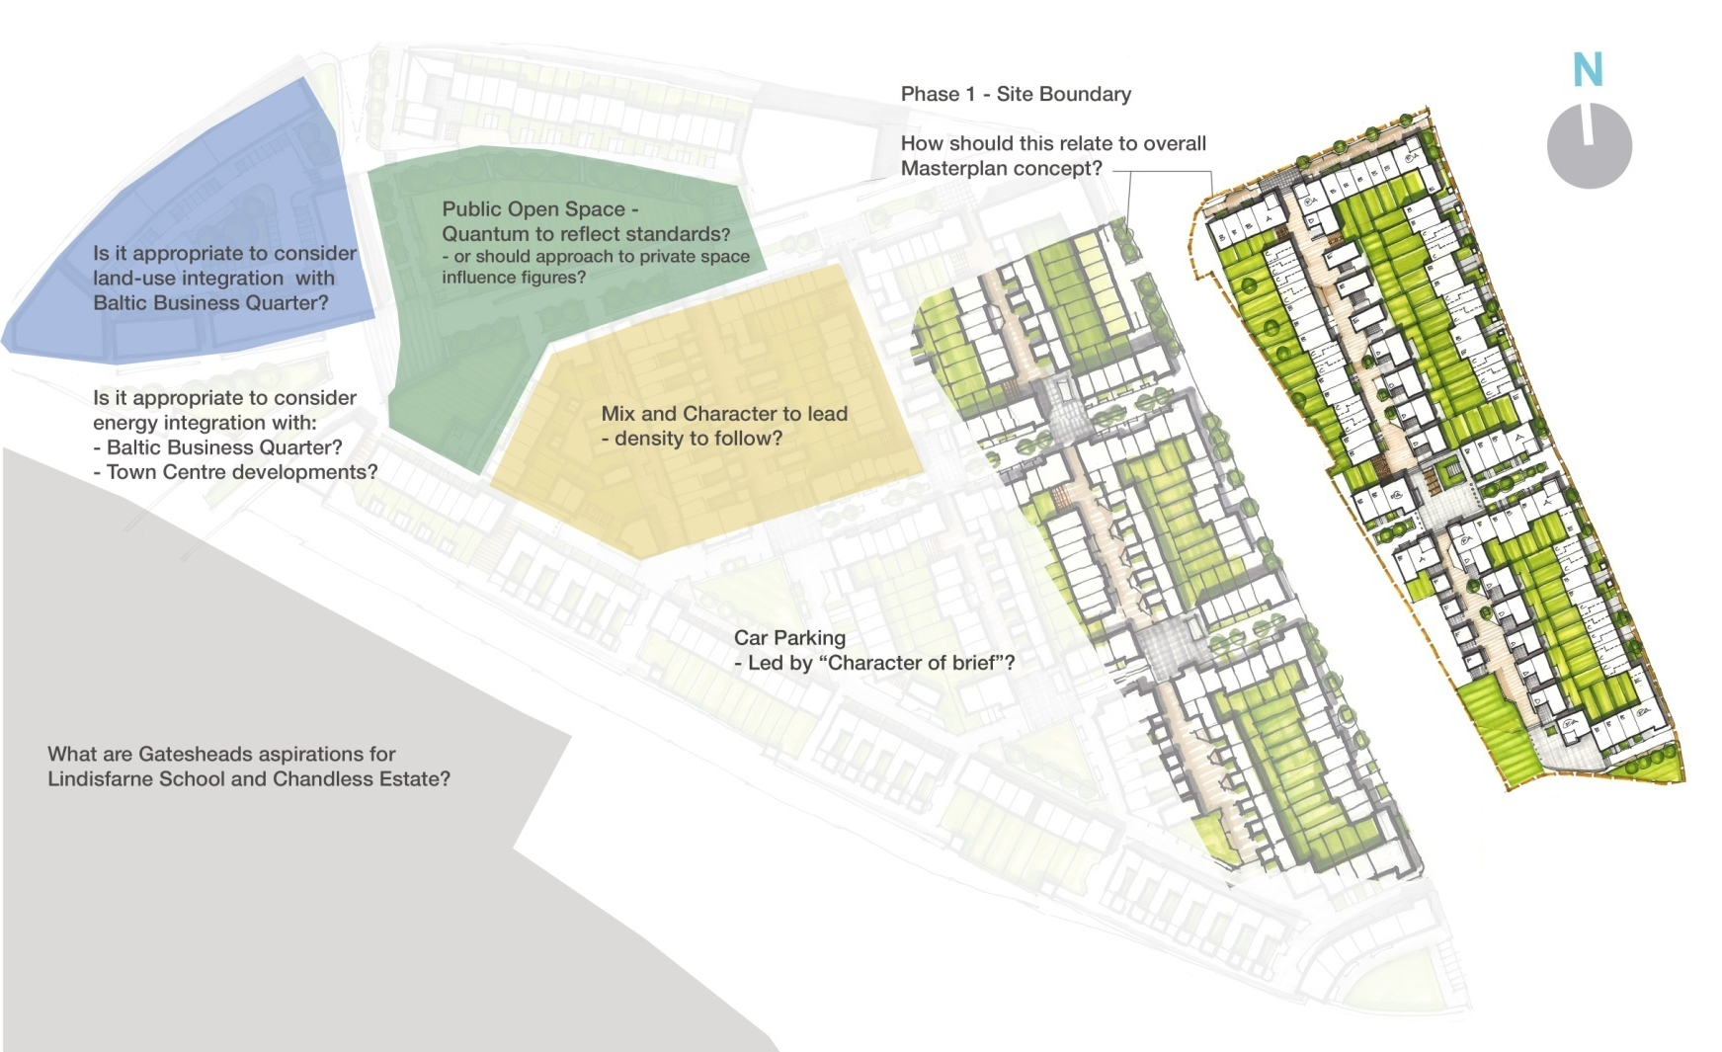
Who cares for the carers

Slide 17
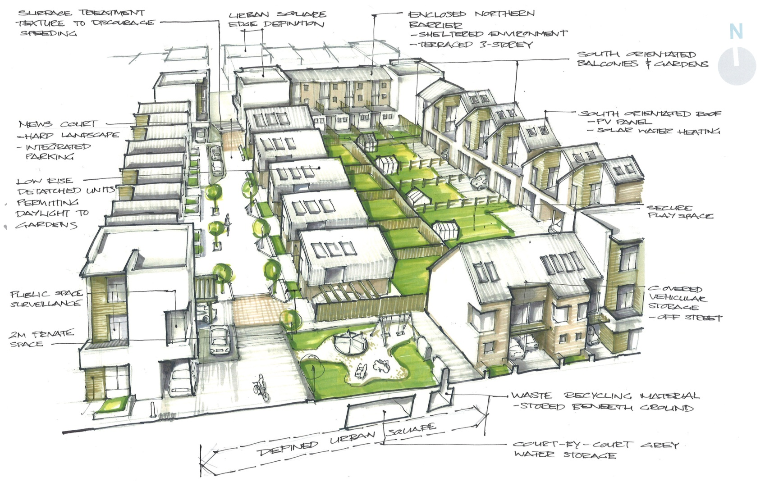
Who cares for the carers

Slide 18
Who cares for the carers
Has this pattern of development the potential to provide more natural social support and caring from within the community ?
Could it reduce the need for care and broaden the base of caring ?

Slide 19
Who cares for the carers
If so how do we ensure most of our future development is driven by Lifetime Neighbourhood Principles ?
Political awareness raising ?
Government housing policy ?
Planning policy locally ?
Serious pressure on homebuilders ?
Incentivisation ??

Slide 20
Who cares for the carers
--- and a measure of some of the challenge in this
the Bankside Neighbourhood Plan issue

Slide 21
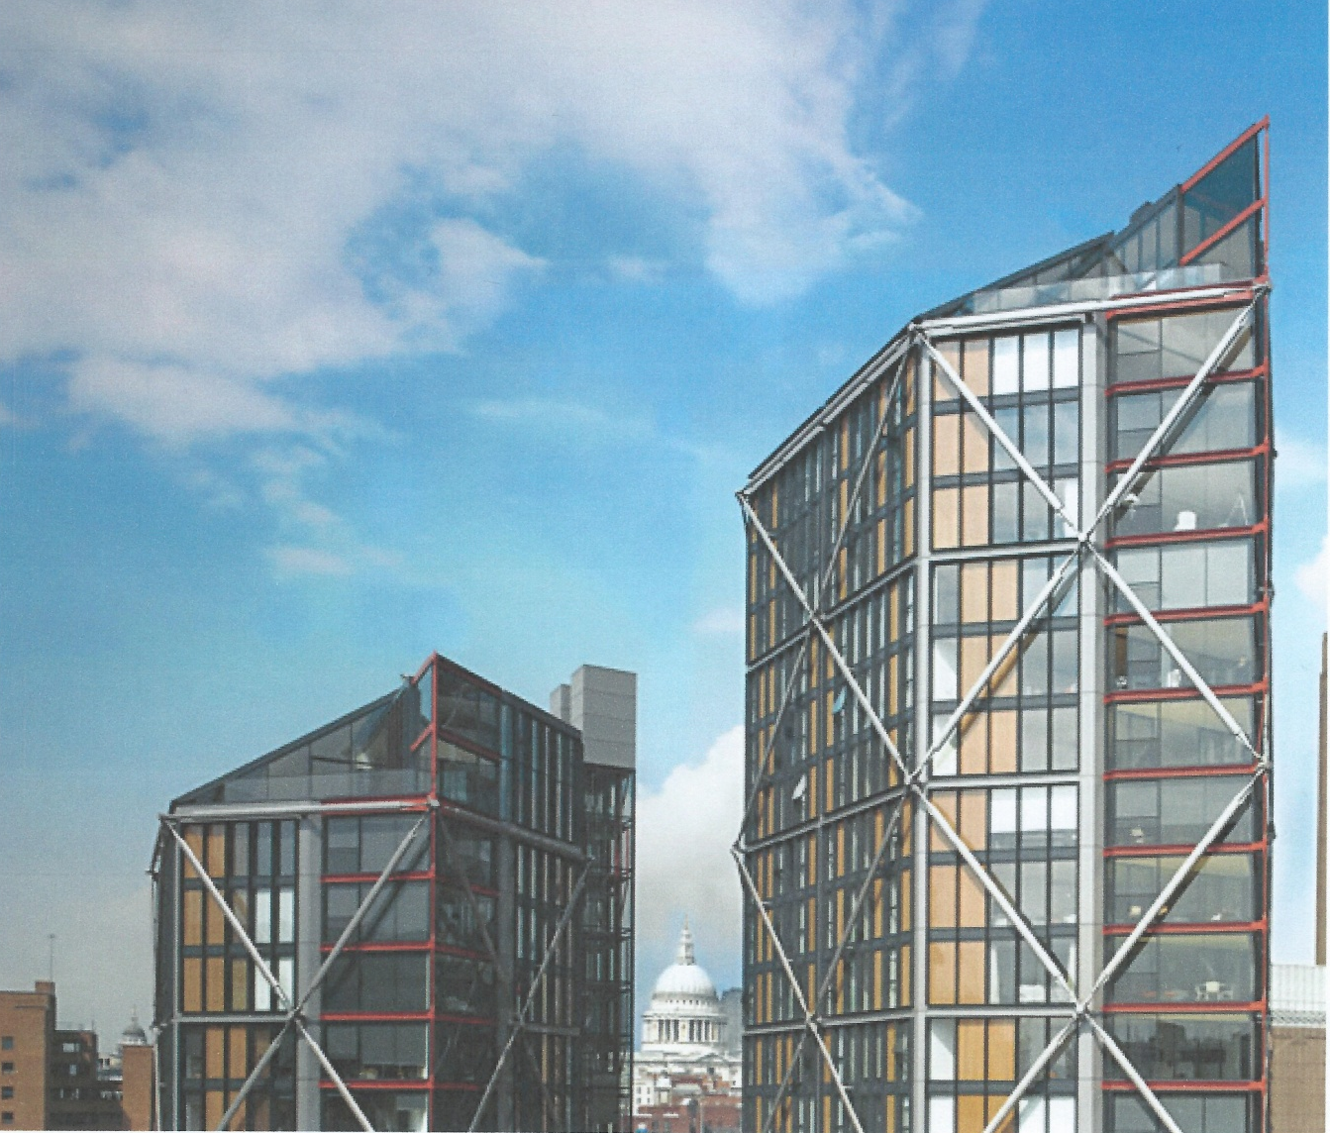

Who cares for the carers

Slide 22
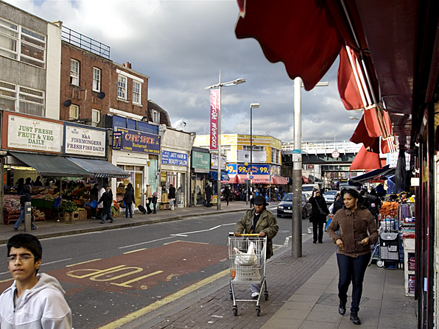
Who cares for the carers

Slide 23
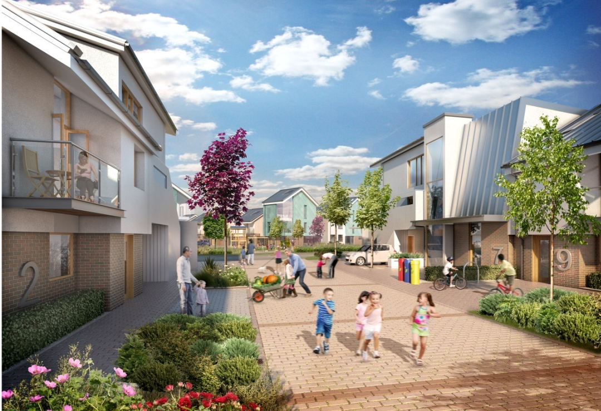
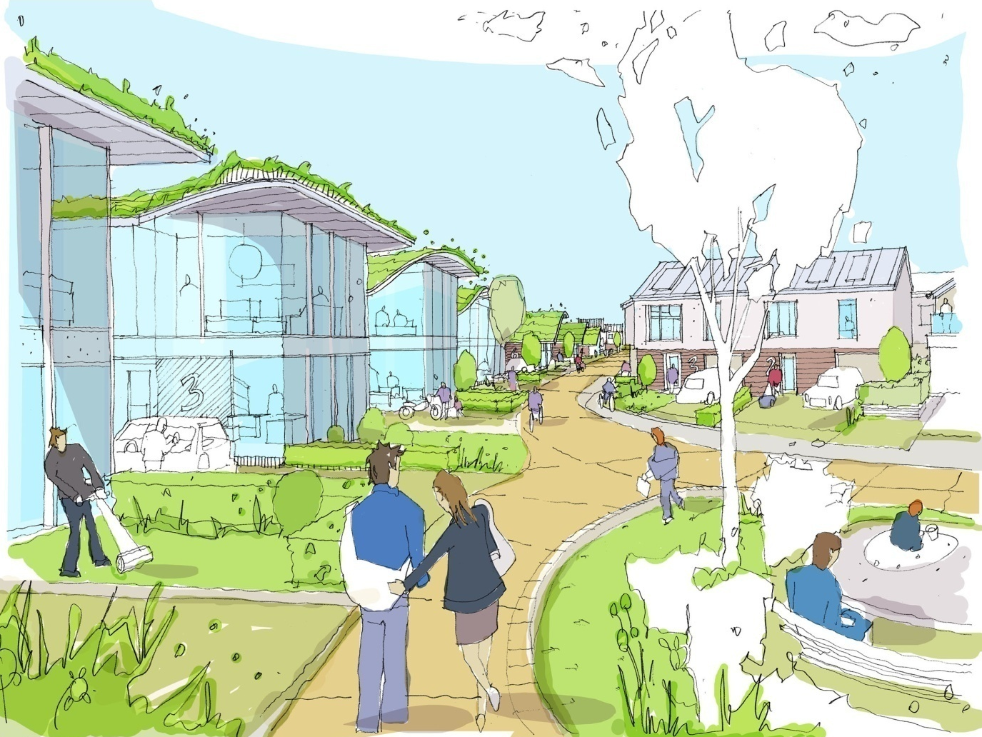
Who cares for the carers

